Slide 1








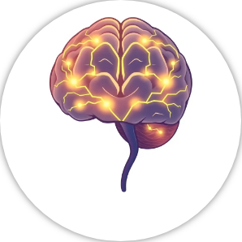














MindUp and CBT
An Introduction to Basic Concepts and Routines
#MentalHealth #CBT #MindUp

Slide 2






What is MindUp? Core Concepts
Mindful Awareness: The practice of paying attention to the present moment without judgment.
Positive Psychology: Cultivating optimism, gratitude, and kindness to build resilience.
Social-Emotional Learning: Developing skills for self-awareness, empathy, and relationship building.
Neuroscience: Understanding how our brains work, focusing on the amygdala, prefrontal cortex, and hippocampus.
#MindUp #Mindfulness
2

Slide 3
The Mind Up curriculum is a program designed to help children develop social-emotional skills, mindfulness, and positive behaviours. The core language and concepts in Mind Up include:
1. Mindfulness: Teaching children to be present and aware of their thoughts, feelings, and surroundings. It involves paying attention in a gentle and curious way to what's happening in the moment.
2. Brain Awareness: Helping students understand how their brains work, especially how different parts of the brain are involved in emotions and decision-making. This includes learning about the amygdala, prefrontal cortex, and hippocampus.
3. Focused Attention: Activities that encourage students to concentrate and focus on specific tasks or their breathing, improving their ability to pay attention and stay on task.
4. Optimism and Resilience: Encouraging students to think positively, manage stress, and bounce back from challenges.
5. Empathy and Compassion: Teaching children to understand and care about the feelings of others, promoting kindness and cooperation.
6. Gratitude: Helping students appreciate the good things in their lives and express thankfulness.
The MindUp curriculum integrates these principles into daily classroom activities to create a supportive learning environment where children can thrive both academically and emotionally.

Slide 4



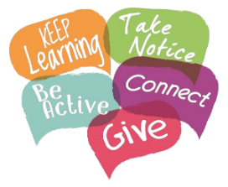









MindUp Routine: The Brain Break
A Core Practice for Focus and Calm
A 3-minute focused breathing exercise.
Practiced three times a day.
Helps calm the mind and improve focus.
How to Perform a Brain Break:
Sit comfortably with a straight back.
Listen for a chime to begin and end.
Focus only on the sensation of your breath.
#BrainBreak #Mindfulness
3

Slide 5

Cognitive Behavioural Therapy (CBT) is a psychological approach that helps individuals understand how their thoughts, feelings, and behaviours are interconnected.
In a school setting, this theory can be extremely useful in supporting interventions and coaching students.
Consistent use of CBT techniques can help students become more resilient, bouncing back from setbacks and adapting to change more confidently.
By integrating CBT principles into school interventions and coaching, teachers and counsellors can support a positive learning environment, helping students thrive both academically and emotionally.

Slide 6
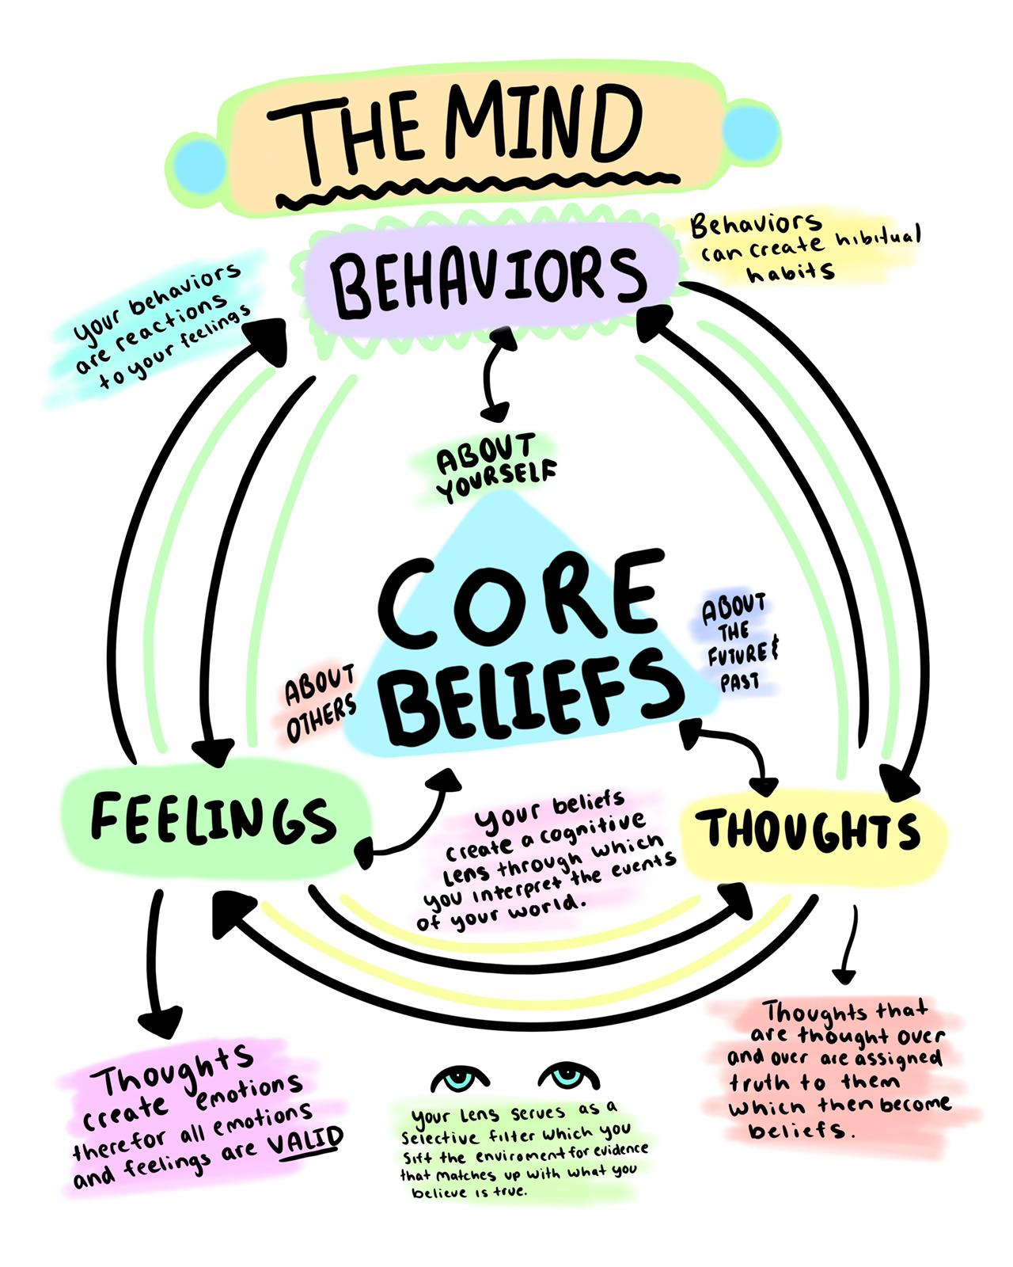
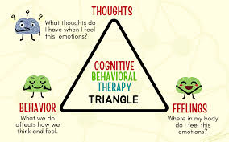

Slide 7
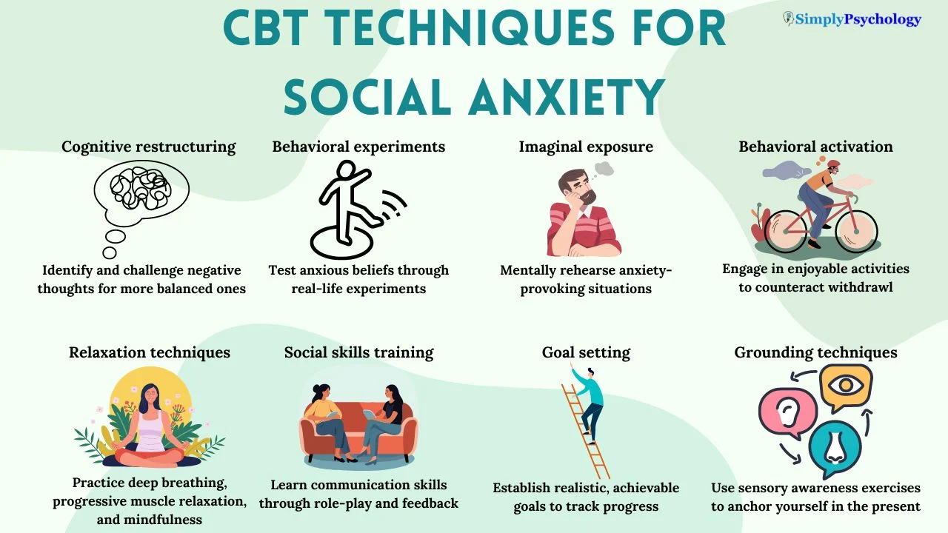

Slide 8
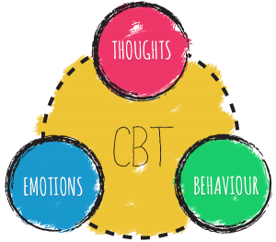
CBT teaches students to recognize and change negative thought patterns. For example, if a student often thinks, "I can't do this," CBT techniques can help them reframe this thought into something more positive like, "I’ll try my best and ask for help if I need it."

Slide 9

Students can learn to manage their emotions better. If they feel anxious before a test, CBT strategies might include deep breathing or positive self-talk to help calm those feelings.

Slide 10
CBT encourages students to try new, healthier behaviours. In school, this might mean participating more in class or using strategies to stay organized.

Slide 11
By identifying and analysing problems in a structured way, students can learn to devise effective solutions, enhancing their ability to handle various challenges in school.

Slide 12
Consistent use of CBT techniques can help students become more resilient, bouncing back from setbacks and adapting to change more confidently.

Slide 13
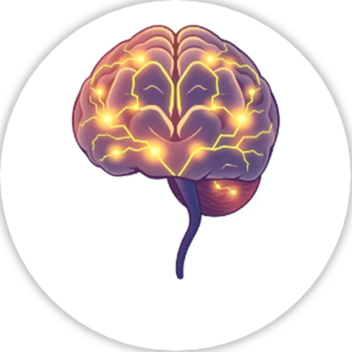
Consider the following Points

Slide 14
What is Cognitive Behavioural Therapy (CBT) and how does it help children understand their thoughts and feelings?
Cognitive Behavioural Therapy (CBT) is a type of talking therapy that helps children understand how their thoughts, feelings, and behaviours are connected. It teaches them to identify negative or unhelpful thoughts, understand how these thoughts affect their feelings, and work on changing their behaviours in a positive way.

Slide 15
What is the MindUP program and what main skill does it teach children to help them deal with stress?
The MindUP program is a classroom-based curriculum that helps children develop mindfulness and social-emotional learning skills. It teaches them how to focus better, understand their emotions, and handle stress through practices like deep breathing and paying attention to the present moment.

Slide 16
In what way do both CBT and the MindUP program help children improve their emotional regulation?
Both CBT and the MindUP program help children improve their emotional regulation by teaching them strategies to manage their emotions. CBT helps them identify and challenge negative thinking, while MindUP encourages mindfulness practices like deep breathing to stay calm. Together, these approaches teach children how to control their impulses and respond to situations more thoughtfully.

Slide 17
How does CBT relate to the self-awareness aspect of the MindUP program?
CBT relates to the self-awareness aspect of the MindUP program by helping children become more aware of their thoughts and how these thoughts impact their emotions and actions. By understanding this connection, children can learn to manage their reactions in a more mindful and positive way, similar to the mindfulness practiced in MindUP.

Slide 18
How might you implement
core concepts daily?

Slide 19
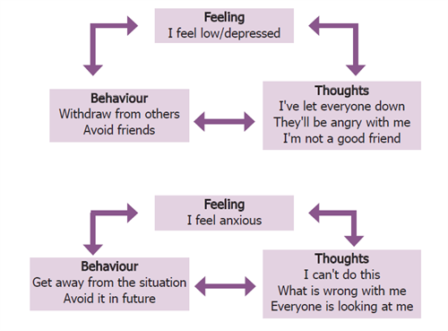

Slide 20

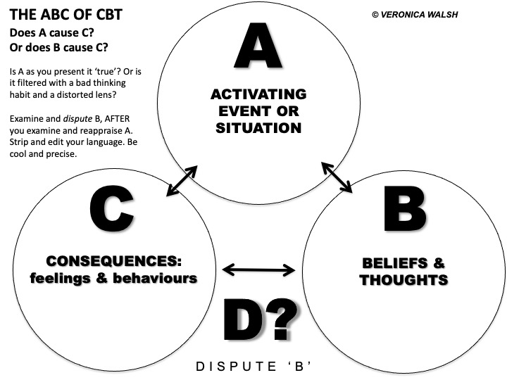

Slide 21
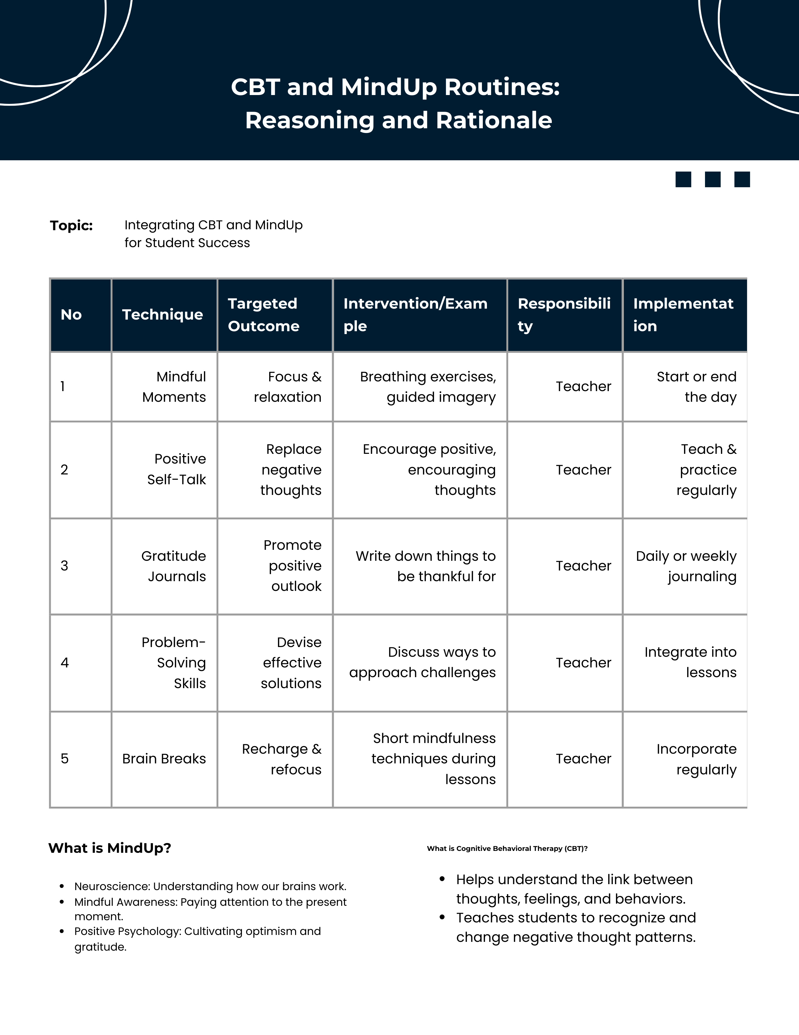
When
Mind Up Item
Focus
Activity
Who will Lead

Slide 22
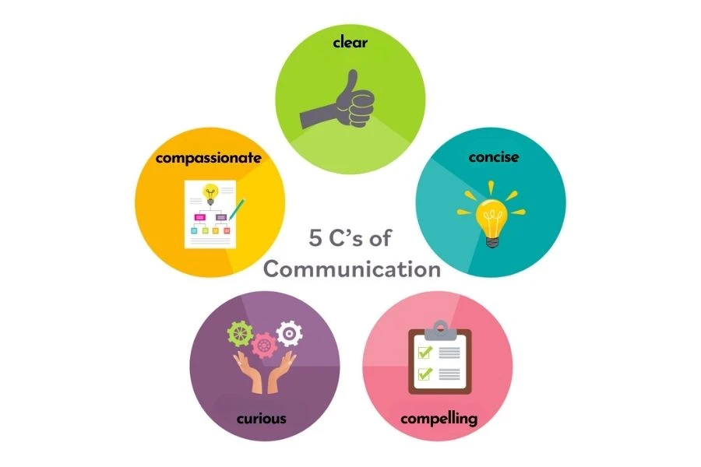

Here's an example of a 20-word word bank based on the
Mind Up curriculum, you can develop your own to utilise language embed concepts:
1. Mindfulness
2. Awareness
3. Thoughts
4. Feelings
5. Attention
6. Focus
7. Brain
8. Amygdala
9. Prefrontal
10. Cortex
11. Hippocampus
12. Optimism
13. Resilience
14. Stress
15. Challenges
16. Empathy
17. Compassion
18. Kindness
19. Gratitude
20. Cooperation
These words capture the core aspects of the Mind Up program covering emotional awareness, brain-function knowledge, and positive behaviour skills.

