Slide 1
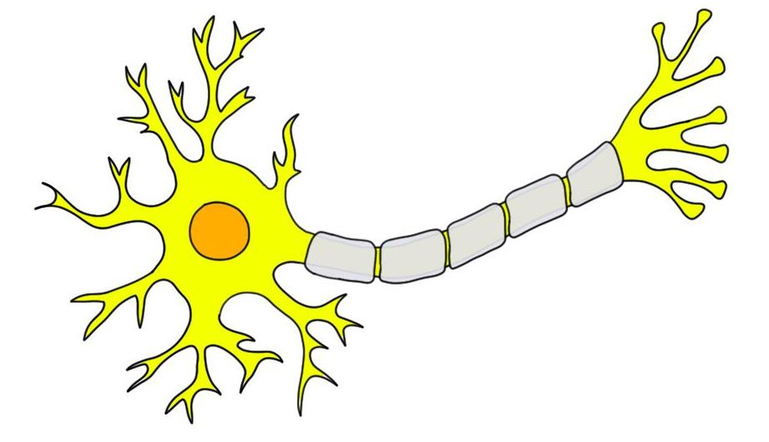
Does anyone know what this is write your guesses and anything you might know on a whiteboard or piece of paper ?

Slide 2
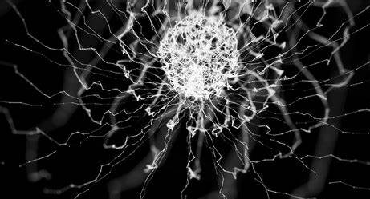
All about Neurons

Slide 3
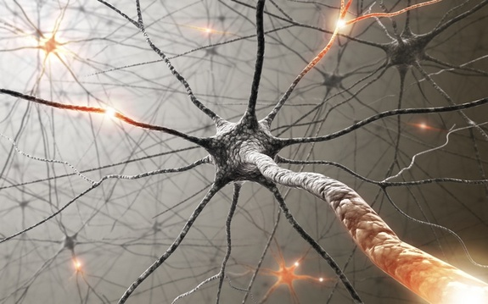
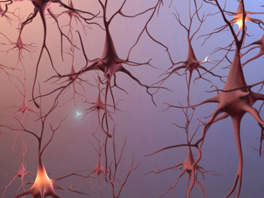
Did you know you have electricity in your brain?

Slide 4
Electrical signals in the brain are extremely small, typically around 70 millivolts (0.07 volts) for a single neuron. Each nerve impulse carries only a tiny amount of electrical energy.
Billions of these signals fire every second throughout the body to control movement, thoughts, and feelings. The total electrical power used by the brain is about 20 watts — roughly the same as a dim light bulb — and this supports everything from breathing to running.
In comparison, mains electricity in the UK is around 230 volts, which is thousands of times stronger than the delicate electrical signals used safely inside our bodies

Slide 5
Neurons
In our brain, we have billions and billions of neurons.
Too many to count!
They are also too small to count!

Slide 6
https://www.youtube.com/watch?v=Ta_vWUsrjho
Let’s watch a video to demonstrate
in a cartoon way,
How they work for us
on 0.07 volts per firing…
https://youtu.be/Ta_vWUsrjho

Slide 7
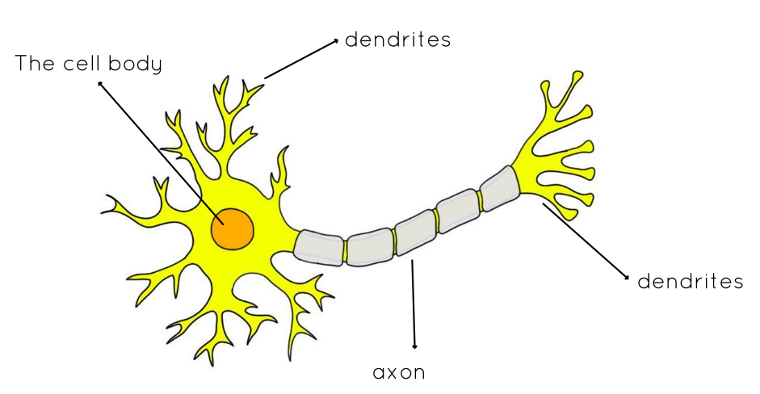

Slide 8
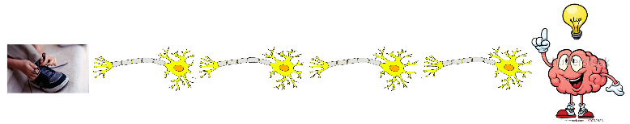
I need some volunteers, lets play!

Slide 9
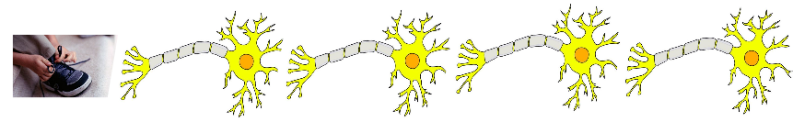
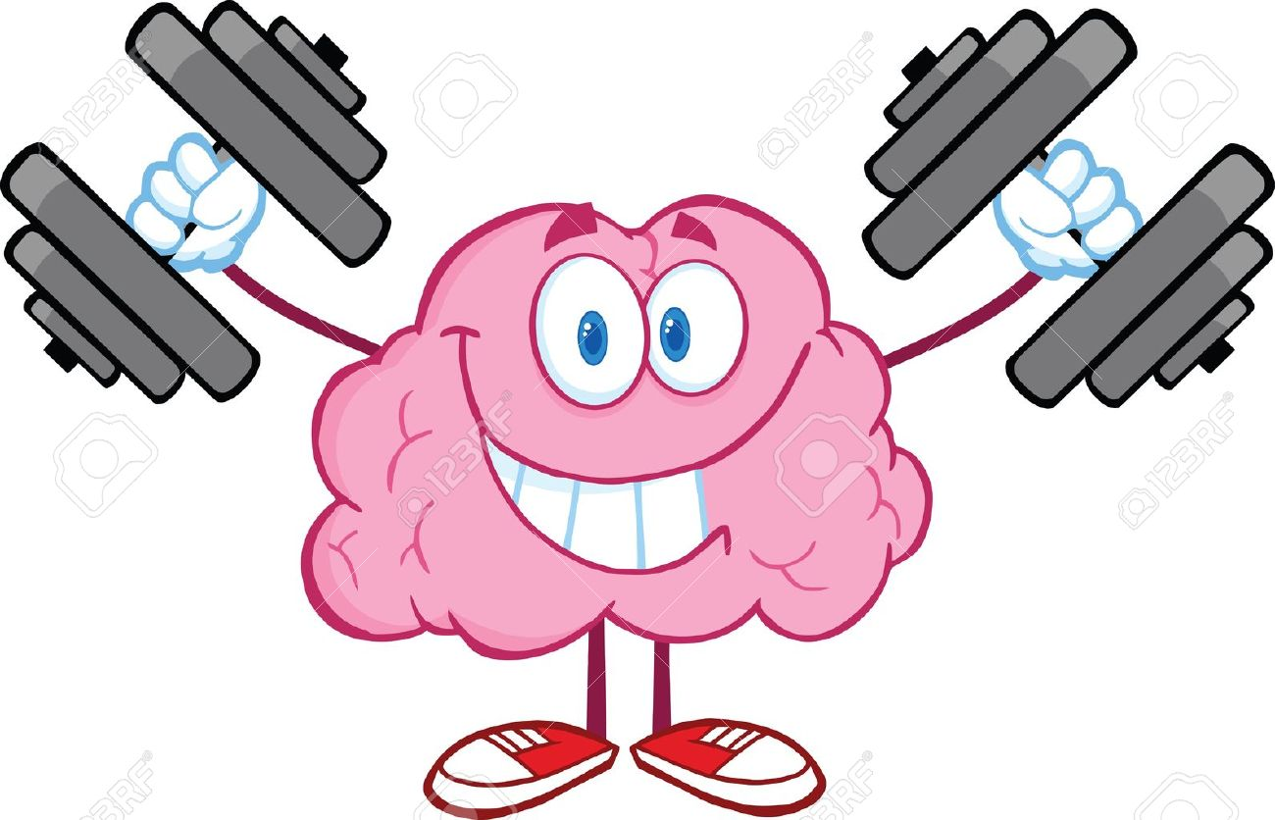
Now we can see how chemical and electrical messages are sent in our bodies…
Neurons send electrical signals along pathways in the body, similar to how electricity flows through wires in a house.
In both systems, energy moves in a controlled circuit from a source to a specific destination. Just as switches control the flow of electricity to lights and appliances, the brain controls when signals are sent to muscles and organs.
However, while household electricity travels through metal wires, neuron signals travel through living cells using tiny electrical 0.07 v and chemical changes

Slide 10
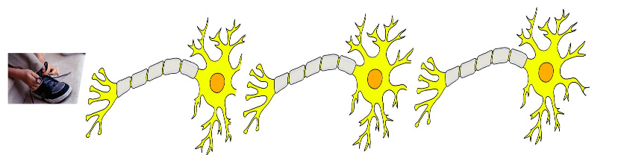
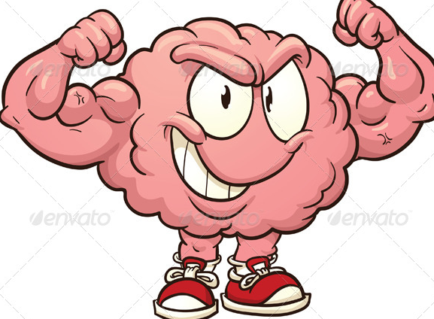
Our senses, understanding, reactions and
learning all
rely on these messages being relayed

Slide 11
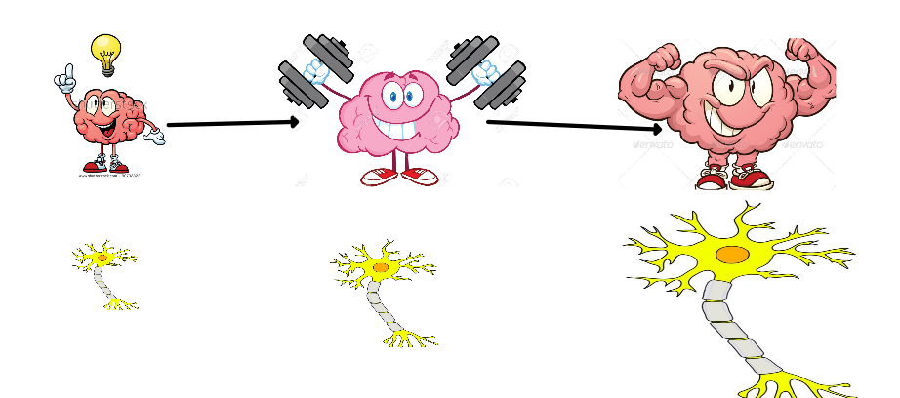
The more you practise something, the stronger your neurons and your brain become.
This is called neuroplasticity.

Slide 12
Thinking Points:
“If our brains use tiny, carefully controlled electrical signals to keep us safe and functioning, what might happen if electricity in our homes wasn’t controlled properly — and what does that teach us about responsibility and safety?”
Can you think of a skill which you would like to practise?
E.g. tie shoelaces, ride a bike, learn to swim

Slide 13
Electricity moves at 186,000 miles per second which is the speed of light.
Strong electrical pulse will burn us and
disrupt our body’s natural signals?
So how can we stay safe from electrical hazards at home ?
Let’s understand more about domestic electricity
https://www.youtube.com/watch?v=Qr2GBbQgw0g
Safety Sadie Video: Hidden Electrical Dangers Around the Home

Slide 14
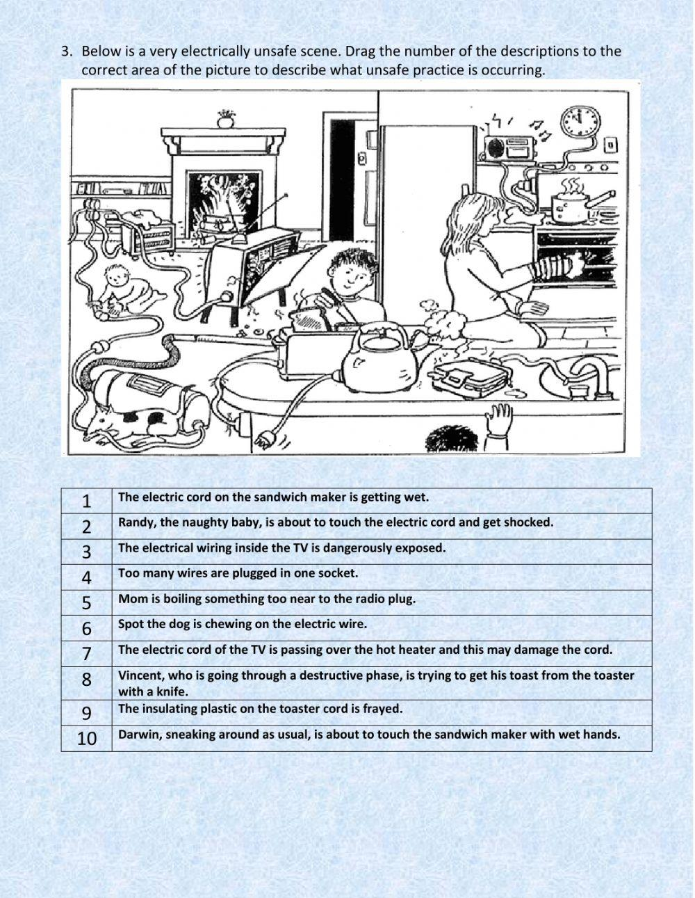
What dangers can you see?
Quick Clue: There are 10

Slide 15
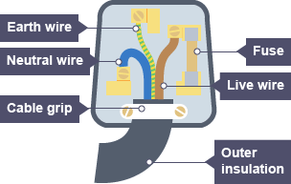
A plug works by safely connecting an electrical device to the mains electricity supply.
Inside the plug are three wires: the live wire (brown) carries electricity into the appliance, the neutral wire (blue) carries electricity back out, and the earth wire (green and yellow striped) provides a safety path if there is a fault.
The fuse inside the plug is a safety device that melts if too much electricity flows, cutting off the power to prevent overheating or fire.
The plastic casing keeps the wires and metal parts covered so we cannot touch live electricity. Together, the coloured wires, fuse, and casing help electricity flow safely while protecting us from electric shock and damage.
https://www.youtube.com/watch?v=wnlMh1XLQkc&list=RDwnlMh1XLQkc&start_radio=1

Slide 16
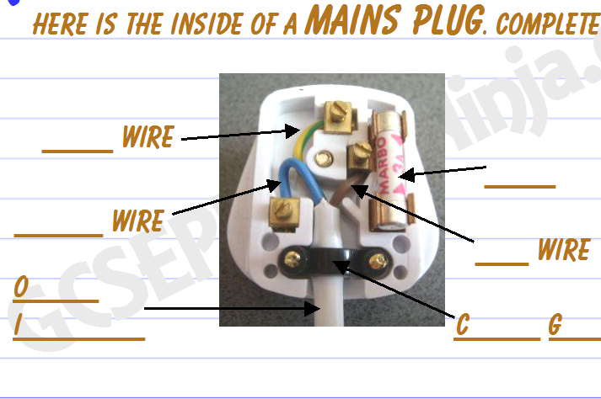

Slide 18
Quick Quiz
1.How many electrical items are there on average in U.K kids bedrooms?
2.What percentage of U.K students have taken risks with electricity?
3.How many people are injured daily by electricity?
4.How many accidents are there per year(356 days) in the U.K?
5.What percentage of people your age charge their phones under their pillows?
6.How many of them are using ”fake” unofficial chargers?
Answers
1. There are on average 10 items per bedroom in the U.K
2. 79% of school aged people have taken risks
that’s approximately (4 out of 5).
3. 1000 injuries daily
4. 2 out of 5 children charge phones under pillows
5. 27% approximately 1/3 of all chargers used are fake in the U.K

Slide 19
Why would we learn this for Wellbeing Week and STEM Week?
We can liken other elements of household electrical system to our brain function:
Fuses = These operate like our safety reflexes (like pulling your hand away quickly)
Wires = These transmit electrical impulses like our nerves
Electricity = Our brain signals are electrical but a far lower voltage 0.07 v
Switch = decision-making and self-control
How can we do that WITH Mind Up?
A switch is like this thinking part of your brain. It helps you decide when to turn energy on, and when to pause. An electric switch in a plug works similarly to our brain’s control function, particularly the role of the prefrontal cortex.
Just like a switches turn electricity on or off, the PFC in your brain acts as a control centre that decides when signals should be sent, slowed down, or stopped.
The prefrontal cortex helps us:
Pause before reacting
Control impulses
Make safe decisions
Regulate emotions
How about the plug you might ask …
The plug is the connection point between the appliance and the power source.
In the body, this is like how our sense organs (eyes, ears, skin) connect us to the outside world and send information to the brain.
Without the plug, electricity cannot flow — just like without our senses and nerves, information cannot reach the brain.
The plug is like your body’s connection system. It links you to the world so energy and information can flow.

Slide 20
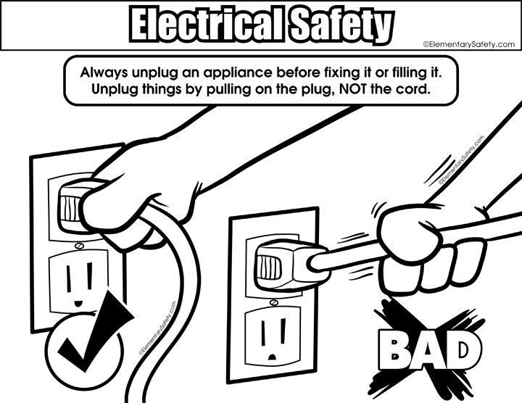
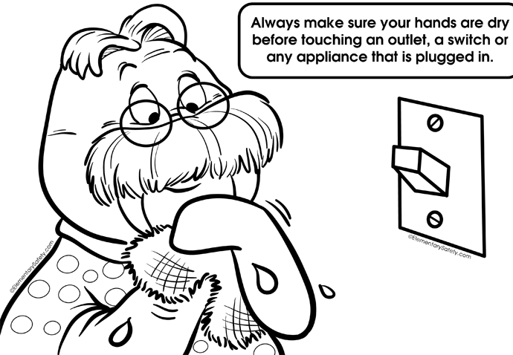
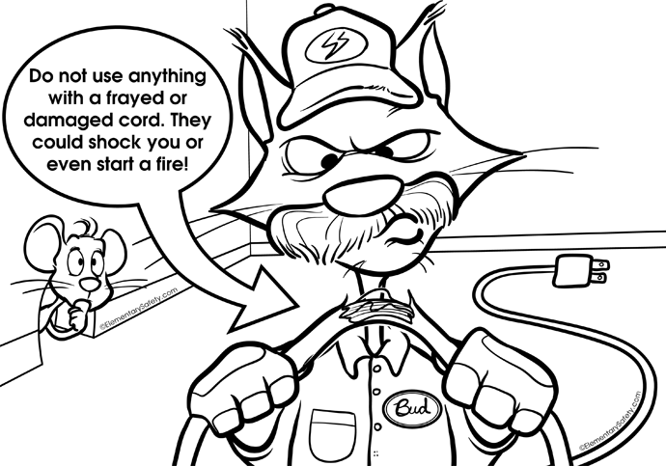
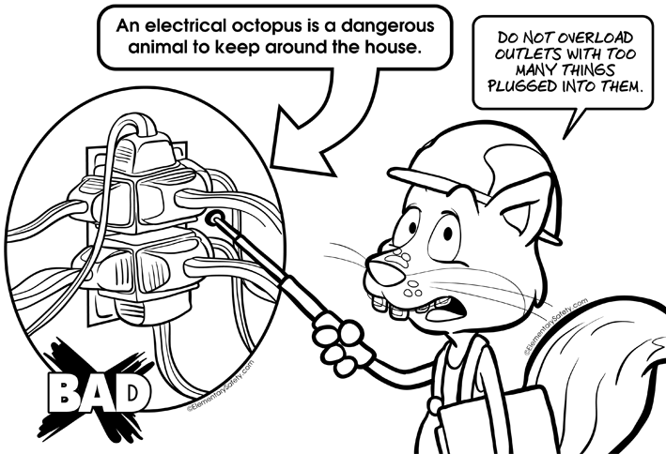
So , What Can You Do ?

Slide 21
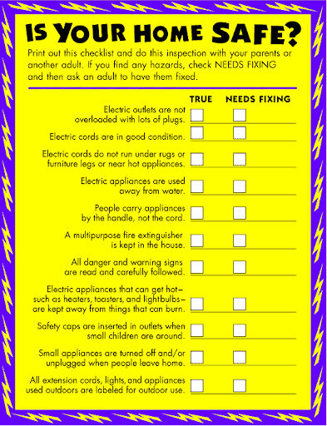
You can work with your parents
to do your own
Safety Audit at home

Slide 22
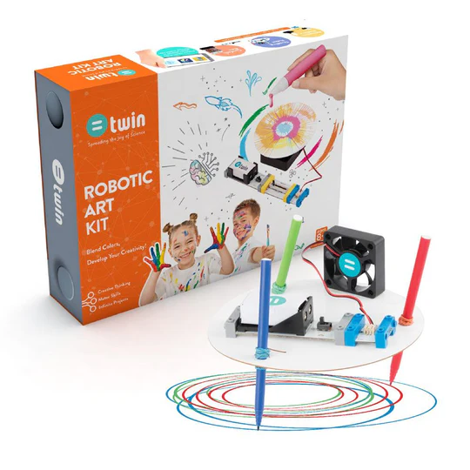
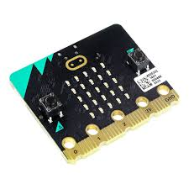
Take part in our poster competition
Create a portrait or landscape A4 poster
About what you have learned about electricity
and safety today .
Children from multiple schools will take part .
We will publish all entries on our website
in our Electrical Safety page.
One lucky class will win a TWIN science Art Machine and 3
Winner will receive a Micro-Bit set of their own.

