Slide 1
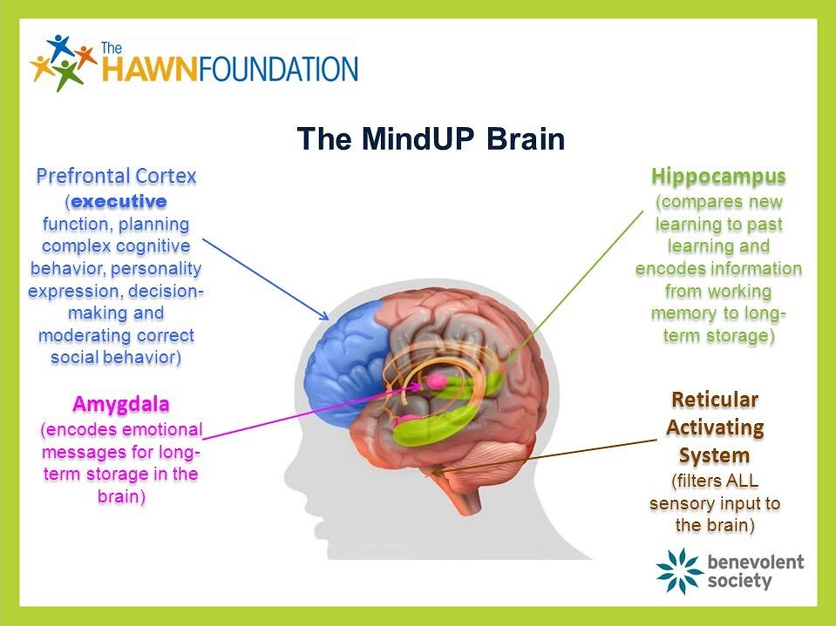

Slide 2
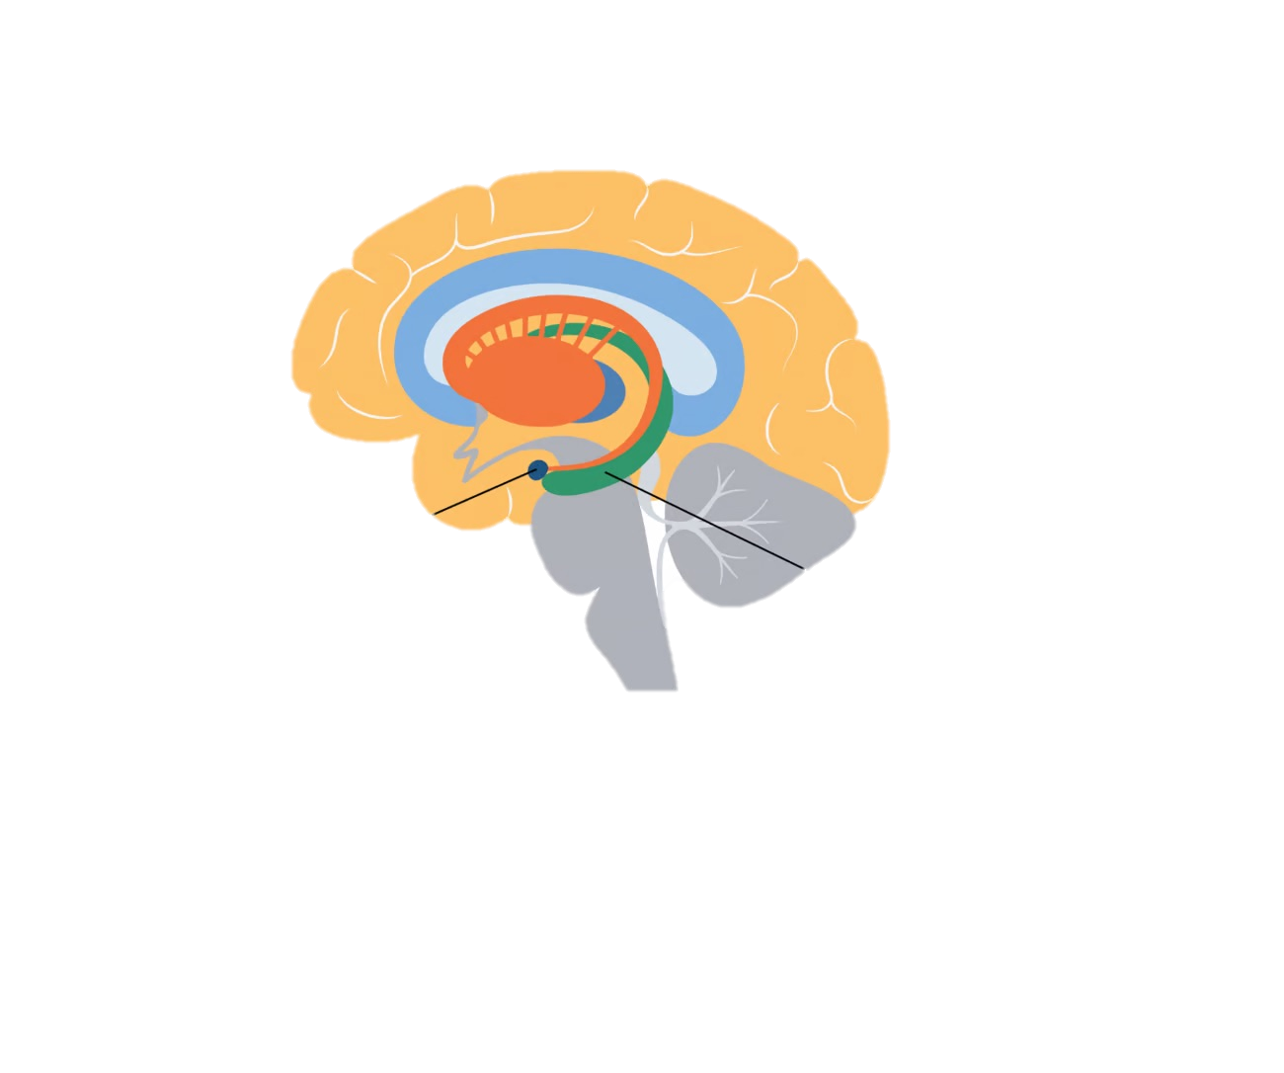
🐕🦉 WHAT IS HAPPENING IN MY BRAIN?
Guard Dog (Amygdala)
“Something’s wrong!”
→ Big feelings start
Wise Owl (Prefrontal Cortex)
“Let’s think…”
→ Helps you calm down
Memory Hippo (Hippocampus)
“Have I seen this before?”
→ Helps you understand

Slide 3
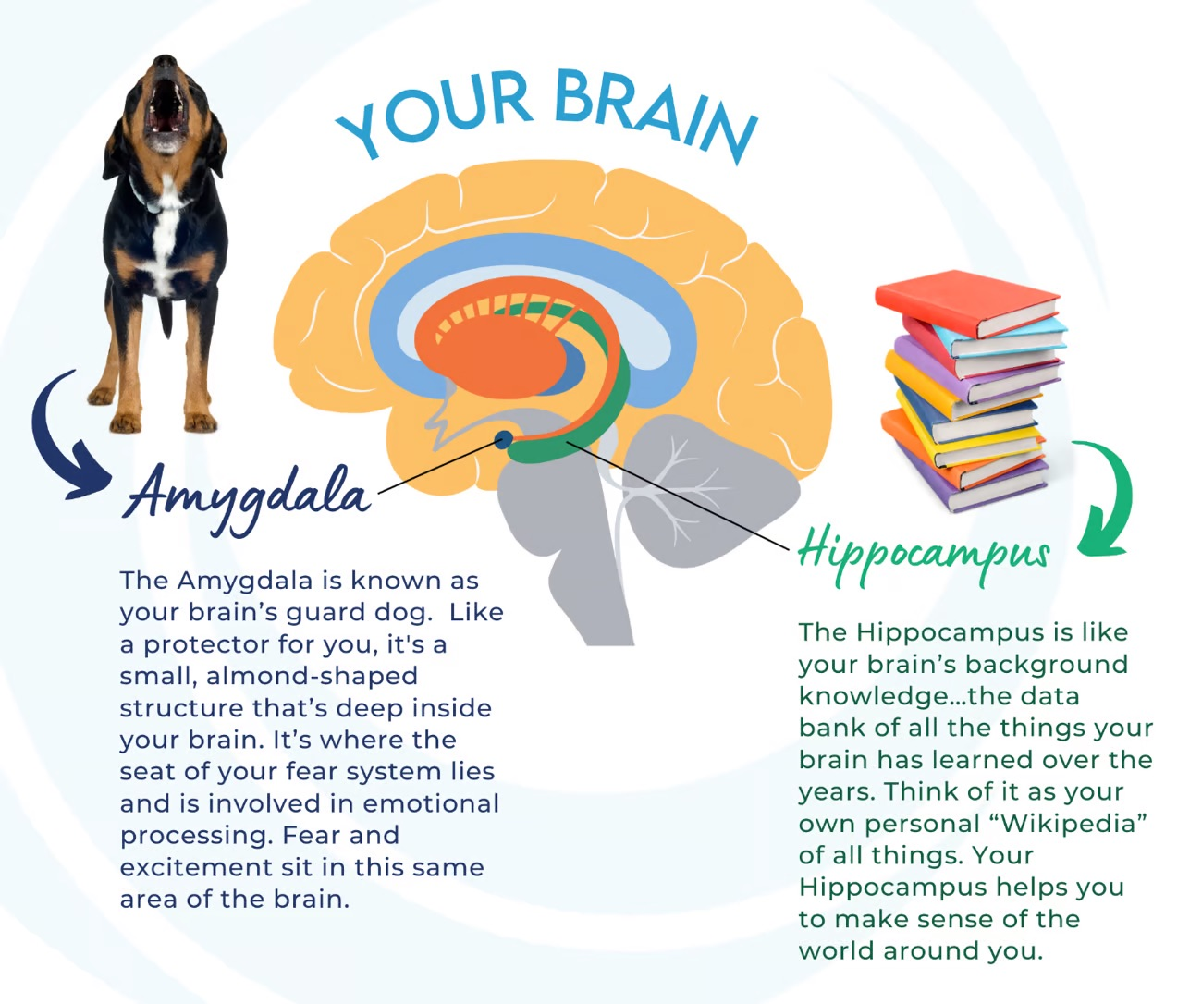

Slide 4
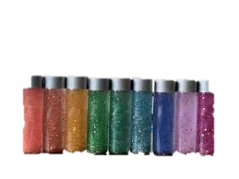
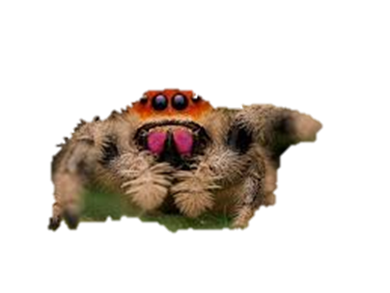
BREATHE → THINK → DO

Slide 5
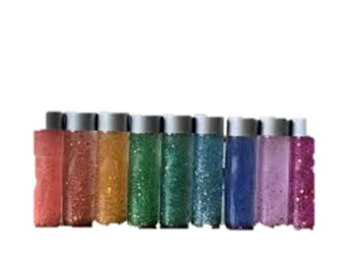
WHAT IS A CALM BOTTLE?
This bottle is like your brain.
✨ When the glitter is still…
→ your mind is calm
→ you can think clearly
WHAT HAPPENS WHEN I FEEL BIG EMOTIONS?
When you feel:
• angry
• worried
• upset
👉 Shake the bottle
The glitter swirls everywhere!
This is like your thoughts when your worry spider wakes up

Slide 6
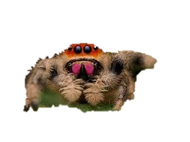
Make your own
Steps:
1. Add water
2. Add glitter
3. Add small glue to inside lid-optional
4. Put the lid on tightly-add tape around sides -optional
5. Shake and watch!
When to use
You might notice
• When I feel angry
• When I feel worried
• When something goes wrong
• When I need to calm down
________________________________________
🕷️✨ SPIDER WISDOM
Be like a spider:
• Pause
• Be still
• Take your time
• Try again
Remember

Slide 7

How to use your bottle to calm yourself to be ready to think?
Put the bottle down…
Watch the glitter…
Take a slow breath in… and out…
✨ The glitter settles
✨ Your thoughts settle
✨ Your wise owl comes back

