Slide 1


Slide 2
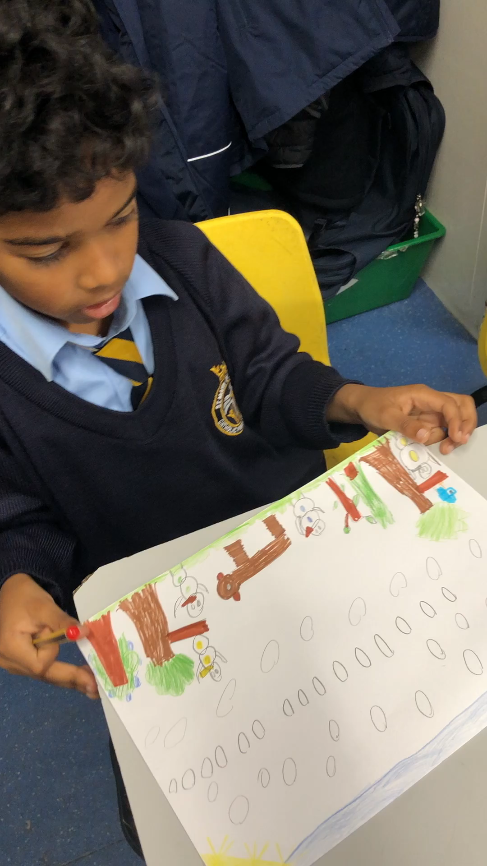

Slide 3
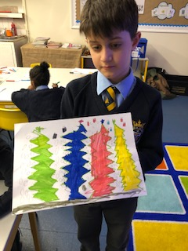
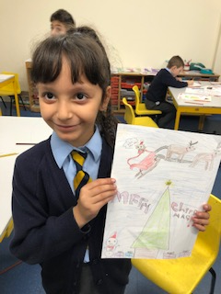

Slide 4
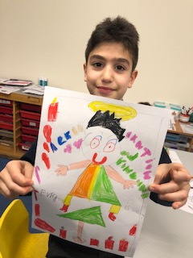
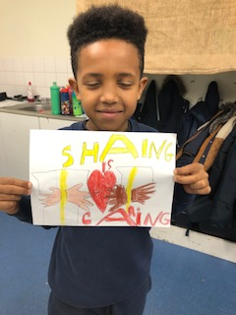

Slide 5
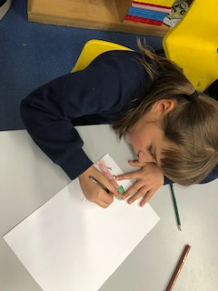
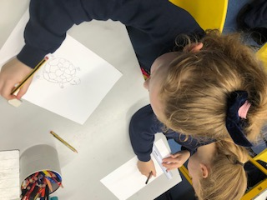
Trees

Slide 6
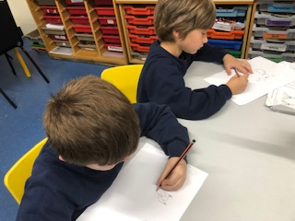
Animals

Slide 7
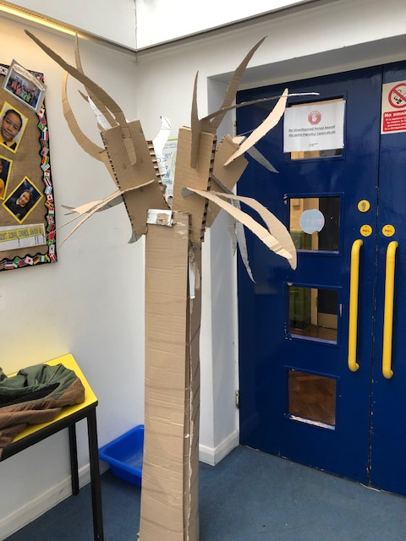
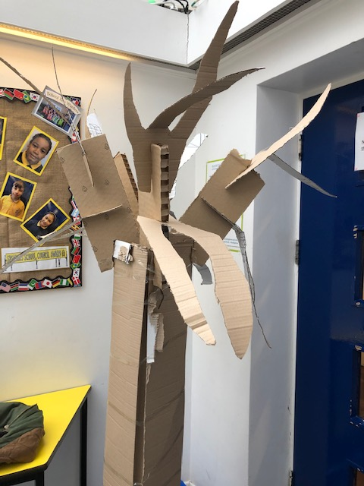

Slide 8
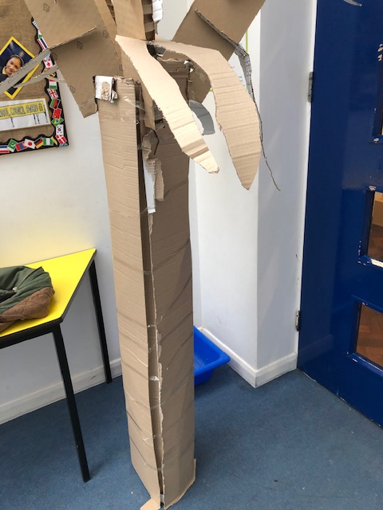
When I found the project online I thought it looked like amazing opportunity to raise awareness for some very vital messages we need to our young people to take on board and encourage our adults to take action on
We have nine partner school currently all within our locality and are looking to increase this number on an ongoing basis I noticed that you do schools out reach and workshops we are very local to the National history museum all of us girls being Westminster I would love to find a way that we could work together and it would be great to have some visits for our schools as I know the students who are currently taking part in the global canvas competition would love that

Slide 9
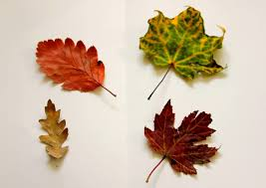

Slide 10
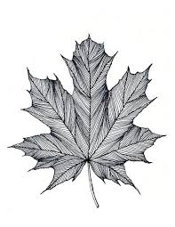

Slide 11
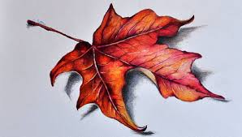

Slide 12
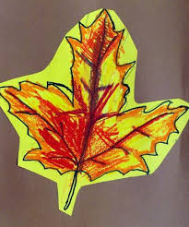
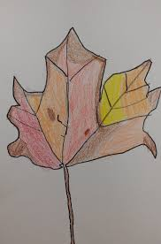
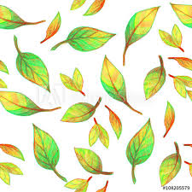

Slide 13


Slide 14
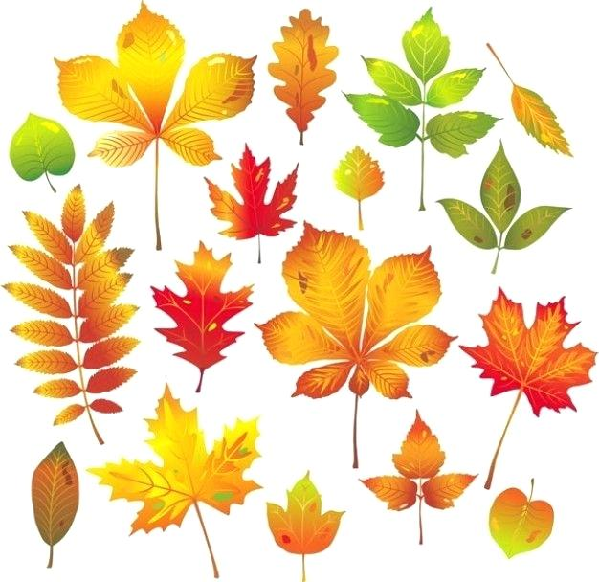

Slide 15
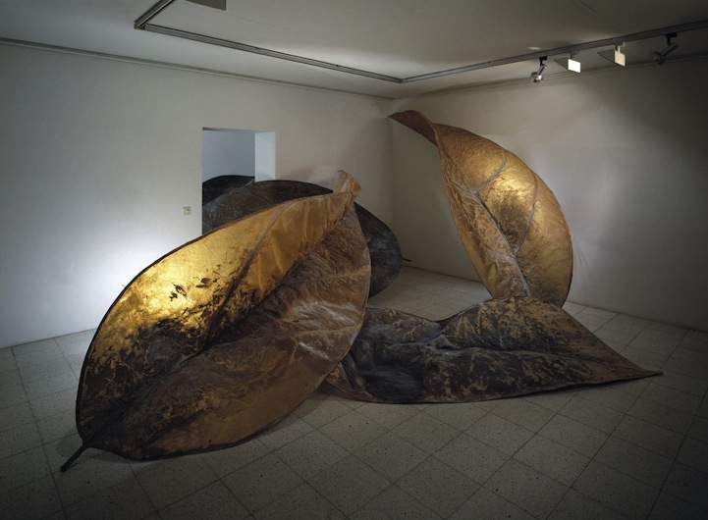

Slide 16


