Slide 1
Construction Site SAFETY
Design a poster competition

Slide 2
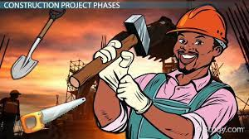
What is construction?
Construction means the building of something. This can mean the building of anything from motorways, to an office block, to a brand new cinema. It is happening all around us, all the time.
The bigger the project, the longer it will take to build, so some construction could last a few weeks, and some could last a few years. There is lots of hard work involved in constructing a building and there are various different stages.

Slide 3
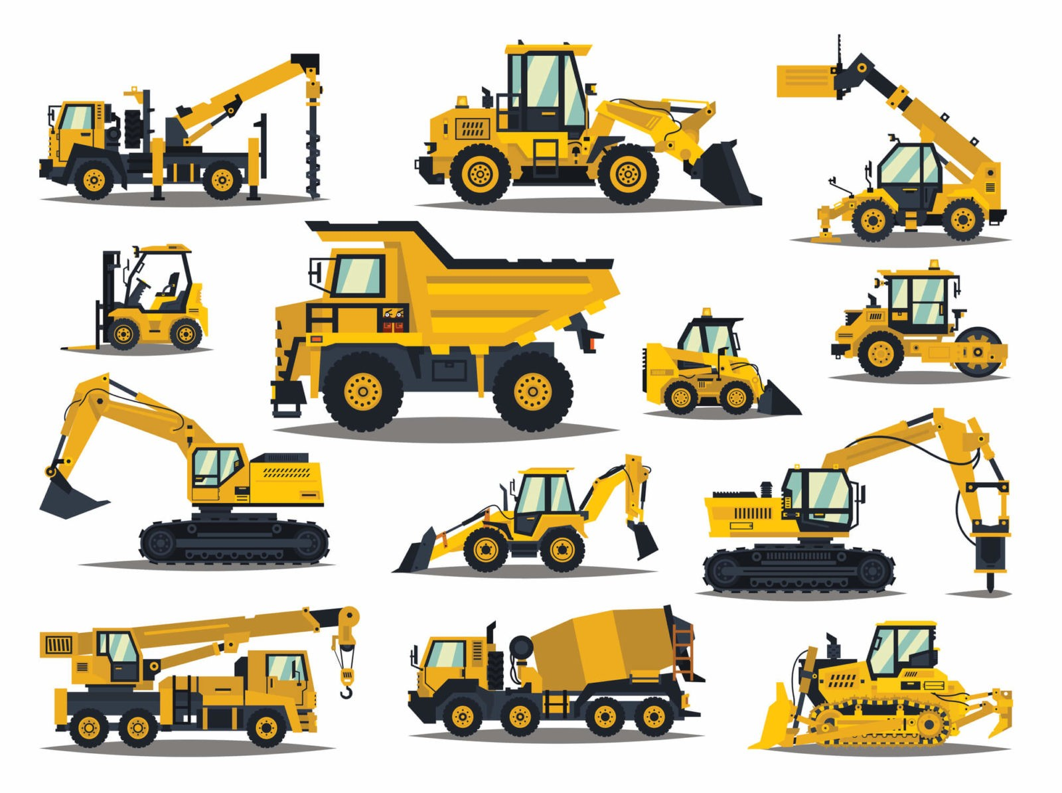
What is construction?
Construction means the building of something. This can mean the building of anything from motorways, to an office block, to a brand new cinema. It is happening all around us, all the time.
The bigger the project, the longer it will take to build, so some construction could last a few weeks, and some could last a few years. There is lots of hard work involved in constructing a building and there are various different stages.
Who might you see on a construction site?
Construction sites are very busy places and you may see lots of different people working on them. Some of their jobs include; builders, supervisors, architects, project managers, engineers and surveyors. Everyone who works on the site will be wearing protective clothing to keep them safe.

Slide 4
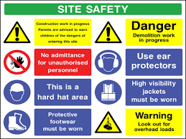
Why are construction sites dangerous?
Although they may look like interesting places, construction sites are very hazardous -
There may be holes and uneven ground that you could fall down
There may be unsafe structures that could collapse
Equipment may be left behind by builders that could hurt you
Vehicles may be driving around the site

Slide 5
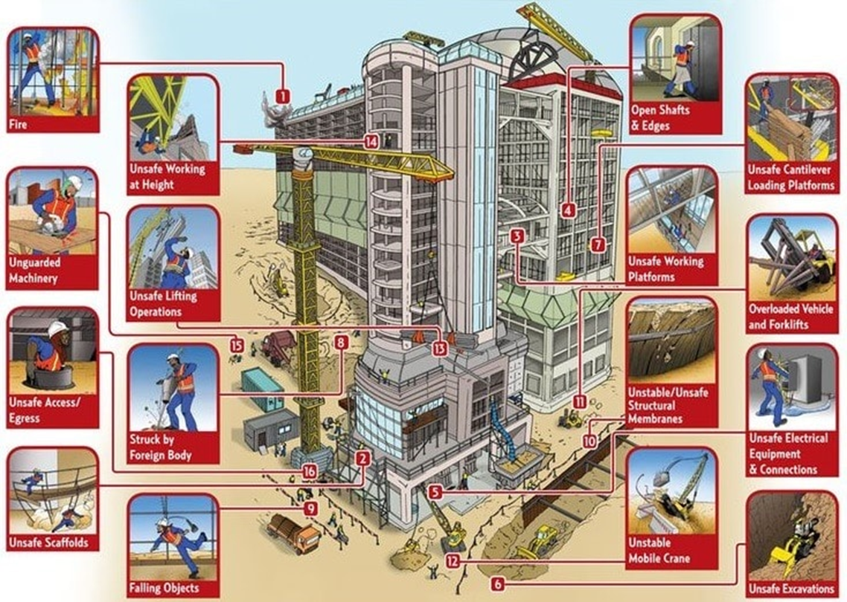

Slide 6
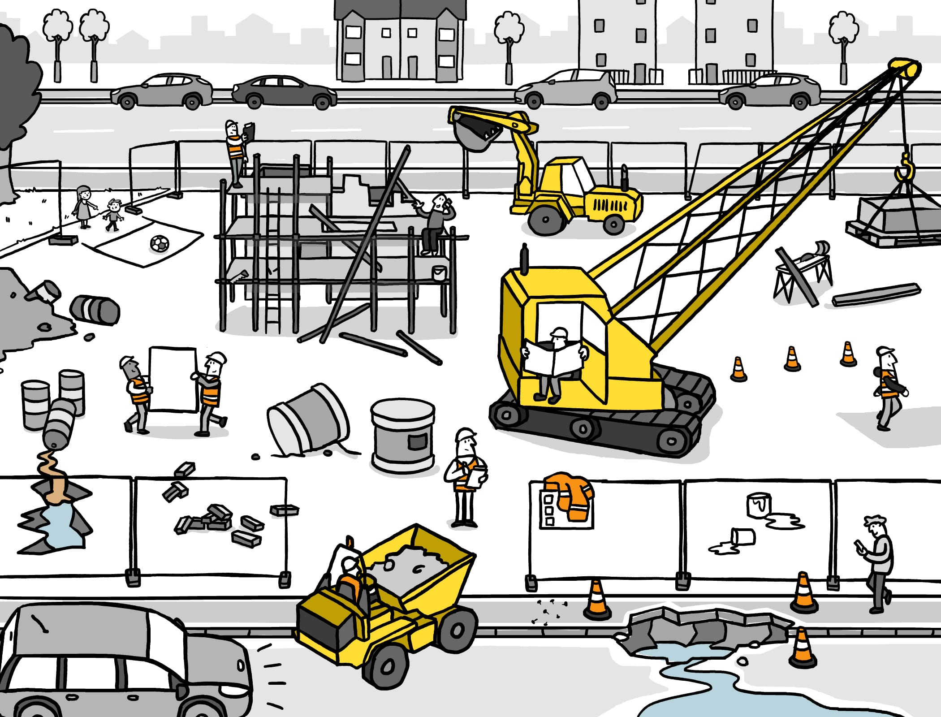
To keep you safe it is important you follow the following rules -
1. Do not walk, run or play around/in construction sites.
2. Always walk on the designated path when passing a construction site.
3. Always concentrate when walking near a construction site. Avoid being distracted by talking, texting, playing games or listening to music.
4. Stop, look, and listen for construction vehicles.
5. Read construction signs to know what to do.
6. Listen/watch for instructions by construction workers.
7. Stay outside of any orange cones, construction fence or tape.

Slide 7
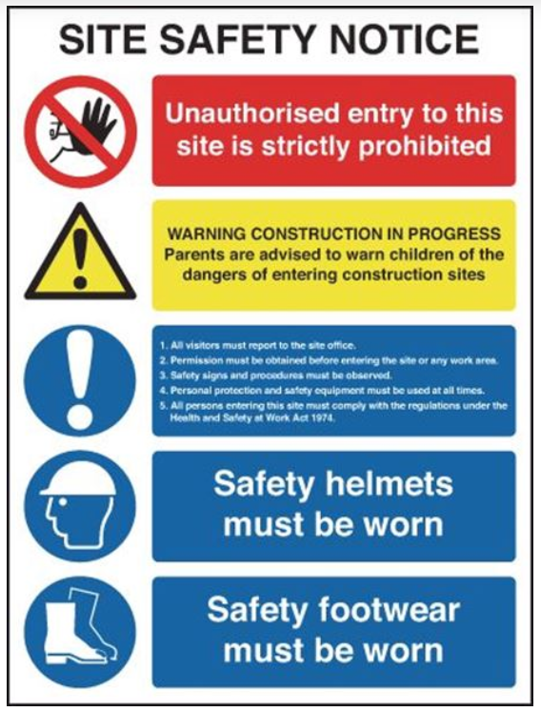
These are the rules EVERYONE must follow to stay safe.
No Entry Without Permission
Be Aware of DANGERS
Report your presence
Follow all signs and warnings
Wear the correct equipment to stay safe
Safety Helmets must be worn
Safety Foot Wear must be worn

Slide 8



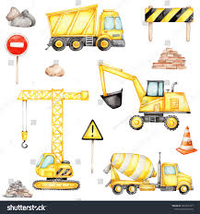
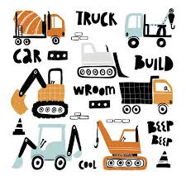
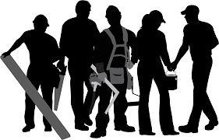

Design Your
Own Safety Poster

