Slide 1

Protective Behaviors
What are they?

Slide 2
Let’s LOOK AT A Poem together

Slide 3
Speaking with someone and feeling relief,
Encouraged, listened to, a sense of belief.
The language of safety, feelings, thoughts and behavior,
Getting the help that you need, your very own savior

Slide 4
Risking on purpose to have fun in life and achieve,
Giving yourself and others a reason to believe.
The 7 strategies in action, a right to feel safe,
A supportive hand, a friendly face.

Slide 5
Putting into practice, because we all have the right,
Whatever age, race or sex - be it day or at night.
So when you're feeling worried or scared
Always know there is someone there.
No matter how much it may feel awful or small
Someone will be there through it all.

Slide 6
So when you're feeling worried or scared
Always know there is someone there.
No matter how much it may feel awful or small
Someone will be there through it all.

Slide 7
We're all people with our own struggles to face,
People who need someone to feel wanted, acknowledged and safe.
Choose your words wisely through each passing day.
Protective Behaviors is effective in every way.

Slide 8
Listen to warning signs from your gut and heart,
No one has the right to tear you apart.
Through 2 themes, 7 strategies and all the rest.
Never forget we deserve the very best.

Slide 9
Next, Let’s Look at another poem about
Young people’s daily challenges

Slide 10
'Cause I Ain't Got a Pencil
I woke myself up
Because we ain't got an alarm clock
Dug in the dirty clothes basket,
Cause ain't nobody washed my uniform
Brushed my hair and teeth in the dark,
Cause the lights ain't on
Even got my baby sister ready,
Cause my mama wasn't home.
Got us both to school on time,
To eat us a good breakfast.
Then when I got to class the teacher fussed
Cause I ain't got no pencil.

Slide 11
What themes or ideas did you notice?

Slide 12
The first theme 'We all have the right to feel safe all the time' incorporates the concepts of ‘Rights and Responsibilities’, ‘Safety’ and ‘Early Warning Signs

Slide 13
’. The second theme 'There is nothing so awful, or too small, we can't talk about it with someone' develops the concept of personal ‘Networks’ of support.
A more recent version of the second theme ‘We can talk with someone about anything, even if it feels awful or small’ is a simpler sentence and suggests a positive
'We can talk

Slide 14
So what about strategies and helpful ideas?

Slide 15
IN PROTECTIVE BEHAVIOURS THERE ARE 7 STRATEGIES,CAN YOU GUESS SOME?

Slide 16
It doesn’t all have to be about you
Think as if you are watching friends play,
empathize and use role play.
use one-step-removed approaches in our search for solutions

Slide 17
Make sure you have helpful adults and friends to speak to and that you speak to them if you need to
Review our personal networks
to ensure they are reliable

Slide 18
If you need help or are unhappy, don’t give up on getting help,
Ask and ask again.
Use persistence in taking necessary action
to feel safe again

Slide 19
Don’t avoid everything that scares you,
Assess risks and be adventurous
Some risk can be useful!
Risk on purpose as needed

Slide 20
If something seems dangerous or unsafe,
don’t ignore that.
Take the safest action to avoid or stop the situation.
Protectively interrupt in unsafe or potentially unsafe situations

Slide 21
Be mindful of what you say and how you say it.
Words are powerful, use I when dealing with difficult situations and be mindful of your actions and speech.
Observe the language of safety for ourselves

Slide 22
Meaning
What exactly are you trying to say?
Ownership
Are you placing blame or sharing thoughts ?
Clarity
Will others be able to understand your intentions?

Slide 23
Lets think about when we are sharing ideas
What parts of PB would be most useful?

Slide 24
Your challenge is to write some PB
Strategies for group work…

Slide 25
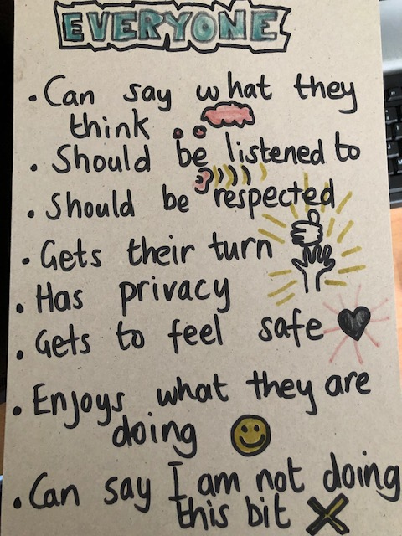
Here’s mine.
What will yours
Look like?

