Slide 1
Journal
Write in one for 5 minutes each day.

Slide 2
Journals give voice to your dreams and aspirations but are also safe spaces to release negative feelings like disappointments that could get in the way of those dreams and aspirations being realized.

Slide 3
WHAT MIGHT GO INSIDE?

Slide 4
Hobbies &
Interests
Food
Feelings
How is your day?
Life
Memories
Plans
Events
Problems
FRIENDS
Drawings Doodles

Slide 5
Another way to generate ideas: take a general theme -- let's say, Fear.
Then spend five minutes breaking that theme into subcategories; for example:
Things that scare me
Things I do when I'm afraid
Techniques for overcoming fear, etc.
If you want, you can break some of those into even smaller categories. For example, "Things that scare me" could be subdivided further:
Scary movies
My nightmares
Irrational fears and superstitions
Fear of failure
People I'm afraid of, etc.
Each item in your list is a topic that you can write about in your journal. With this system, in less than an hour, you can come up with enough writing topics for a whole year of journaling.

Slide 6
Use your journal as a general record of your daily life. Or you might prefer to focus on a certain topic such as your garden or your reading or current events.
You can write about your experiences, your thoughts, your memories.
You can use it to collect material to use in fiction writing and poems. Some people keep notebooks next to their beds and write down their dreams.
There's no right or wrong way to keep a journal. The journal is for you, so you get to set the rules.
Experiment, try different approaches, different kind of subject matter.

Slide 7
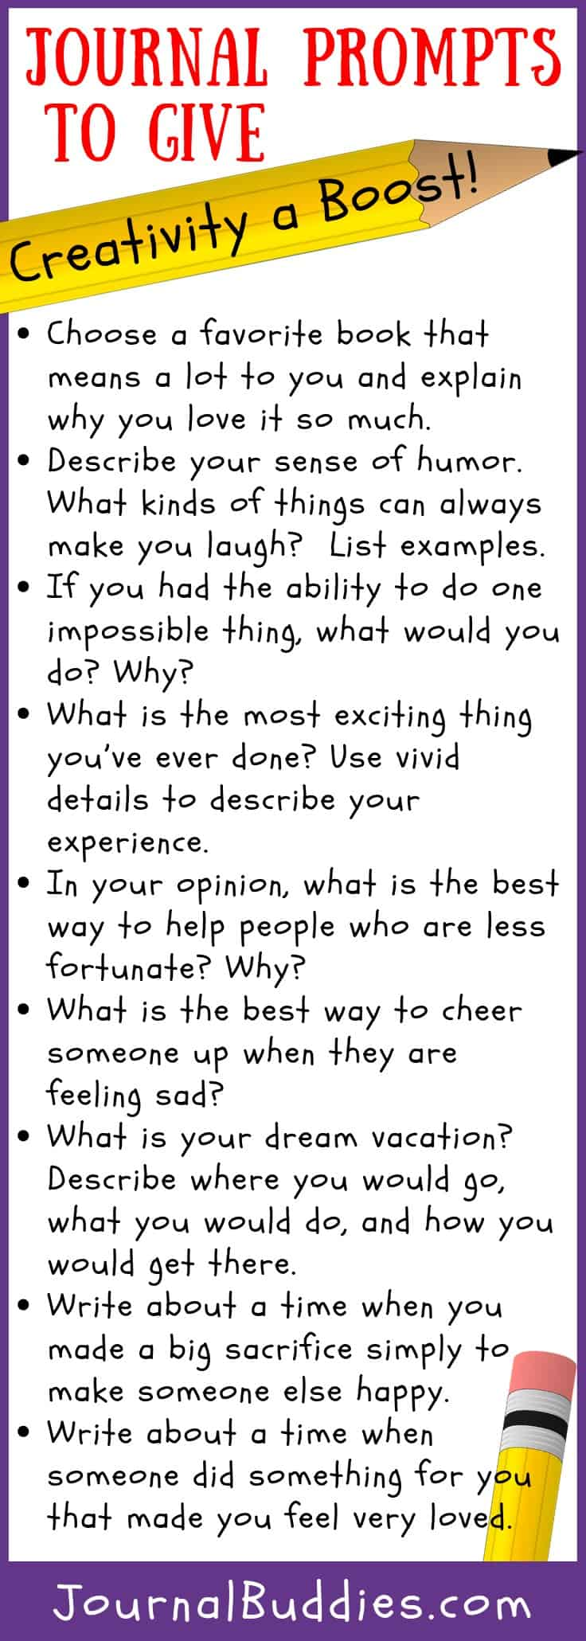
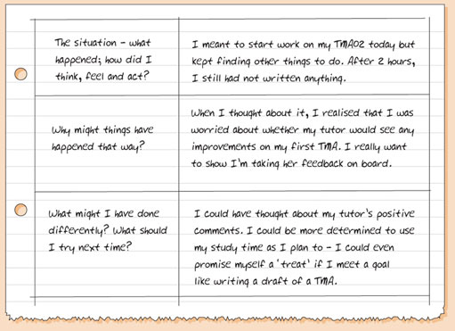

Slide 8
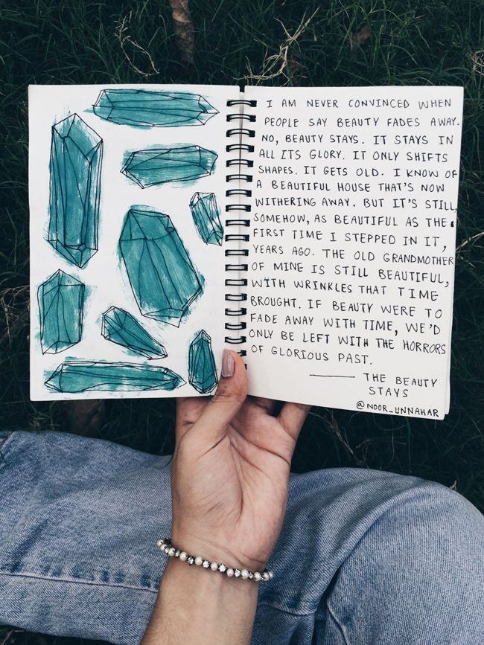
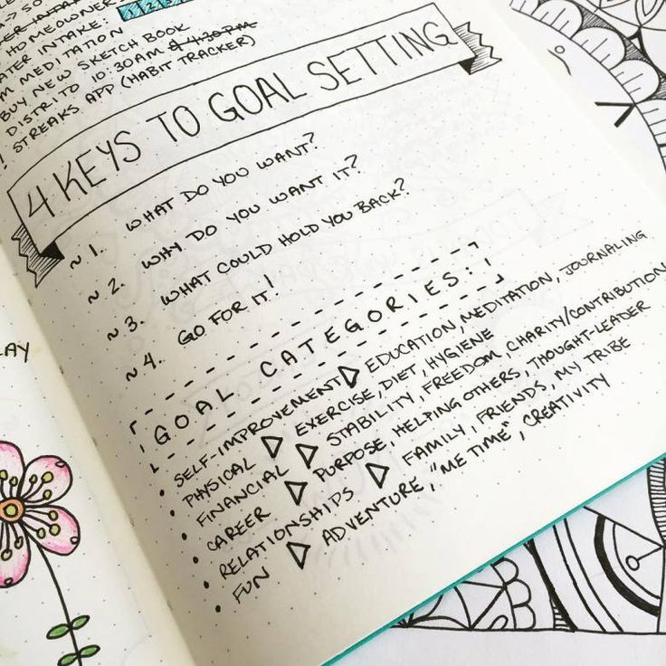

Slide 9
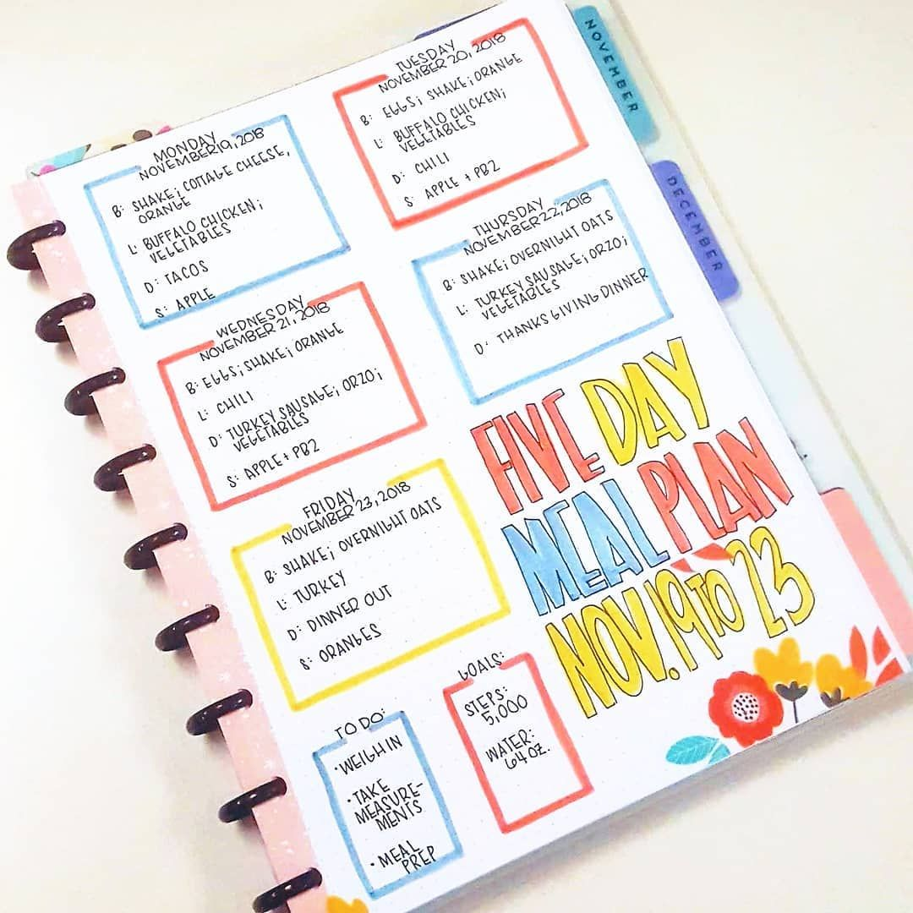
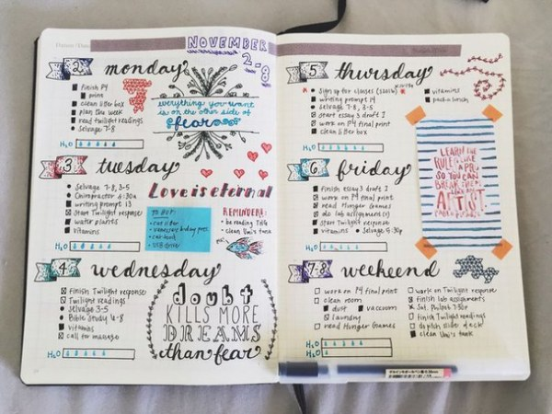

Slide 10
If you don't know what to write about, take a walk and make notes on what you observe around you: the buildings and people or the plants and birds, the weather, the look of the sky, the look of the ground (grass? wildflowers? pavement? dirt/pebbles? what color?), the sounds (cars? birds? wind? your own breath?), the smells (cut grass? car exhaust? sweat? wood smoke?), the shards and scraps that collect in the gutters.
In every scene, there are an infinite number of details to notice if you pay close enough attention.

Slide 11
Why are Journals Useful?

Slide 12
Journaling is different. With journaling, there are no rules, no rights or wrongs. You might decide to share parts of your journal, but, fundamentally, your journal is for you. So you're in charge. Your journal is a space where you're absolutely free to express yourself.

Slide 13
Not only does regular writing make you feel good, it helps you re-live the events you experienced in a safe environment where you can process them without fear or stress.
Keeping a journal can help you: Clarify your thoughts and feelings. Get to know yourself better through journal keeping.

Slide 14
Journals Improve your writing. Generally, the more you write, the better a writer you become. Writing regularly makes writing easier, and it helps you develop your own writing voice.
Even if your journal is just for yourself and it doesn't matter how "good" it is, journaling builds muscles that you can use for other kinds of writing. And the fact that it is, generally, for your eyes only makes your journal an ideal laboratory for experimenting with new styles, techniques, and subject matter, increasing your range as a writer.
Your journal is also a place to collect ideas and material for creative writing. All of the sights, sounds, tastes, and feelings you record, the overheard pieces of conversation, the people you were watching in the street -- all of these can be recycled in stories and poems. These observed details will give your creative writing the texture of reality.

Slide 15
Journals preserve memories.
It's amazing how quickly we forget. For instance, try remembering in detail your day exactly one week ago. Can you remember what you wore? What you ate for lunch? What you felt and thought about?
Try an experiment. Write down in detail everything that happened to you today. I bet you can keep going for a dozen pages or more. But if you try to write about yesterday, you might have trouble filling up more than a couple of pages. And if you go to the day before yesterday, you probably have even less.
Journals are a great way of preserving memories and looking back as well as making plans for the future

Slide 16
Journals Sharpen your senses. Writing about your experience can make you a better observer.
When we know we're going to write about something, we pay a different kind of attention to it. Keeping a journal gets you in the habit of noticing the details of your daily life.
The result is like a heightening of the senses, as you observe the world with greater richness and complexity.

Slide 17
Memento
Someone to talk to
LOOK FOR PATTERNS
Help you remember
LET OUT FEELINGS
Lists and patterns
Organizing

Slide 18
You could create a Helping Hand
Inside.

Slide 19
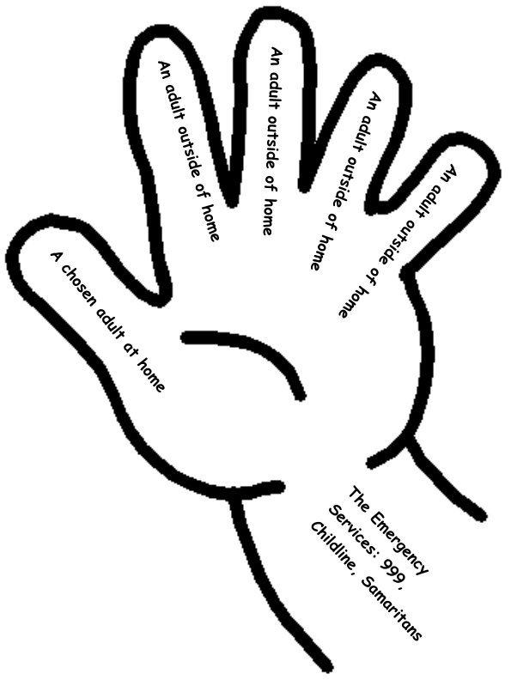

Slide 20
Happy Journaling

