Slide 1
Zones of Regulation
Feelings ,Thoughts and the language of Zones

Slide 2
What are zones of regulation?
The Zones of Regulation is a curriculum geared toward helping students gain skills in consciously regulating their actions, which in turn leads to increased control and problem solving abilities. ... In the activities, students also learn how to use strategies or tools to stay in a zone or move from one to another.

Slide 3
The Green Zone
The green zone is used to describe when you’re in a calm state of alertness.
Being in the green zone means you are calm, focused, happy, or ready to learn. This is predominantly the state you want your child to be in.
It’s also the state most needed in the classroom in order to learn.

Slide 4
The Yellow Zone
The yellow zone describes when you have a heightened sense of alertness. This isn’t always a bad thing, and you typically still have some control when you’re in the yellow zone.
Being in the yellow means you may feel frustrated, anxious or nervous. But, it could also mean you’re feeling excited, silly, or hyper – which is okay in the right situations.

Slide 5
The Red Zone
The red zone describes an extremely heightened state of intense emotions. When a person reaches the red zone, they’re no longer about to control their emotions or reactions.
Being in the red zone means you’re feeling anger, rage, terror, or complete devastation and feel out of control.

Slide 6
The Blue Zone
The blue zone, on the other hand, is used when a person is feeling low states of alertness or arousal.
When you’re in the blue zone you may be feeling down – sad, sick, tired, or bored. You’re still in control, as you are in the yellow zone, but with low energy emotions.

Slide 7
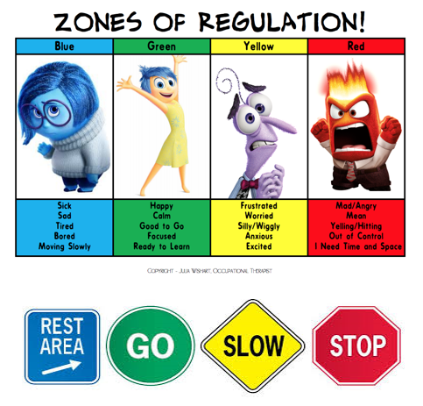
Inside OUT
This film can be a great way of thinking about Zones

Slide 8
The important thing is you decide which zone you are in AND TO REMEMBER THAT:
There are no BAD ZONES
We all change ZONES
ZONES ARE NEVER ABOUT BEING IN TROUBLE or DOING THINGS WRONG

Slide 9
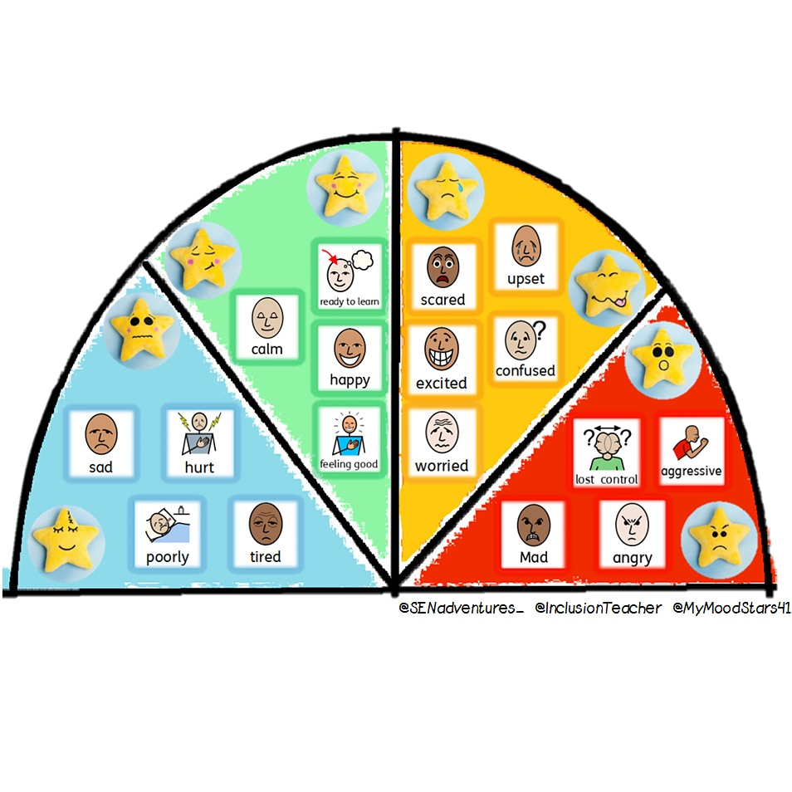
Where would you point the spinner?

Slide 10
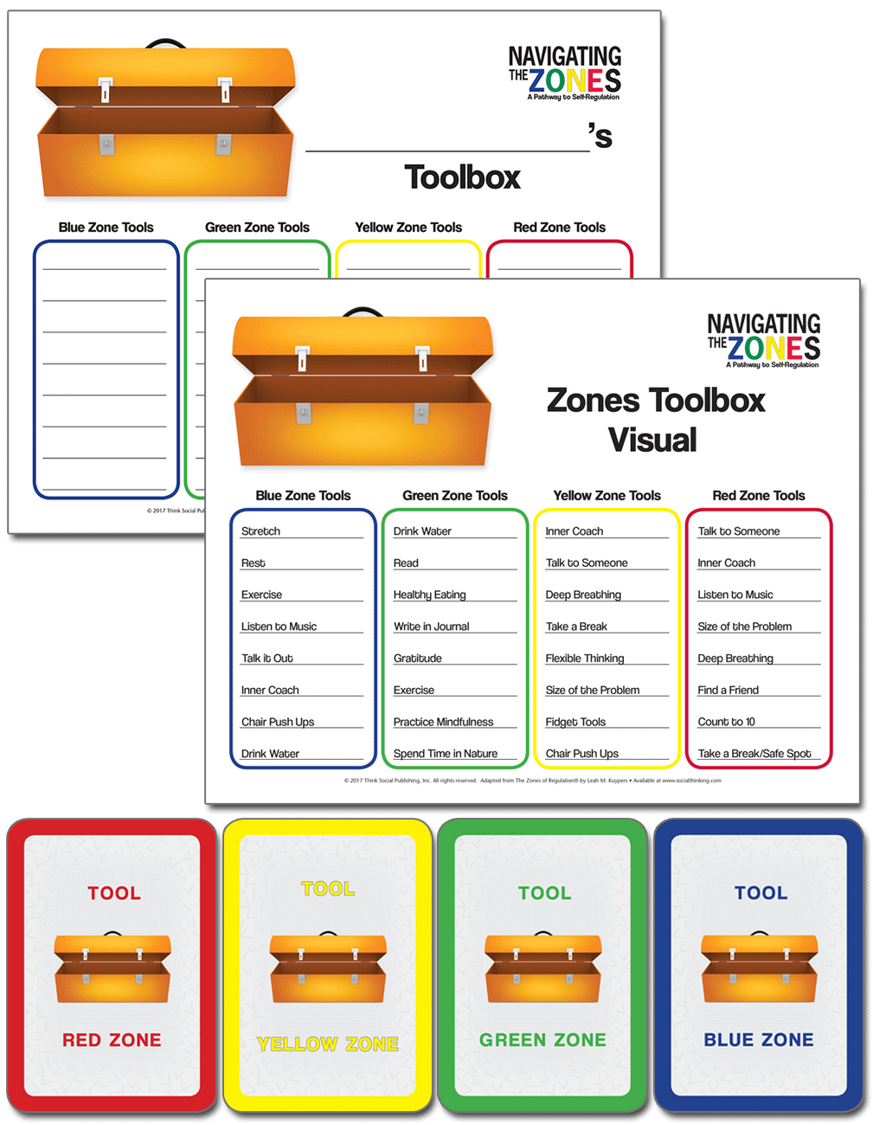
Create a tool box for each zone
Your challenge is to…

Slide 11
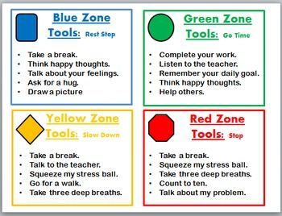
Examples of useful tools

Slide 12
Everyone's tool kit is different,
Pick what works best for you.

Slide 13
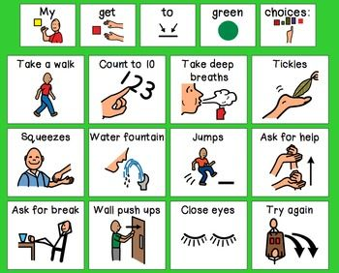
What will your tool kit look like?

