Slide 1
Future Without rubbish competition
DESIGN A CARRIER BAG COVER

Slide 2
Your bag should promote
good habits
Upcycle
Recycle
Choose better alternatives

Slide 3
You might add a slogan
Do your bit
Save our planet
Save our seas
Choose to re-use
Future without rubbish

Slide 4







You might use symbols

Slide 5
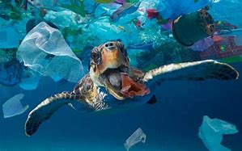


Which animals or habitats are
you trying to save?

Slide 6
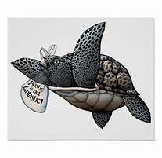




Other Ideas

Slide 7
Get Designing on A4
The winner will be printed
on re-useable bags

