Slide 1

Westminster children’s university
Let’s start a journey together!

Slide 2



Slide 3
What happens when we join?
Registered organizations are presented with a wide range of free, Learning Activities delivered by myriad partners called ‘Learning Destinations’. These partners include museums, sports associations, local and global businesses and afterschool clubs to name but a few.
We will arrange, organize and coordinate your participation for you.

Slide 4












What type of opportunities are available?

Slide 5

Accrediting Opportunities
Each learning experience is accredited against our robust quality assurance framework, ‘Planning for Learning’, ensuring that learning offered anywhere across the CU network is of the same high standard, irrespective of location or subject area.
We will check ,arrange experiences with providers for you.
We believe that financial position should never
limit access, so we will negotiate experiences
for you that are free
or support them so that they are free to you.

Slide 6

Undergraduate levels for Accreditation
Credit Targets
Children’s University Undergraduate Level
30 to 400 hours of learning
Bronze Silver Gold
Awards 30 65 100
Certificate 130 165 200
Diploma 230 265 300
Degree 330 365 400
HOW DO ACREDDITATION LEVELS WORK?

Slide 7
Recognition of effort and achievement is central to the program's success. Each time a child completes a Learning Activity they receive a stamp, or credit, in their CU ‘Passport to Learning’. One hour of learning equals one credit. Sufficient earned credits earn CU Certificates of Achievement across 3 levels: undergraduate, postgraduate and fellowship.
Last year alone, our partner school
students earned 81000 extracurricular
hours!
Stamps and Credits

Slide 8

Awards are presented at CU Graduation ceremonies held at Kensington Town Hall.
The ceremonies are closely modelled on the ‘grown up’ version, with caps and gowns and parents
watching proudly in the
audience.
We will hold a graduation
just for you, annually;
You can earn awards for 1000+ hours!

Slide 9
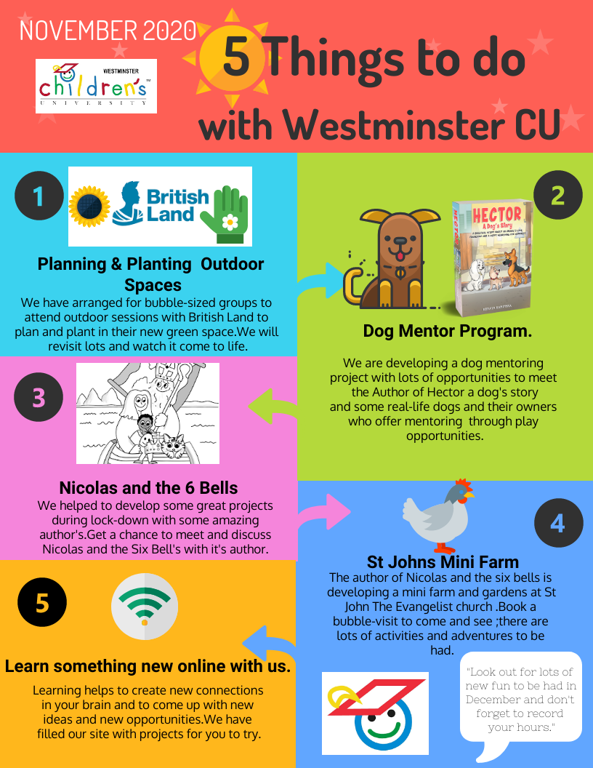
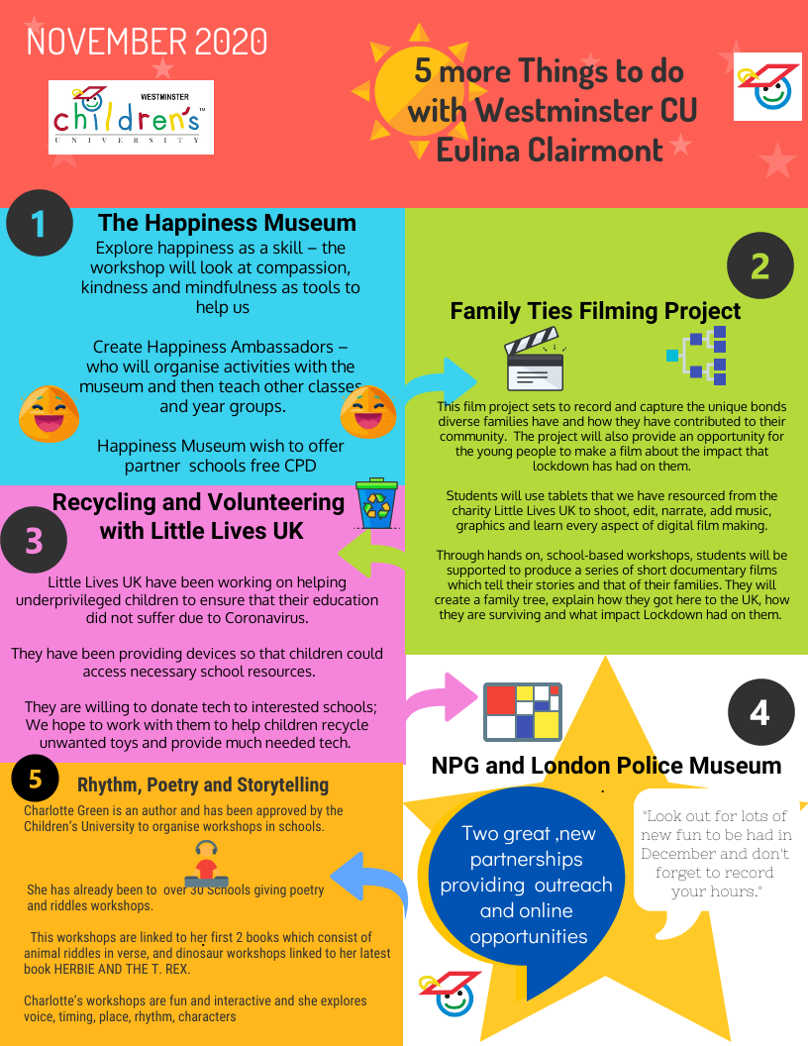
We will coordinate a quarterly offer for you

Slide 10
We know that many schools and extra-curricular organizations have been quickly adapting their delivery to take into account closures due to coronavirus.
We have been working hard to support educators in continuing to engage with children, young people and their families during this difficult time.
We have been busy uploading and updating content on our website so that you will have plenty of exciting things to do, even if you are not in school or able to travel at the moment.
What about the current restrictions?

Slide 11
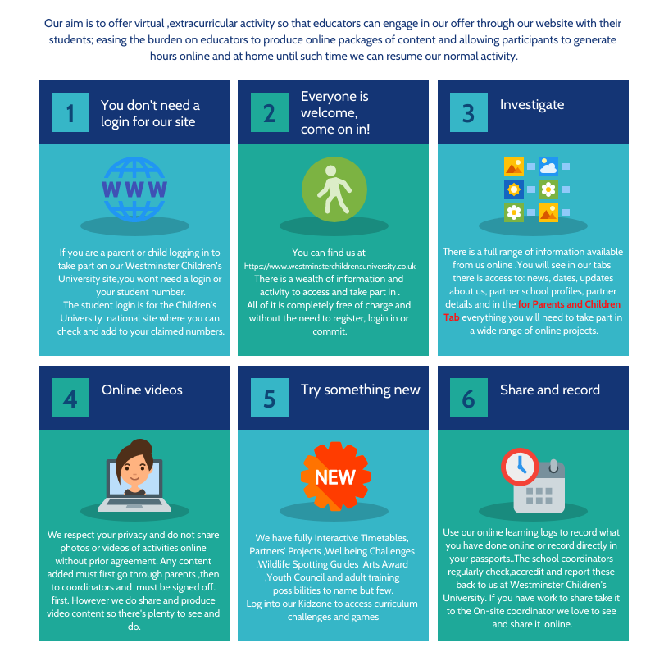

Slide 12
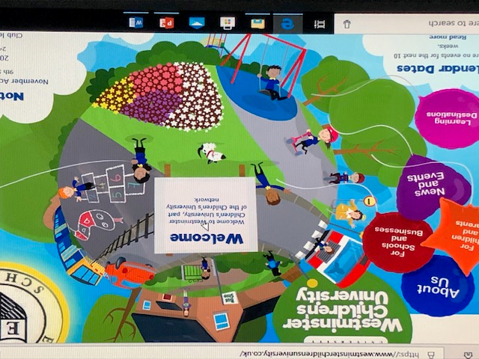
Our aim is to offer virtual ,extracurricular activity so that educators can engage in our offer through our website with their students; easing the burden on educators to produce online packages of content and allowing participants to generate hours online and at home until such time we can resume our normal activity.
There are 83 online opportunities currently active ,with three virtual events in planning for November-December.
Our online
commitment
to extracurricular
learning

Slide 13
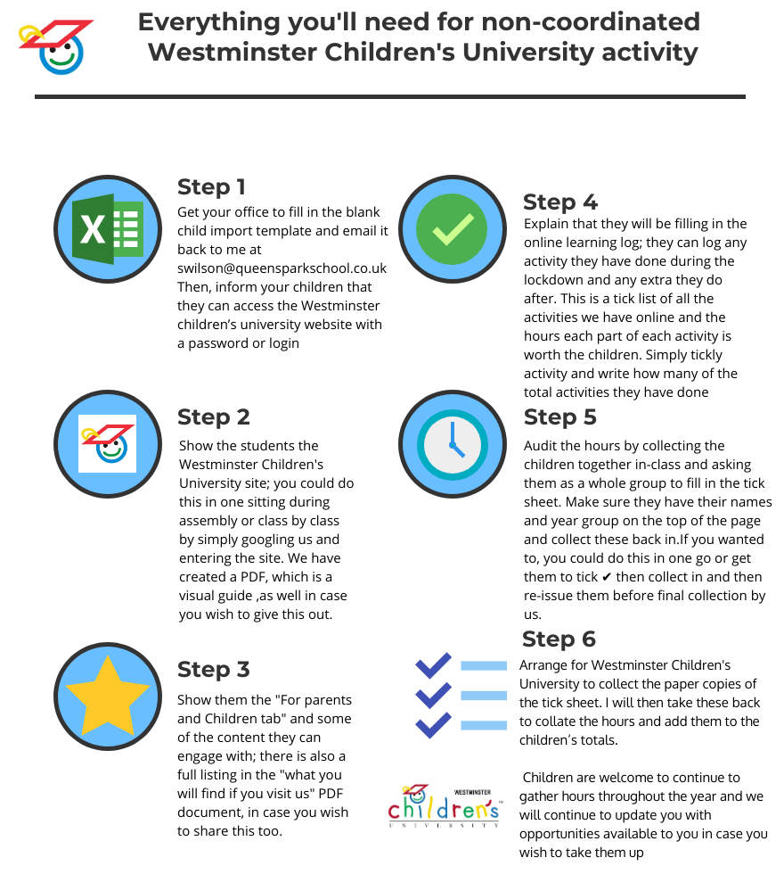
You can take part
remotely

Slide 14
CU builds confidence and nurtures critical life skills such as the ability to work as part of a team, effective communication, resilience and use of initiative.
These are all attributes highly prized by employers. Finally, CU motivates young people to get involved in positive out-of-school and extracurricular activities, significantly reducing the likelihood of them participating in negative/anti-social activity, now or in later life.

