Slide 1

2020 Entries are now open! Entries close 29th January 2020

Slide 2

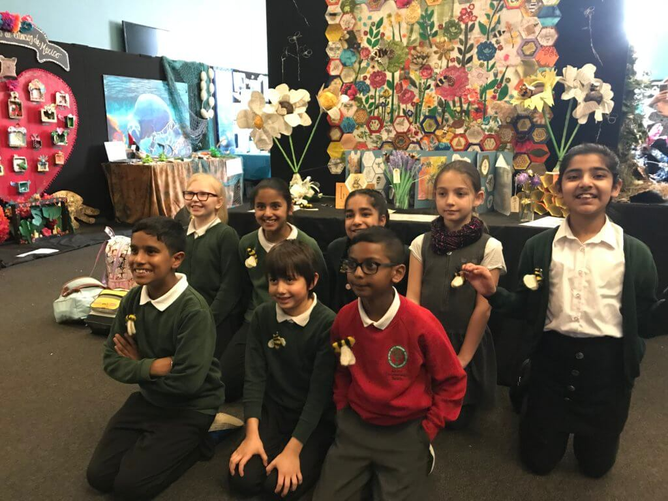
To be in with a chance of displaying a colourful creation at London’s Natural History Museum,

Slide 3
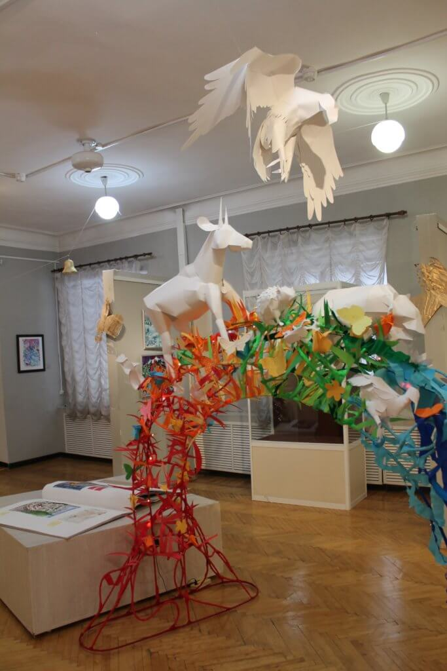
Be as creative as you can, using anything from paint, sculpture or sewing to recycled art to create your own mini-exhibition! Make sure that you use some form of recycled materials in the final piece.

Slide 4
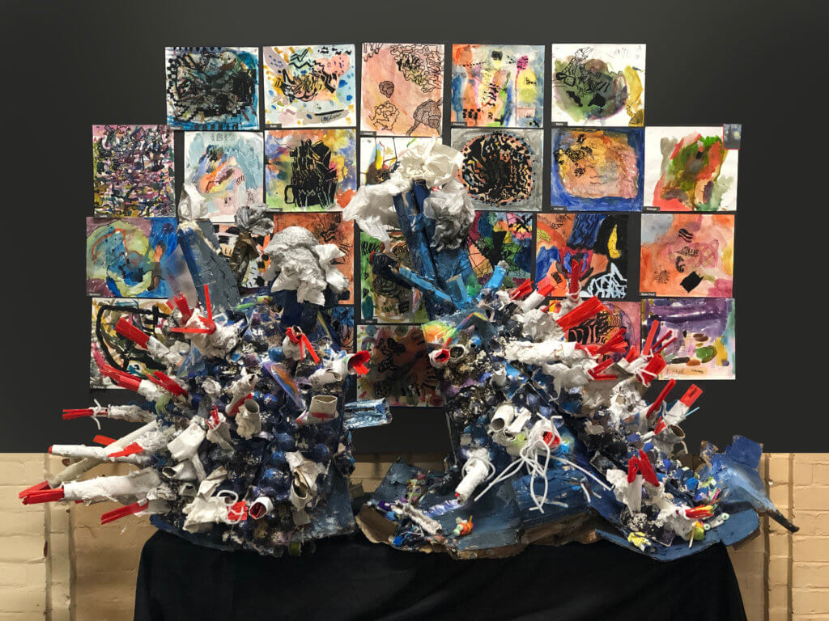
Alongside your entry form you will need to submit a photograph of your Group’s entry and a video/PowerPoint presentation telling us all about your entry and how you have interpreted the theme.

Slide 5
The video/presentation will be shown at the Natural History Museum if you are selected as an overall or category winner.
*Shortlisted finalists will be chosen

Slide 6
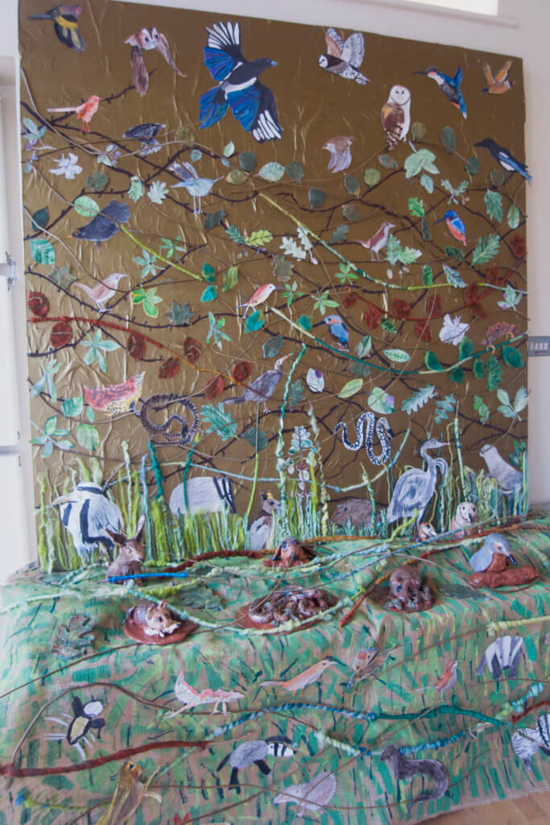
Shortlisted finalists will be chosen from the photographic submission and video/presentation. The successful groups will display their entry at the Natural History Museum on Thursday 12th March 2020.

Slide 7
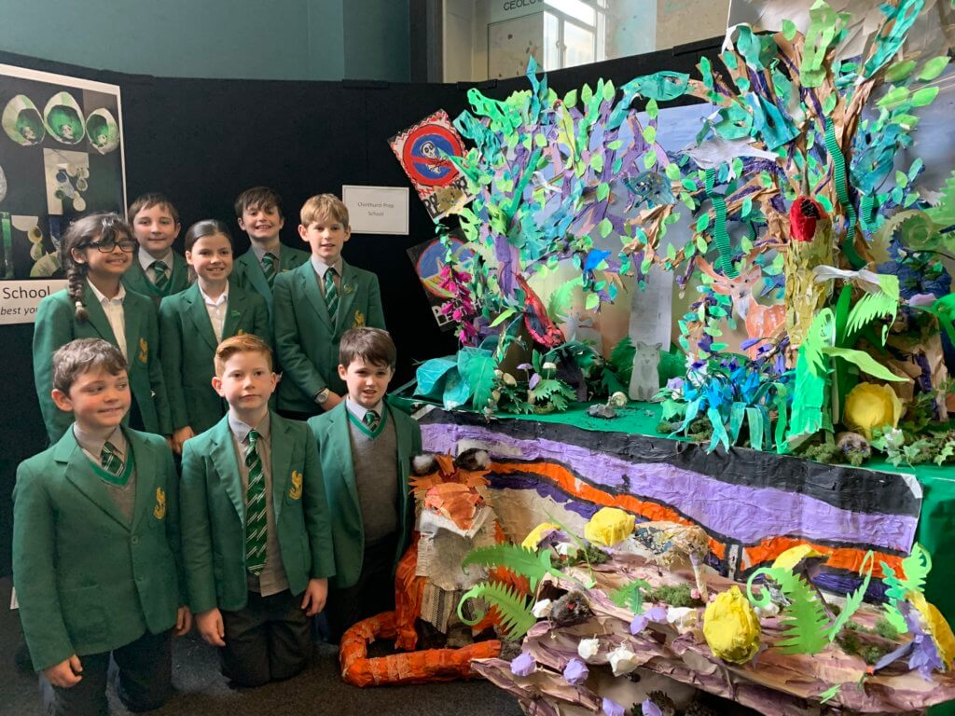
There will be prizes for 1st, 2nd and 3rd place, an award for the best International Entry, Personal Choice Awards from the guest speaker and our sponsors, Michael O’Mara Books, as well as the David Shepherd Award. Every shortlisted finalist will receive a special certificate and a goody bag.

Slide 8
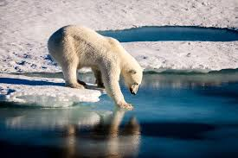
Ozone Depletion, Greenhouse Effect and Global Warming: All the three physical phenomena are related to one another to a great extent. ...
Desertification: ...
Deforestation: ...
Loss of Biodiversity: ...
Disposal of Wastes:

Slide 9
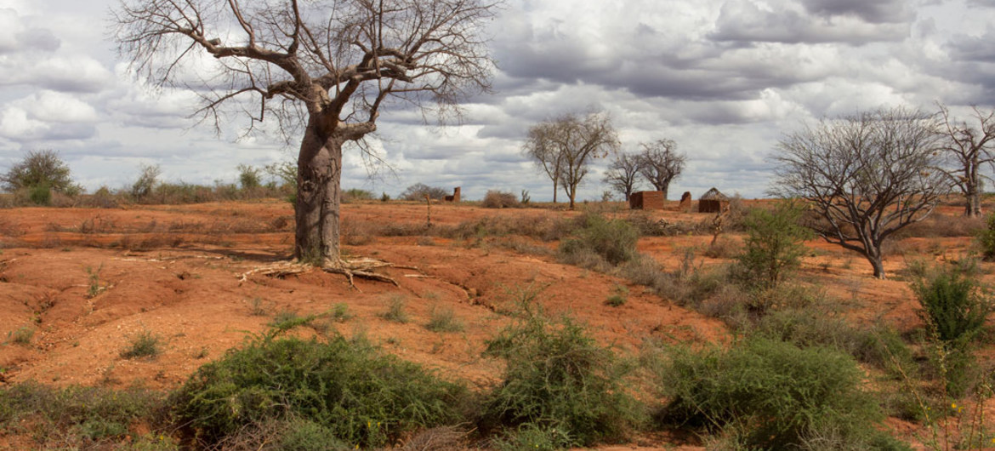

Slide 10
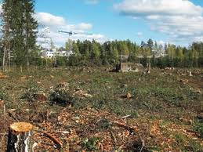

Slide 11
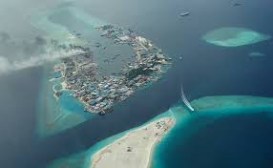

Slide 12
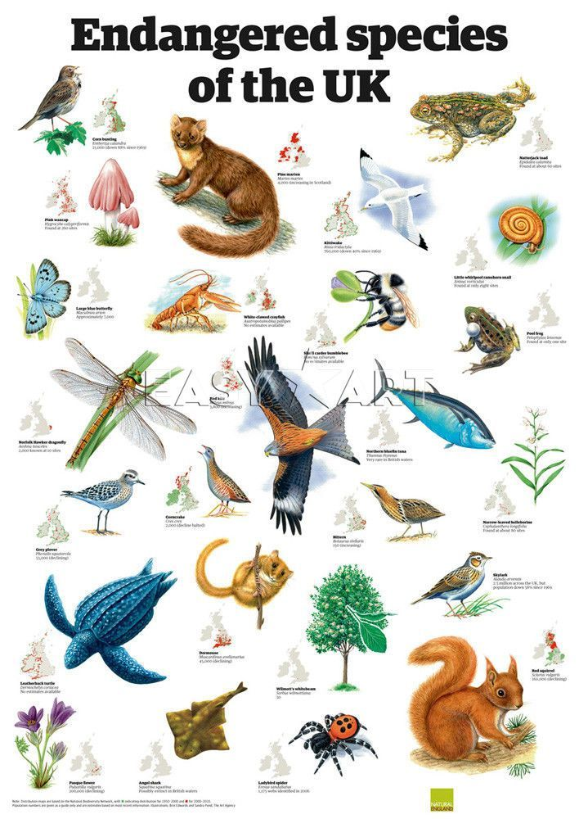

Slide 13
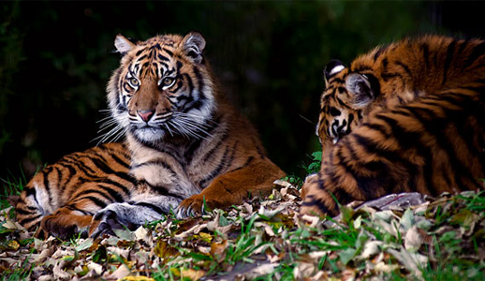
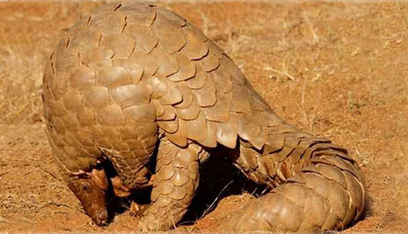
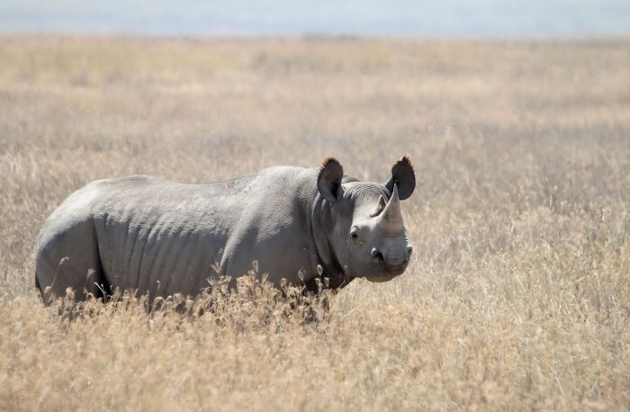
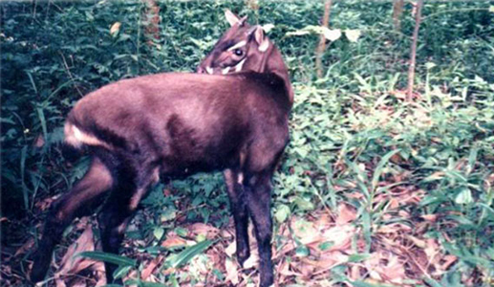
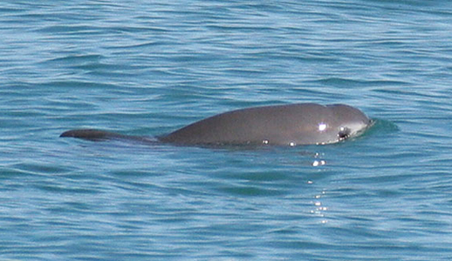
Pangolin
Vaquita
Saola

Slide 14
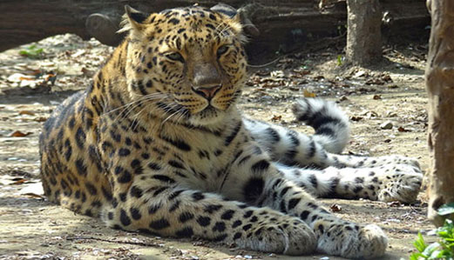
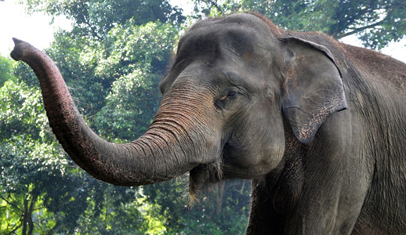
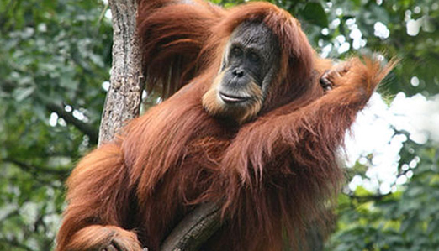
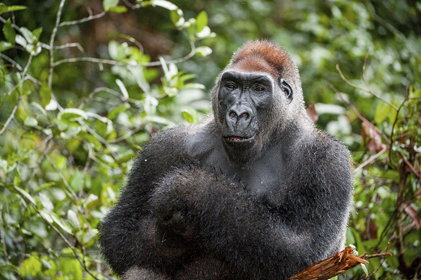
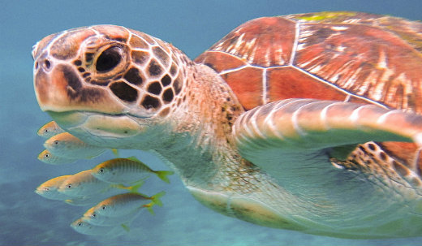

Slide 15
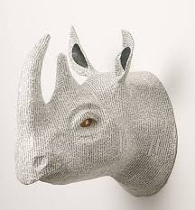
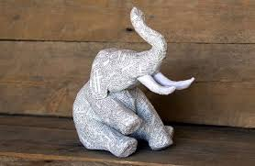
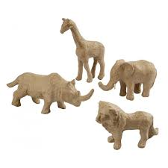
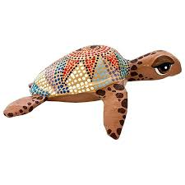
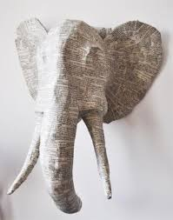
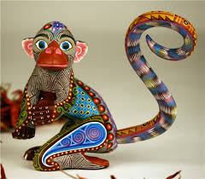

Slide 16
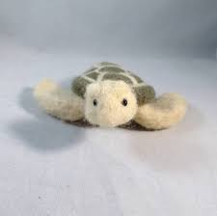
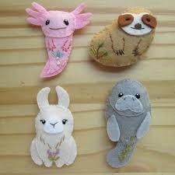
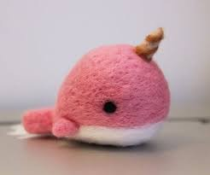
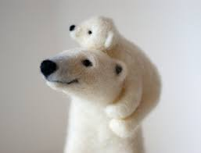
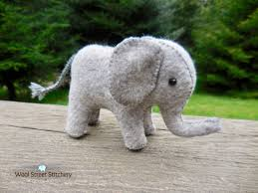

Slide 17
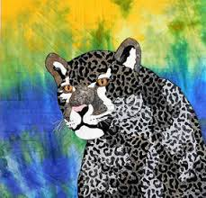
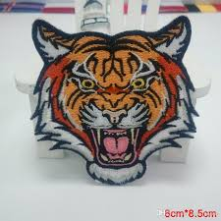
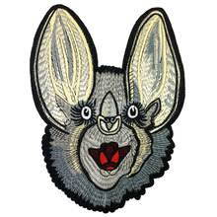
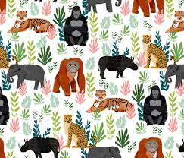
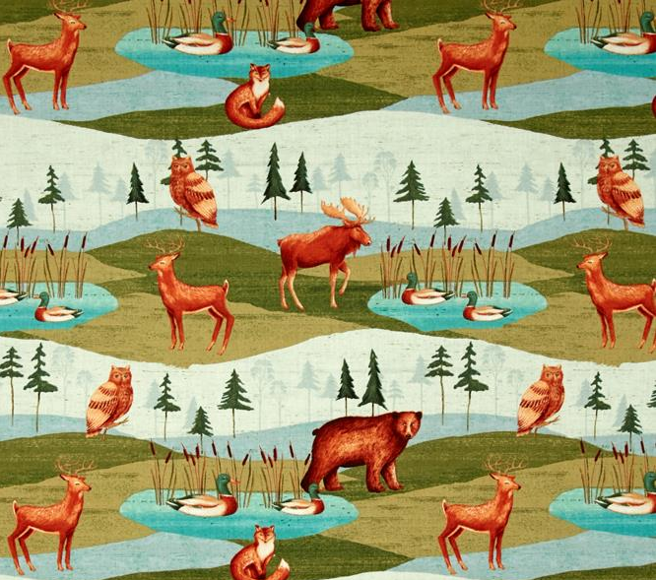
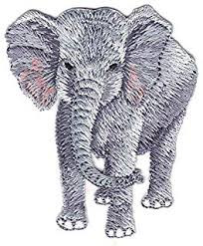

Slide 18
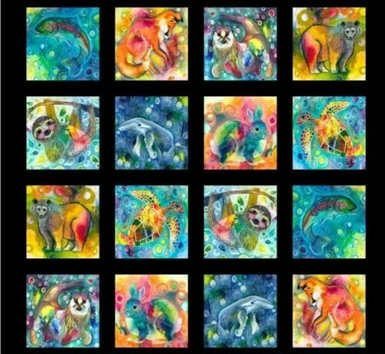

Slide 19
ENTRIES CLOSE THURSDAY 29th JANUARY 2020
Good luck – we can’t wait to see what you come up with!

Slide 20
2020 Entries are now open! Entries close 29th January 2020
READ THE TERMS BELOW AND FILL OUT OUR ENTRY FORM HERE.
To be in with a chance of displaying a colourful creation at London’s Natural History Museum, please read about the competition and how to enter below:
*This competition is group entry open to everyone aged 16 and under. Entries are welcomed from any art groups, classes, year groups or a whole school!
*This year’s competition theme is ‘Endangered’ – the challenge is to create an exciting group mini-exhibition/art display interpreting this theme! (See examples from last year’s theme below.)
*Each Group’s entry should fill a wall space 180cm x 180cm with a table 180cm x 60cm in front. Be as creative as you can, using anything from paint, sculpture or sewing to recycled art to create your own mini-exhibition! Make sure that you use some form of recycled materials in the final piece.
*Entry is FREE. Donations are welcome but will not affect judging (suggested donation £20).
*When you are ready to enter please complete our entry form – you will need to submit 200 words describing how you have interpreted the theme.
*Alongside your entry form you will need to submit a photograph of your Group’s entry and a video/PowerPoint presentation telling us all about your entry and how you have interpreted the theme. Please send these via WeTransfer/Dropbox/Google Drive to jo.elphick@davidshepherd.org (videos must be no more than 3 minutes long). The video/presentation will be shown at the Natural History Museum if you are selected as an overall or category winner.
*Shortlisted finalists will be chosen from the photographic submission and video/presentation. The successful groups will display their entry at the Natural History Museum on Thursday 12th March 2020.
*If this isn’t possible (e.g. you’re overseas or a long way from London) we will display a photograph of your entry for judging at the museum.
*Judging to select the final overall and category winners will take place between 12-1pm, with the guest speaker’s talk and prize giving taking place between 1.30-3pm.
*There will be prizes for 1st, 2nd and 3rd place, an award for the best International Entry, Personal Choice Awards from the guest speaker and our sponsors, Michael O’Mara Books, as well as the David Shepherd Award. Every shortlisted finalist will receive a special certificate and a goody bag.
Make sure you have checked our printable competition details and Terms & Conditions before you enter: click here.
ENTRIES CLOSE THURSDAY 29th JANUARY 2020
Good luck – we can’t wait to see what you come up with!

