Slide 1
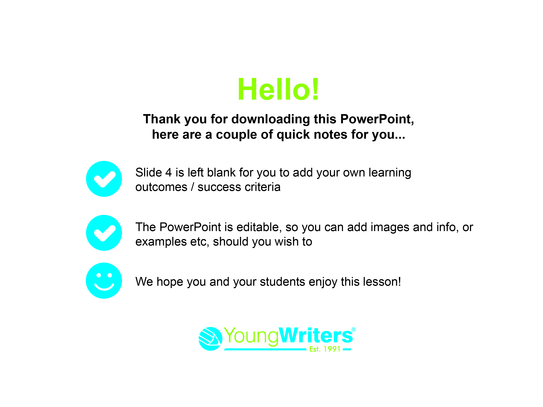

Slide 2

CREATIVE
WRITING COMPETITION
CLOSING DATE: 16th December 2022

Slide 3

Today you are going to go through a magic door and write about what you find on the other side!
Let’s get started…

Slide 4
Learning outcomes & success criteria for today’s lesson:

Slide 5
Your teacher is going to describe a door.
Close your eyes and listen to what they say.

Slide 6

Did you guess where the door will take you?
Your teacher will tell you the answer…
Notes:
ADD AN IMAGE OF THE DOOR THAT LINKS TO YOUR CLASS TOPIC HERE

Slide 7
Using Your Senses
Now close your eyes again and imagine you have walked through the door.
What can you see?
What can you feel?
What can you hear?
Are there smells or tastes?

Slide 8
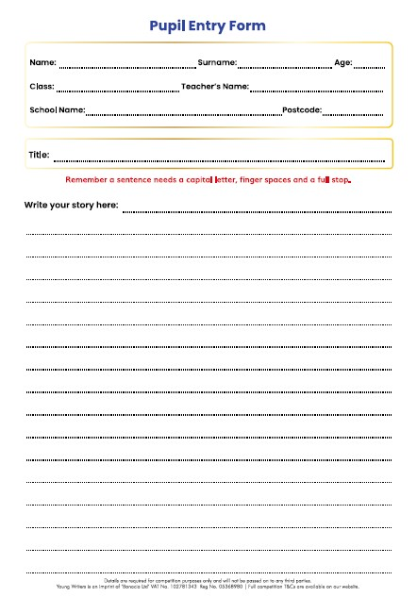
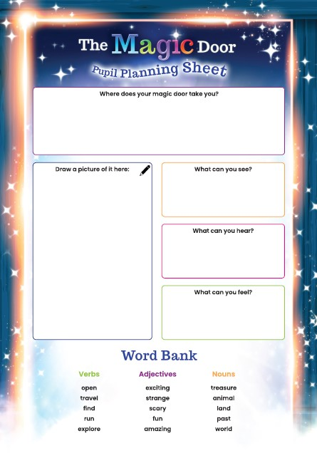
Write down your ideas on your planning sheet.

Slide 9
Picture It
Draw a picture of what is behind your magic door.
Or
Write down words that are connected to the time or place that it takes you to.

Slide 10
Get Writing!
Now it’s time to write about where your
magic door takes you.
Here are some lines to help you start:
“I stepped through a door and found myself in…”
“I went through the magic door and saw…”
“One day, I found a magic door. I went through it and found…”

Slide 11
Get Writing!
Remember to use lots of describing words and the sense details you came up with earlier.
“I could feel…”
“Then I saw…”
“It sounded like…”

Slide 12
Story Ideas
Why not turn your description into a complete story? Here are some ideas to help:
Do you meet anyone there?
How do you feel?
What happens while you are there?
What do you do next?
How does your adventure end?

Slide 13
Remember to add an ending!
Do you go back home through the door or stay there?
What did you think of your adventure?
Was it fun, exciting, scary?
Will you go back?

Slide 14
Peer Assessment
Read your story to a friend. They will tell you what they like about it and if anything can be improved.
Do the same for them.

Slide 15
Make sure your name and age are on your story, and hand it in to your teacher.
Well done! You’ve written a story for
The Magic Door competition!
You should be proud of yourself.

Slide 16

We hope you have enjoyed writing a mini saga for
A Twist in the Tale today!
CLOSING DATE:

