Slide 1
Poetry Competition for 7-11 Year-Olds

Slide 2
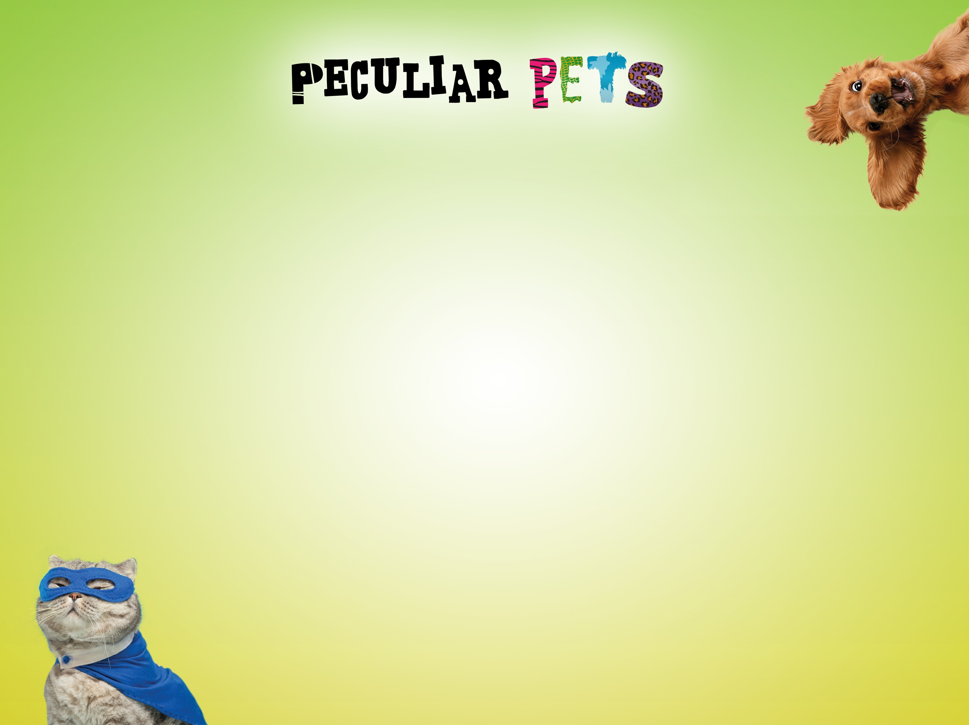
Today you are going to:
Slide 2
Watch a video
Create a character and write a poem inspired by it
Take part in a group discussion
Explore poetic techniques and types
Write a poem for Young Writers’ Peculiar Pets poetry competition

Slide 3
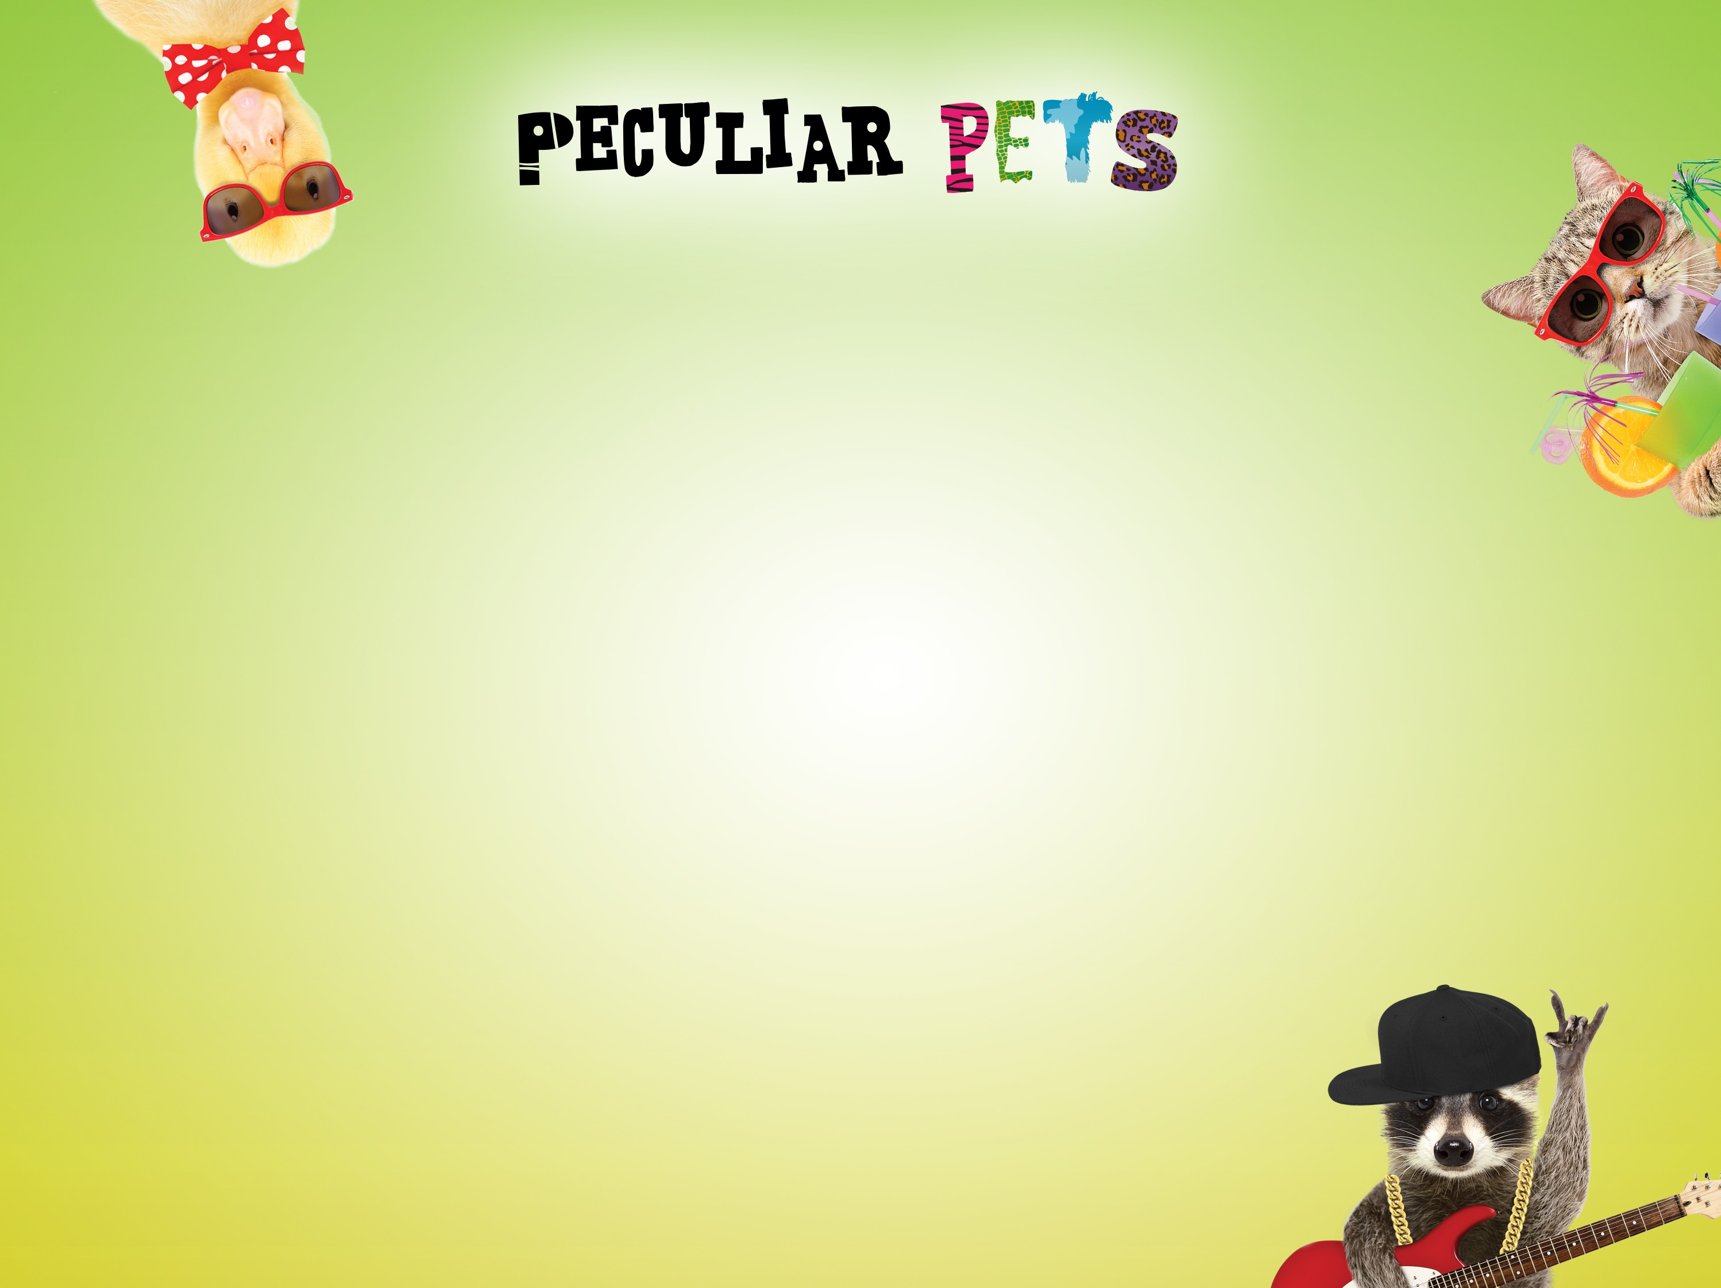
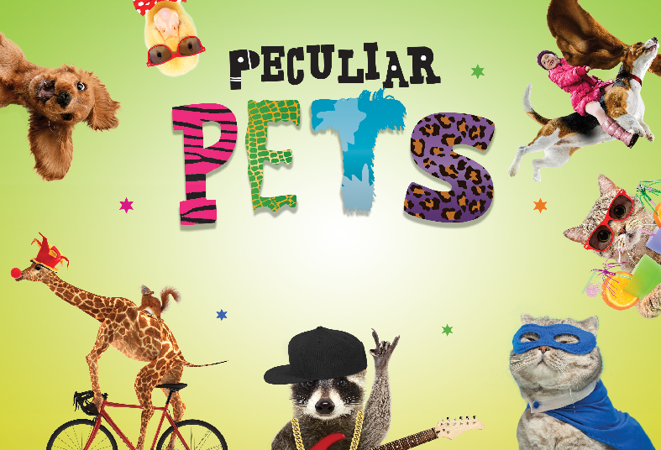
Slide 3
Poetry Competition for 7-11 Year-Olds
Watch the video that introduces you to the activity:
https://youtu.be/yonJ9IwhWpM

Slide 4

Today you will be writing a poem inspired by a peculiar pet that you have created!
Slide 4
Your teacher may give you an idea to write about or ask you to choose.
Once you have decided what your peculiar pet is, draw a quick sketch on your entry form.

Slide 5
Poetry types are styles that you can write in...
Slide 5
There are lots of poetic forms to choose from, but here are 3 we’ve shortlisted:
Rhymes
Do you know what a rhyme and a half rhyme are?
In case you didn’t know, a half rhyme is a similar but not identical sound.
E.g. ‘Egyptian’ and ‘description’ rhyme but
‘Egyptian’ and ‘kitchen’ are a half rhyme.

Slide 6
Can you guess if these are half rhymes or rhymes?
Slide 6
I’m a giant purple puppy With a soft, furry tummy
Bob the giraffe is floating in space It’s such an amazing place
I’m a ferocious dragon Viking And my life is very exciting!
I’m a snake-scorpion baby I like to eat bugs daily
Hello I’m Doctor Lion
In the air ambulance I’m flying!

Slide 7
Narrative Poetry
Slide 7
A narrative poem is a type of poem that tells a story. They don't have to rhyme and are almost story-like except they usually use poetic techniques, description and verses or shorter sentences.

Slide 8
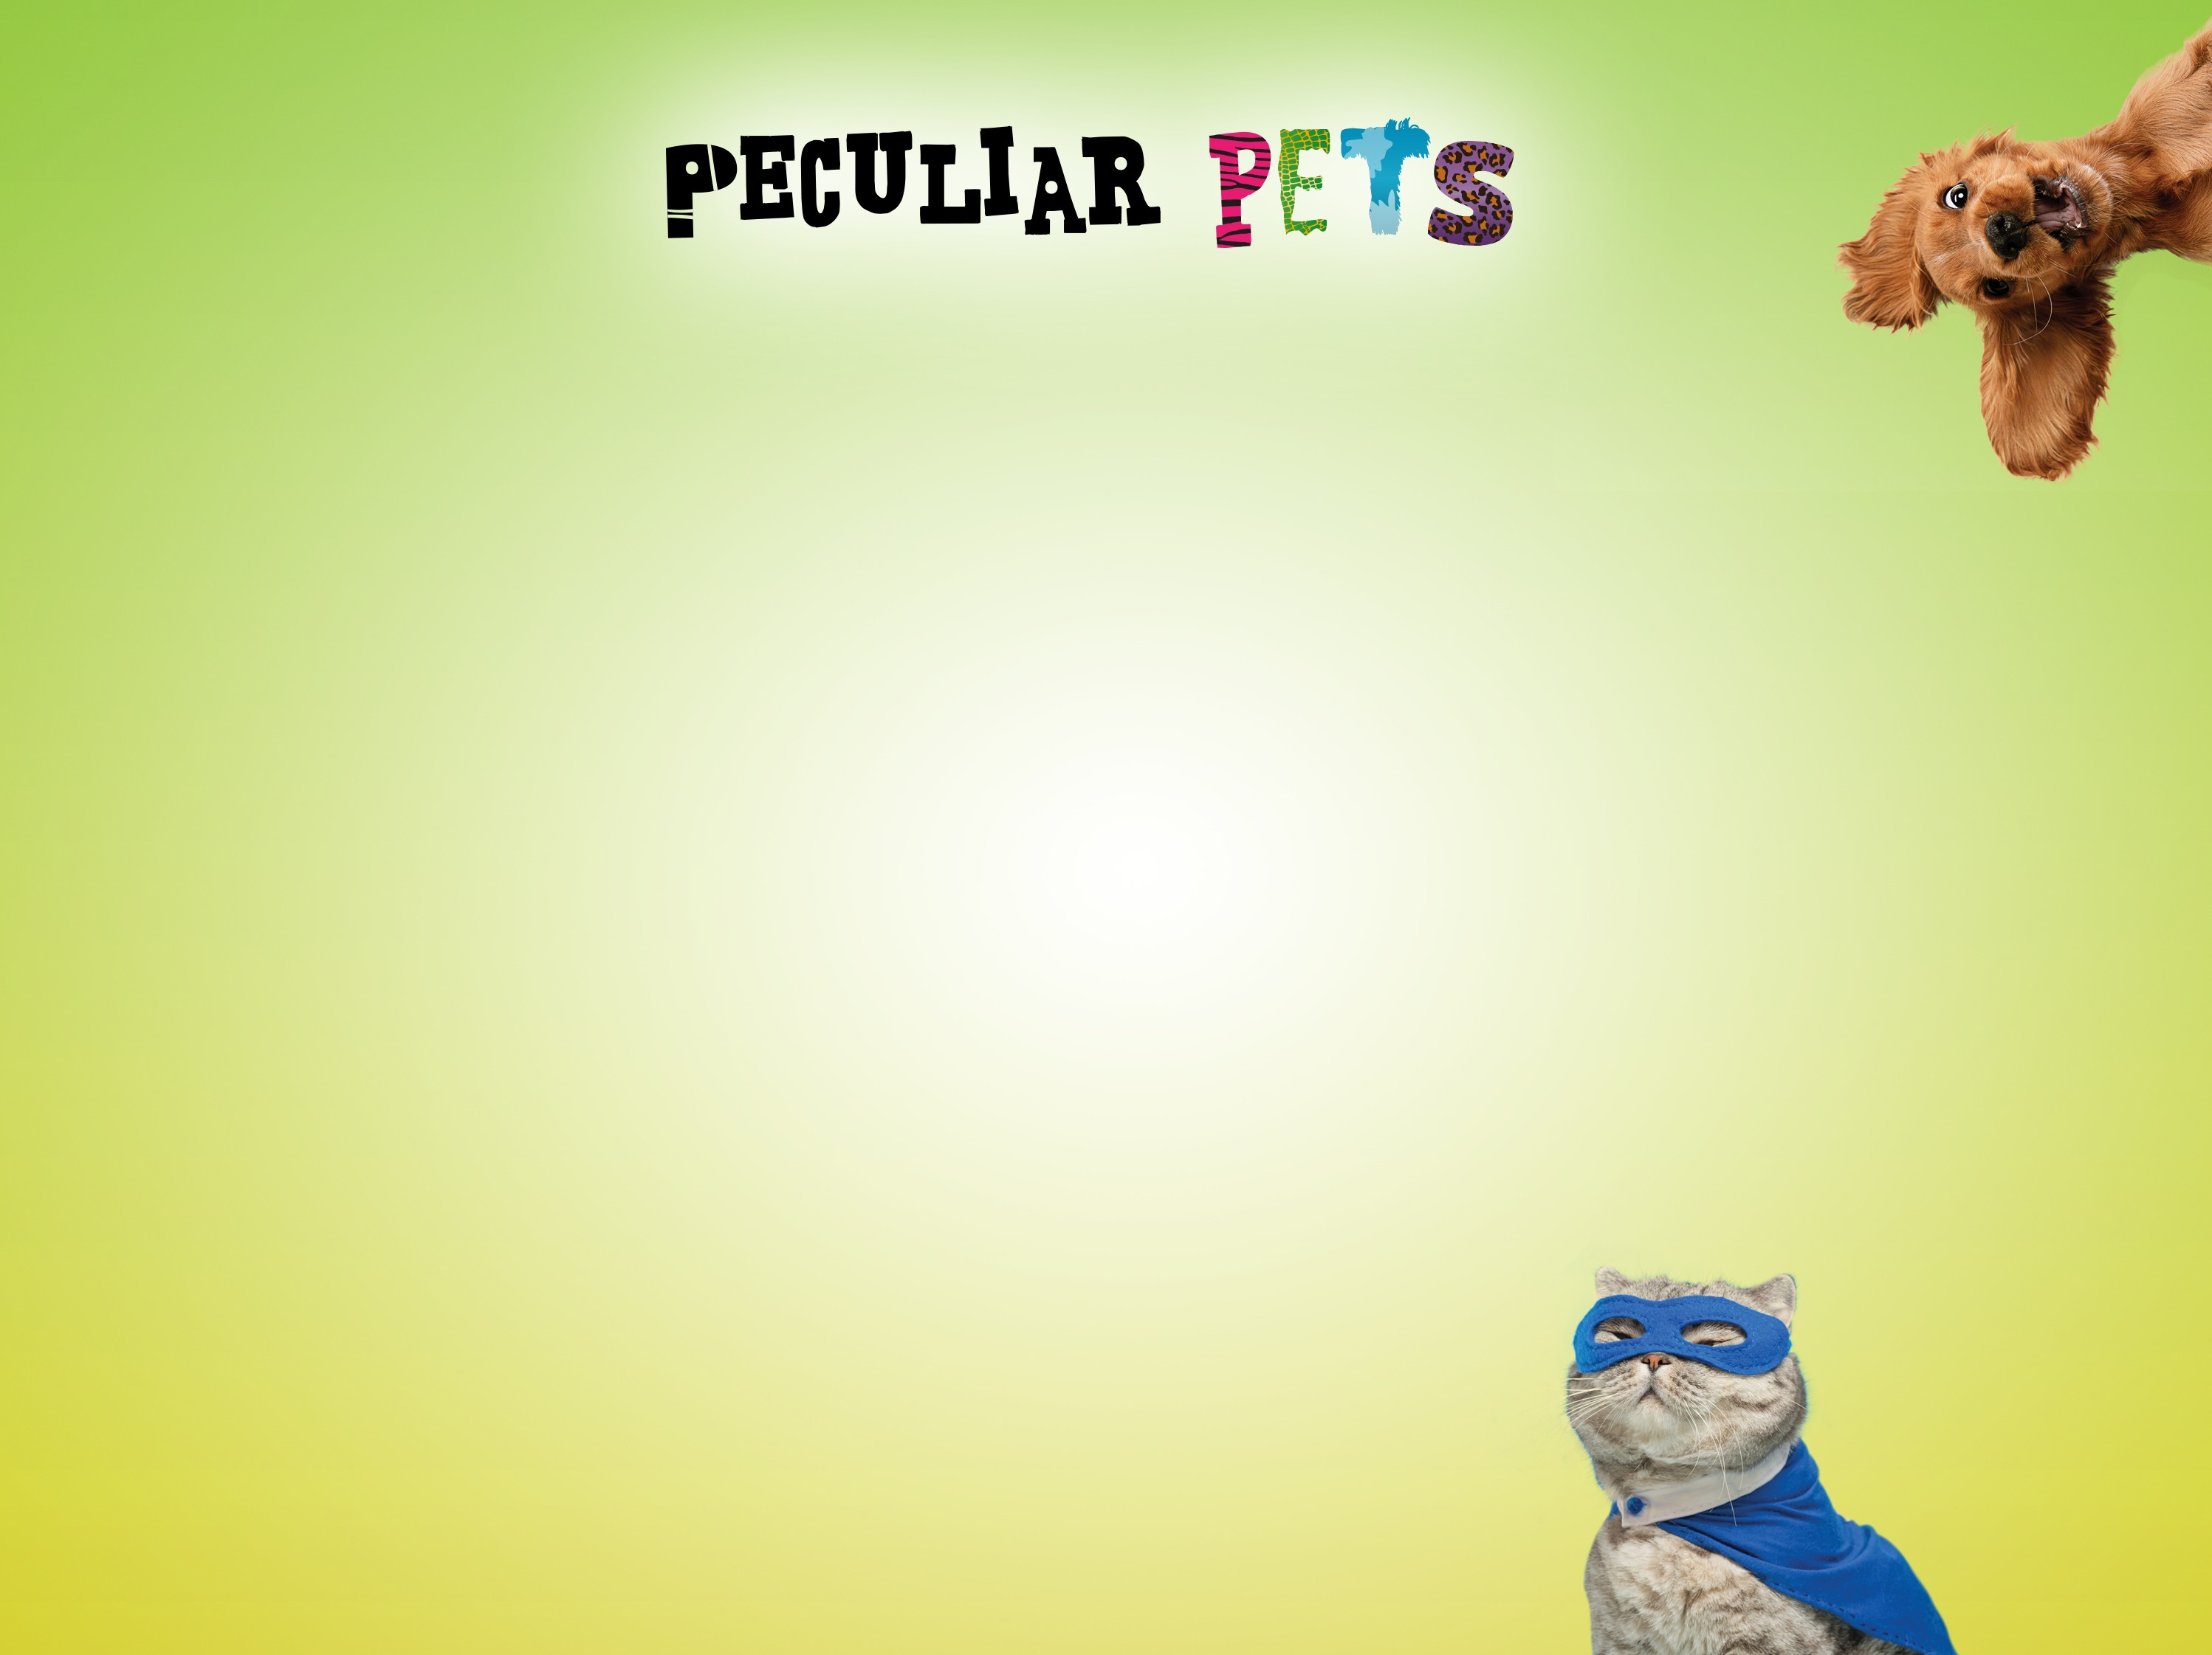
Here is an example of a narrative poem...
Slide 8
I took my Hydro Hippo out for a walk It boosted up its hydro engine and Vroom! Whoosh! We were off!
Zooming by trees and houses Bumping over paths
Splash!
We were in the river!
My Hydro Hippo chilled out We bobbed along for a bit Then...
Vroom! Whoosh!
My clothes were dry by the time we got home!

Slide 9
Acrostics
Slide 9
By writing the name of your peculiar pet as the acrostic word, you can then have fun telling the reader about it...
E.g.
D inocorn is a very special pet
I t lives in the shed
ight-time is when it comes out to play
h it shines and shimmers in the moonlight
C ome and see it!
O range eyes and blue claws
R oar! It calls to me when it’s time to play
N o one else has a Dinocorn, it’s my very special pet.
Now write down on your worksheet the type of poem you are going to write.

Slide 10

Poetic techniques are writing tools that make your poem more interesting to read.
Slide 10
Here are our top 3 techniques that complement writing from a different perspective:
Imagery - using description, particularly senses, to paint a picture in the reader’s mind. E.g.
The were-rabbit was fluffy but huge with fangs as long as your arm!
Simile - describing something like or as something else. E.g. Roger the T-rex was friendly like a puppy, as loud as thunder and as terrifying as a thousand spiders!
Onomatopoeia - a word that names a sound, but also sounds like that sound! E.g.
Stomp! Stomp! Zanloo the badger-horse was on her way to cause trouble again!

Slide 11
Here are some sentences about our Young Writers’ peculiar pet called Barney (he’s an octopus that works in a shop), can you guess whether these sentences are a simile, imagery or onomatopoeia?:
Slide 11
Barney is as slippery as an eel.
Gloop! Gloop! Goes Barney as he slides through the store.
Barney smiled as he’s scanned the items through the till. He loved wearing his purple uniform and baseball cap... and he loved scanning shopping as fast as possible with his 8 strong tentacles!
Now write down on your worksheet any poetry techniques you are going to use in your poem.

Slide 12
Now you are ready to get writing!
Slide 12
If you have any questions, now is the time to ask your teacher!
It’s time to write your peculiar pet poem!

Slide 13
It’s peer assessment time!
Slide 13
Share your work with a partner. They are to give you a suggestion on how to improve your poem and let you know what they liked about it. You then do the same for your partner.
Edit your work if necessary!

Slide 14
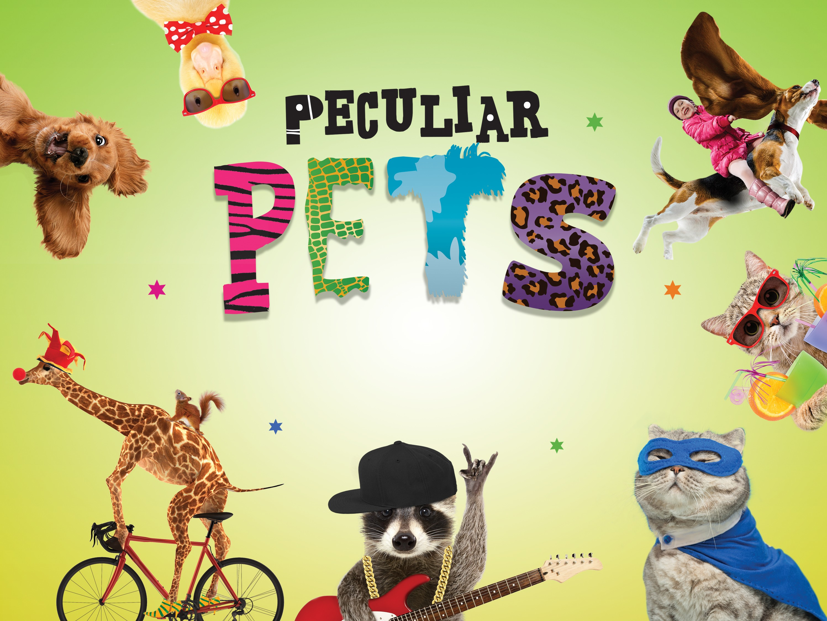
We hope you enjoyed writing a poem for Peculiar Pets!
www.youngwriters.co.uk

