Slide 1


Slide 2

Today you are going to:
Write an acrostic inspired by someone you love or admire
Use adjectives in your poetry writing
Give feedback to your classmates

Slide 3
What is an acrostic?
It is a poem that spells out a word:

Slide 4

Your teacher is going to write a word on the board for you to learn how to write an acrostic.
When your teacher tells you to, call out a word to describe the word on the board that begins with one of the letters.
This is the start of planning an acrostic poem.

Slide 5

You need to use adjectives to describe your word, one word per letter.
An adjective is a describing word.
Think about what the thing looks like, what colour(s) it is and things to do with the word.
E.g. if it the word is “teacher”, then the things to do with a teacher could be whiteboard, pencil, story time, smiling, helping, coffee etc
Work together as a class until you have one word for each letter down the board.

Slide 6
Your teacher will write the word down the board again.
Now you need to work as a class to turn each word your teacher has already written down into a
sentence.
You might get stuck and have to think of a new word to make the acrostic work!
Think of it like a puzzle – it is fun to work out where the words will go!

Slide 7

As a class pick a short word to write one last class acrostic about.
Think of adjectives, turn them into sentences and have fun!

Slide 8

On your worksheet write down a word you want to write your acrostic on.
Here are some ideas if you need some help:
Nurse
Driver
Key workers
Family
Best friend
Your hero
Your teacher’s name
Your pet

Slide 9
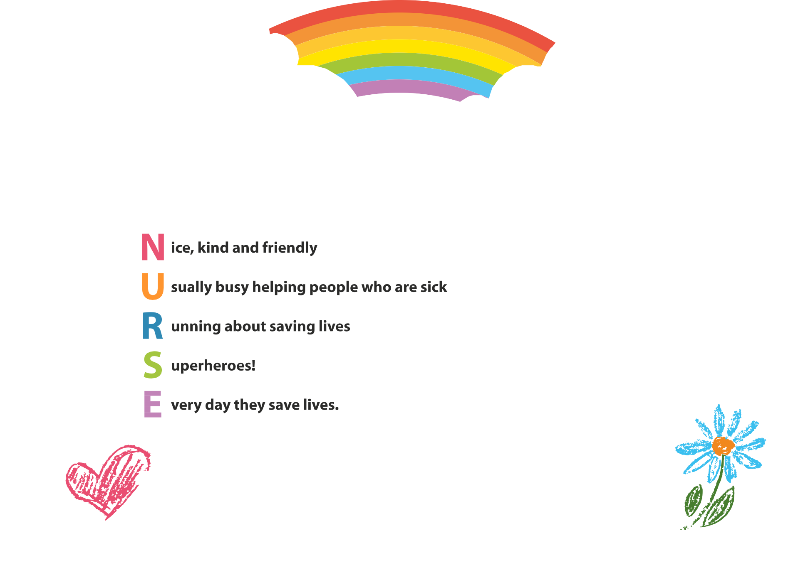
Here are two acrostic examples:
J
is for Jared
A is for awesome _{R} is for respectful _{E} is for excellent _{D} is for daredevil.

Slide 10
Draw your picture in the box.
Fill in the other boxes.
Then write your acrostic on the back of the worksheet.
Write your name and age on the back of the worksheet too!

Slide 11
We hope you enjoyed writing your acrostic today!
www.youngwriters.co.uk

