Slide 1

What do kindness and coping mean?
Kindness and coping
Learn activity
Kindness and coping
Learn

Slide 2

Kindness.
Kindness and coping
Learn activity
Kindness means: thinking about others and their feelings, and being generous and helpful.

Slide 3

Coping.
Kindness and coping
Learn activity
Coping means: when something difficult happens, I can make the best of things.

Slide 4


Kindness and coping
Learn activity
Does coping mean…?
Dealing well with a difficult situation
b) Not knowing what to do
c) Not helping
The correct answer is…
a) Dealing well with a difficult situation

Slide 5
Kindness and coping
Learn activity
Coping well with a difficult situation means…
Running around and shouting
b) Breathing deeply and doing what you can to help
c) Leaving quickly
The correct answer is…
b) Breathing deeply and doing what you can to help

Slide 6



Kindness and coping
Learn activity
Can you think of things that might help you to cope in a difficult situation?

Slide 7

Kindness and coping
Learn activity
Can you think of an example when you or someone else did something kind?

Slide 8


Kindness and coping
Learn activity
Do you think kindness can help people to cope with difficult situations? Is it important in first aid?

Slide 9
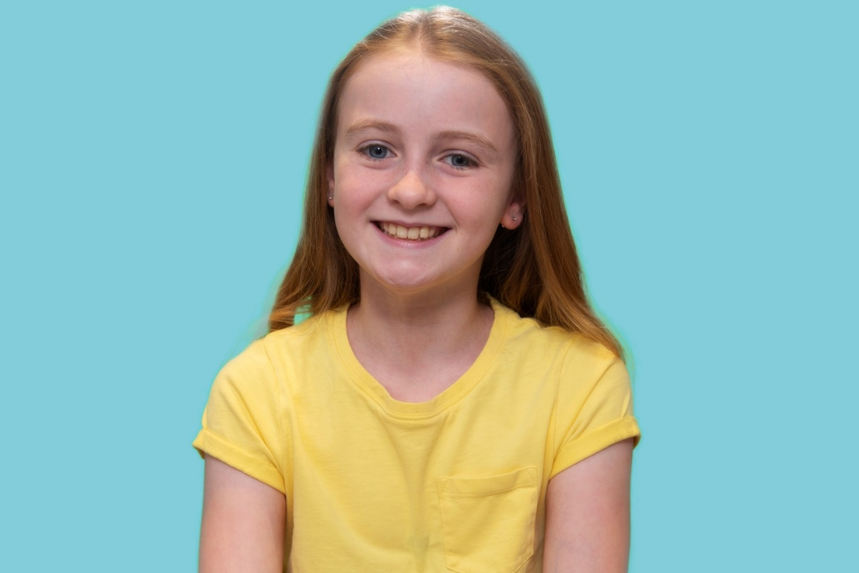
Kindness and coping
Learn activity
Being Kind
“Hi, I’m Georgia, it’s very easy to get lost in our own thoughts and feelings and forget how others might be feeling. Kindness doesn’t cost anything and does so much good! By encouraging and supporting others to try something new or to get through difficult times, we can feel safer and happier together. Be kind and stay safe!”
Click on Georgia’s photo to watch the film
What could you do to be kind to others?

Slide 10
Kindness and Coping
Learn Activity
Consider the words:
Kindness Coping
Acrostic poem ideas

Slide 11
Kindness and coping
Learn activity
Acrostic poem example
Red Cross helps those in need
Every day, lives are saved and minds are changed
Daily, we think about being kind and helping others
Can you think of how you could help?
Red Cross needs volunteers who can help others
One kind act can make all the difference
Share your kindness with people around you
So that you too can help others.

