Slide 1


Spot the danger.
Safety - practise

Slide 2
Go to the 360 photograph on the safety page.

Slide 3


Quiz.

Slide 4
The best way you can spot a danger is by ‘looking’ and which of these…?
a) Feeling
b) Talking
c) Listening

Slide 5
Why must you think about your safety when you help a person who is hurt?
a) I could get hurt too
b) They might not want help
c) My clothes might get dirty

Slide 6
If you help at an accident, you should first check if the area is what?
Quiet
Safe
Clean

Slide 7
Which of these is a danger in a house?
a) A cushion on a sofa
b) A t-shirt in a cupboard
c) A hot pan on a cooker

Slide 8
If you see a pile of toys left on the stairs, what should you do?
a) Play with them
b) Safely move them
c) Leave them

Slide 9
The correct answers are:
The best way you can spot a danger is by looking and which of these…? C) listening
Why must you think about your safety when you help a person who is hurt? A) I could get hurt too
If you help at an accident, you should first check if the area is what? B) safe
Which of these is a danger in a house? C) a hot pan on a cooker
If you see a pile of toys left on the stairs, what should you do? B) safely move them

Slide 10
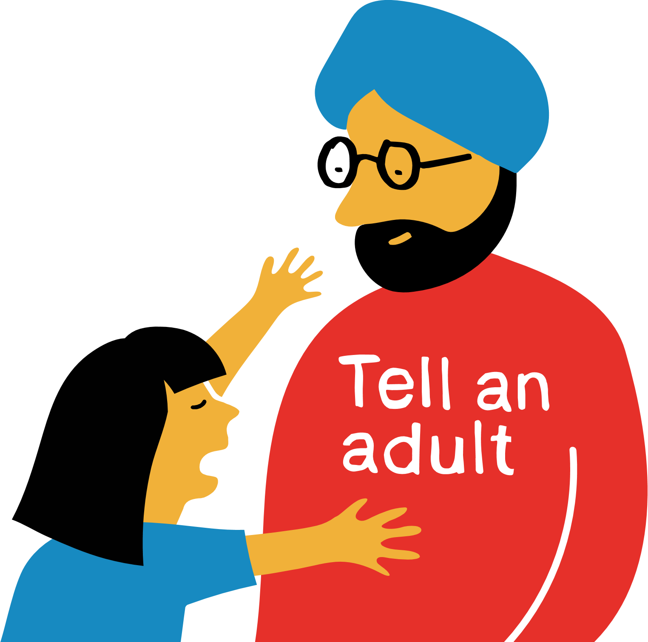
Now think about what you,
or a trusted adult,
could do to make the kitchen safer.
You could note your ideas down

Slide 11



Now you’ve learned about the dangers in the kitchen, think about what first aid skills you might use to help someone who has:
a burn
    bumped their head
          a cut that is bleeding a lot

Slide 12
Below is a list of the dangers in the 360 photo
Toaster – things that use electricity should not be near water as it could cause an electric shock. Bad electric shocks can cause burns or even make someone become unresponsive and stop breathing.
Hot pans – on the cooker should always have their handles turned safely away from where they can be knocked. Hot pans can lead to bad burns
Liquitabs – for washing clothes or dishes have very dangerous chemicals inside them. They are often brightly coloured, so they may look fun but they can cause burns or poisoning
Hot irons – can cause burns. They are also very heavy and can cause bumps and bruises if they fall on someone
Wires/trips – things lying on the floor like power cables could cause someone to trip over and fall. This could cause a nasty bump or even a broken bone.
Heavy objects that could fall – heavy things close to the edge of surface could fall and cause bad bumps and bruises.
Knives – should not be left out where young children could reach them. Accidents can lead to bad cuts and bleeding.
Cloths near hobs - tea towels and other items near a hob can catch fire. Fires can cause damage and burns.

