Slide 1


Sense Poetry

Slide 2

Today you are going to:
Learn about your senses
Learn about sense poems
Discuss your theme and offer opinions and suggestions in a group discussion
Plan, draft and write a poem

Slide 3
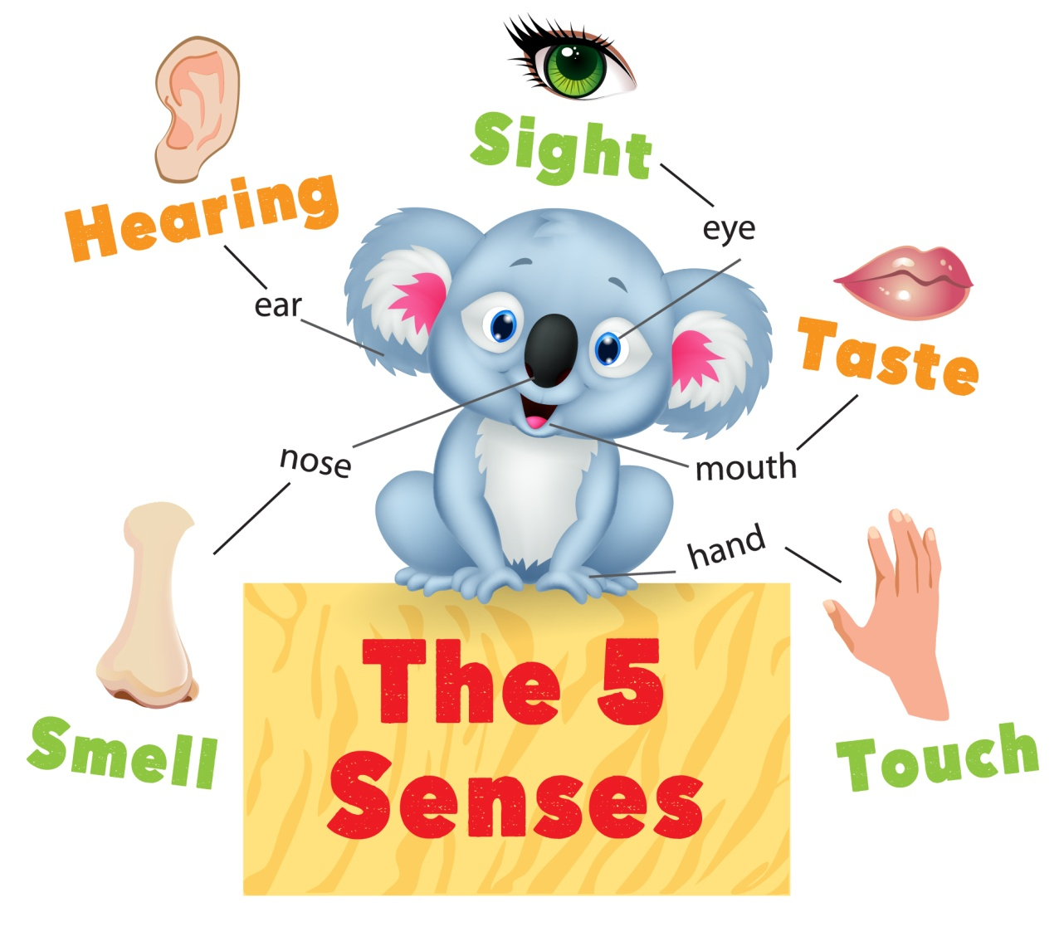
What are your senses?

Slide 4

What is a sense poem?
A sense poem can describe anything
using your 5 senses
A poem uses imaginative language to show feelings and ideas
Poems use poetic techniques, such as imagery, alliteration, rhyme and similes to help bring the words to life for the reader

Slide 5

How to write an animal sense poem
Remember to use all 5 senses
You can describe the animal how you like!
Use your imagination to create fun and interesting descriptions, like 'Polar bears taste like hot mints
with hair on!'
If you write a simple line, like,
‘Bears feel cuddly - think how you
can make this more interesting,
close your eyes and imagine cuddling
a bear ... ‘Bears feel
cuddly, soft and warm, just like I feel
in my bed.’

Slide 6
Example 1
You can write a
sense poem about any animal...
My Polar Bear Poem
Polar bears smell of snow and ice,
all cold and fresh.
Polar bears look fluffy but they are fierce!
Polar bears sound like... Roar, growl, splash!
Polar bears feel cuddly, soft and warm,
just like I feel in my bed.
Polar bears taste like hot mints with hair on!

Slide 7
Example 2
Dragon Sense Poem
Dragons smell smoky, like a crackling bonfire
Dragons look like giant, fire-breathing monsters
Dragons sound like a puffing steam train
Dragons feel all rough and scaly, like a roof
Dragons taste of burnt barbecue!

Slide 8
Example 3
My Pet Sense Poem
Buddy smells like mud, sweat and just stinky!
Buddy looks kind, his eyes are happy and friendly.
Buddy sounds like a very noisy party with fireworks.
Buddy feels like velvet, all soft and cuddly.
Buddy would taste like sausages and ham,
his favourite snacks.
I love Buddy, my dog!

Slide 9
Write a sense poem as a class
Pick an animal in your classroom to write about.
Remember to:
Use all 5 senses
Use your imagination
Use description
Try a poetic technique
Be original
Enjoy writing it!

Slide 10
Reviewing
your class poem
Can you change any of the lines to make them more interesting?
Have you used any poetic techniques?
Do you have a favourite line? Why?

Slide 11
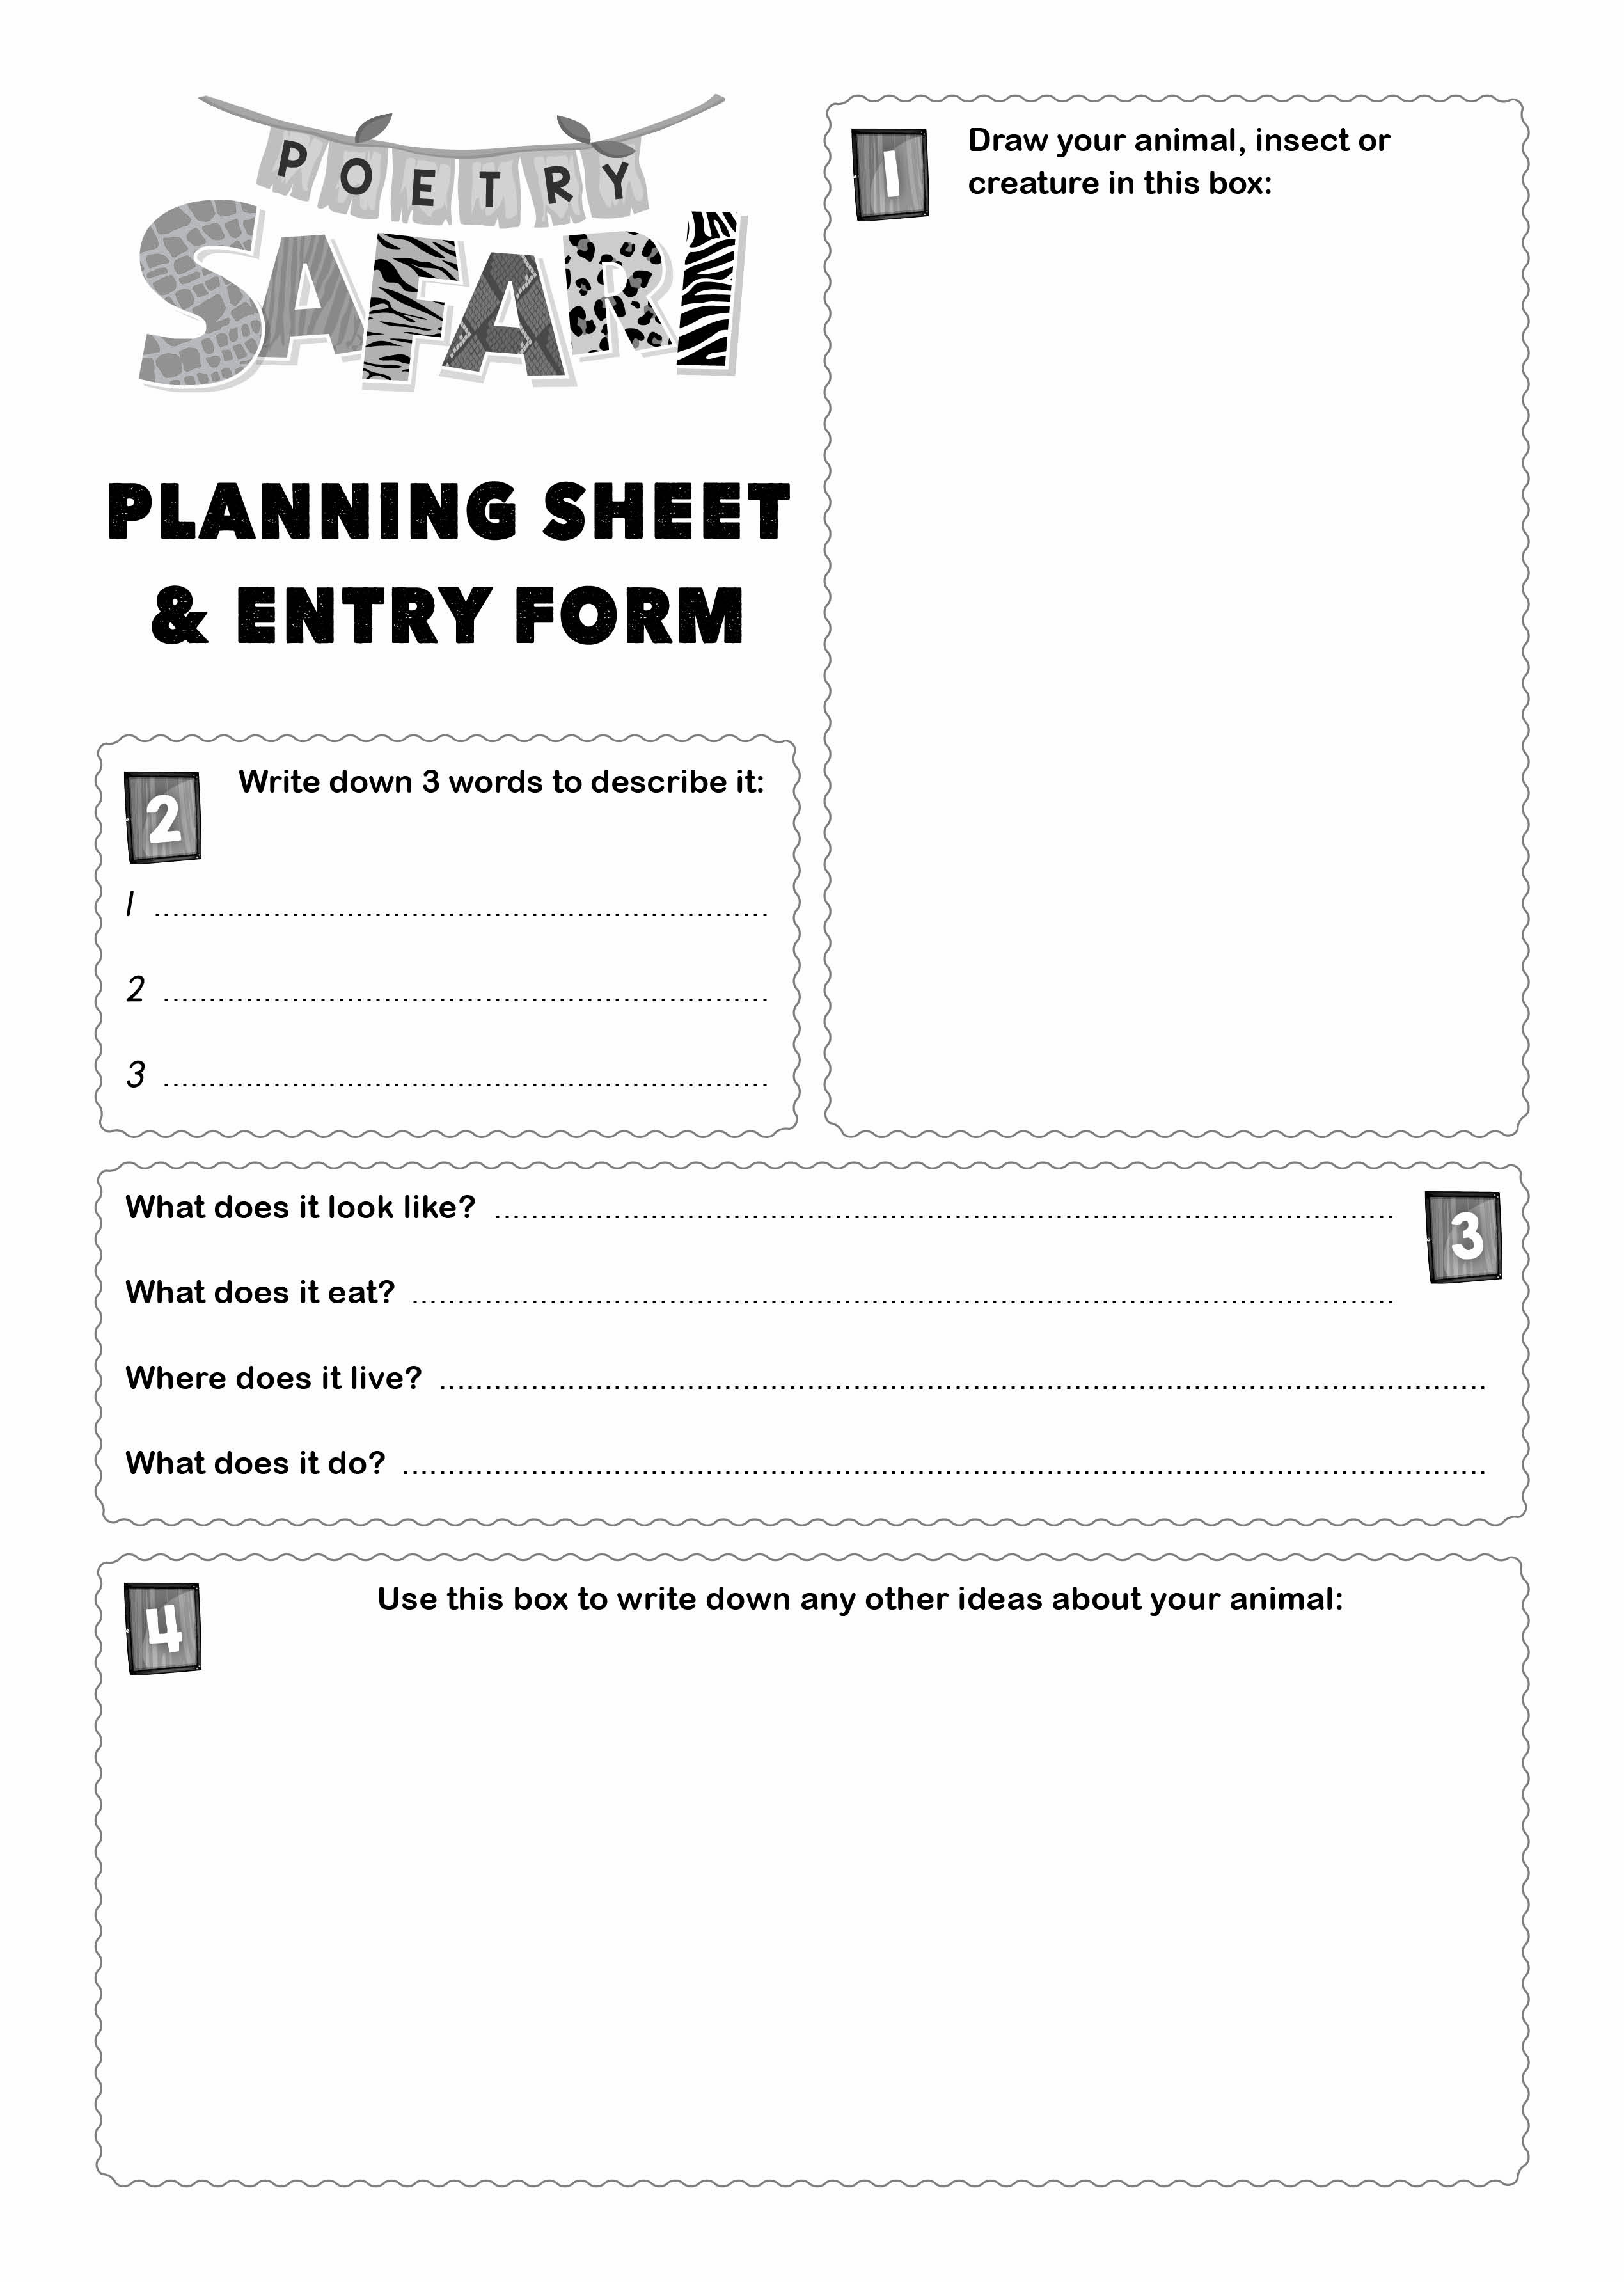
Now it is time to write
your own animal poem!
Fill in the planning sheet
Draw or write things that describe
your animal
Turn the sheet over and
write your poem
Write something for each sense
Write your name and age
Don't fill in any other details on the
entry form, unless your teacher tells
you to!

Slide 12

Once you've written
your animal sense poem...
Work with a partner
Read your poem to them
Your partner is to give feedback; something they liked about your poem and a suggestion on how to improve it
You then listen to your partner’s poem and give them feedback

Slide 13
We hope you have enjoyed writing an animal sense poem for 'Poetry Safari’
www.youngwriters.co.uk

