Slide 1


Riddle

Slide 2

Today you are going to:
Learn what a riddle is
Write descriptively about an animal
Expand vocabulary
Plan, draft and write a poem for 'Poetry Safari'

Slide 3

What is a riddle?
A riddle is a type of poem that describes something without actually naming what
it is, leaving the reader to guess
Riddles can be written on any theme (but for 'Poetry Safari' the theme is animals!)

Slide 4

How to write a riddle
You have to describe the animal as other things, such as:
a colour
a person
a food
a season
a feeling
a place

Slide 5

Planning your riddle
You can write about any animal you like:
your pet
a pet you wish you had
a wild animal
a mythical creature
a crazy creature from your imagination
Or your teacher may give you
an animal to write about.

Slide 6
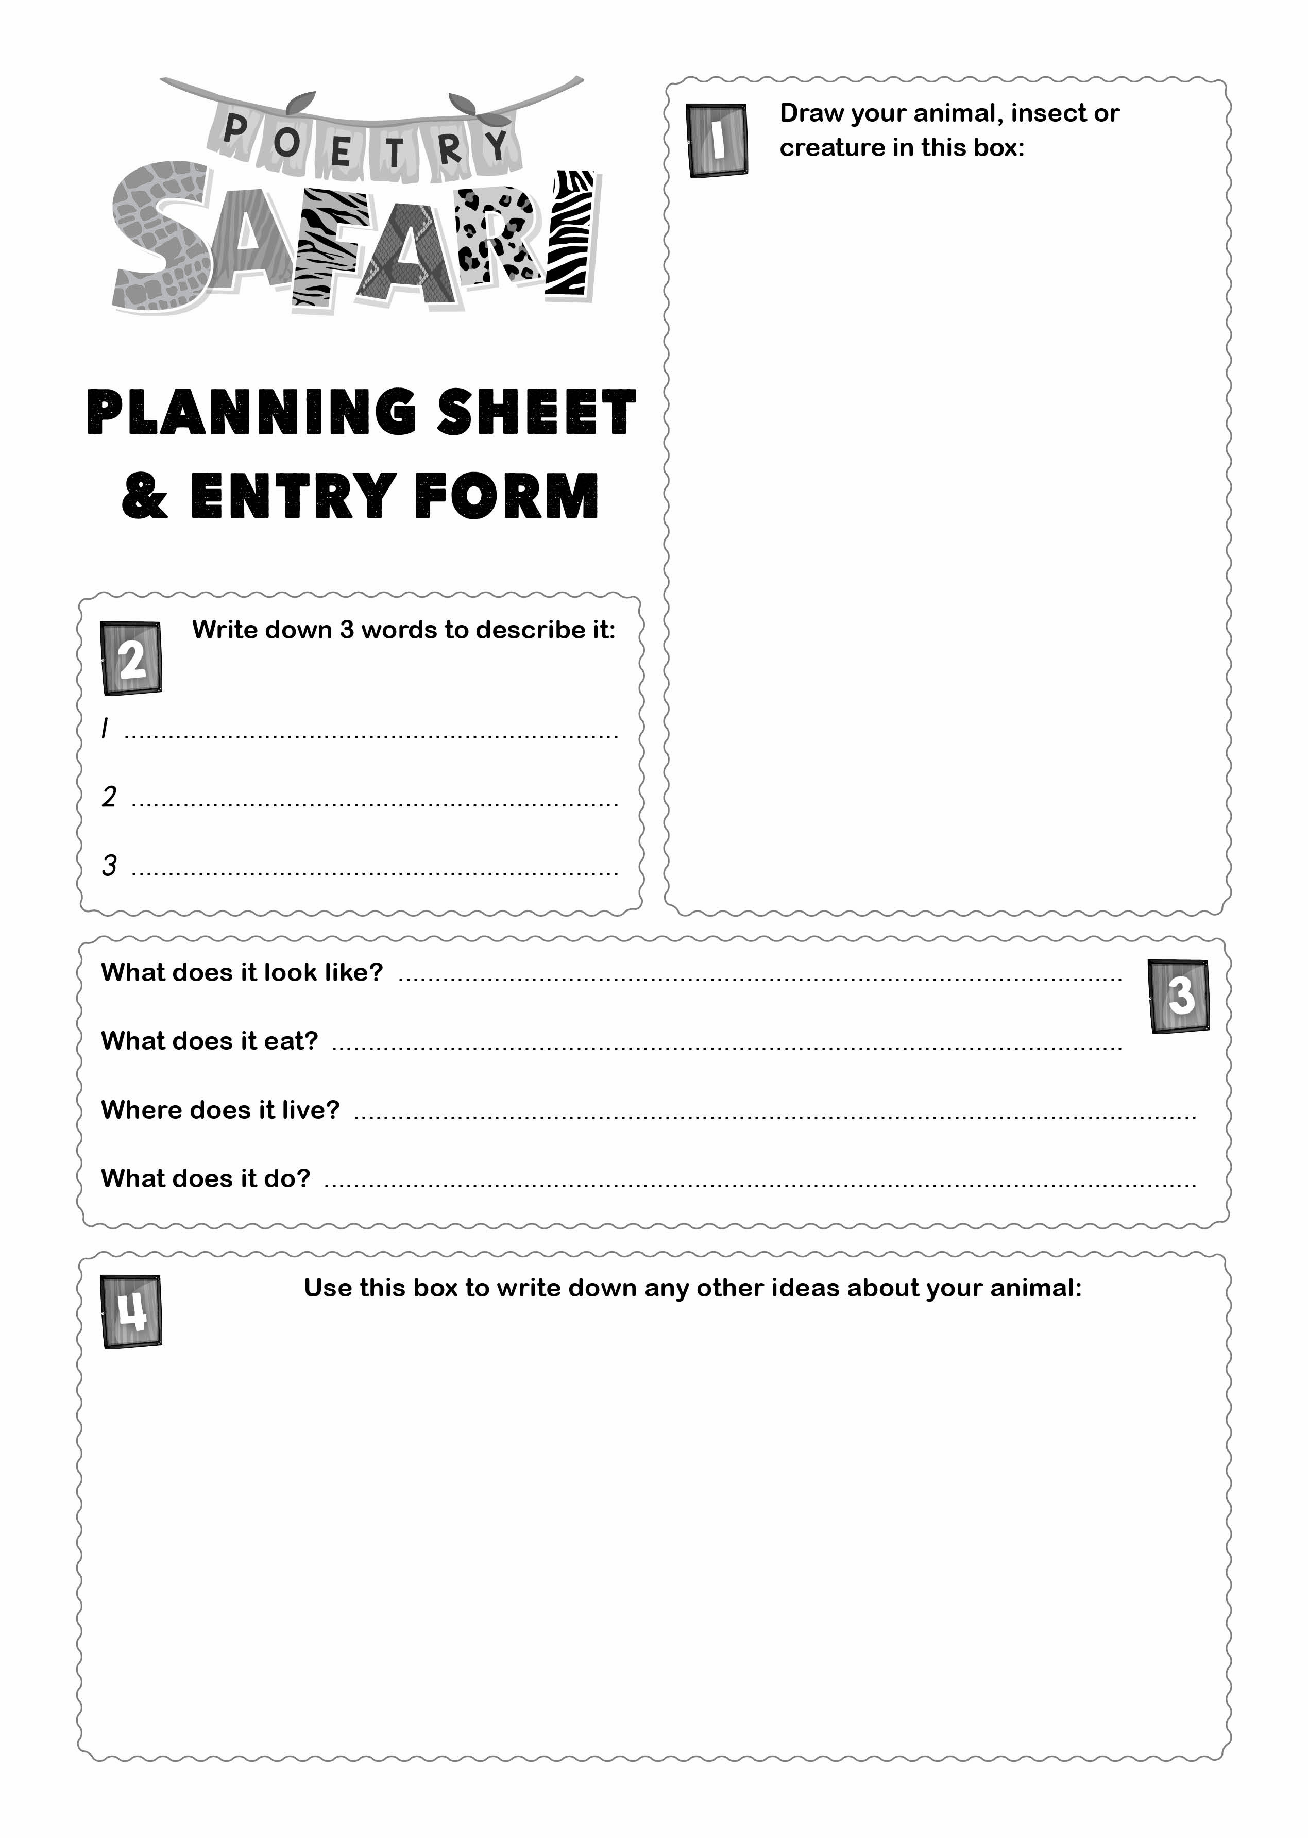
Draw what you are going to write your riddle about on your planning sheet
In box 4 write down any adjectives and descriptions of your animal

Slide 7
Here are some riddle examples to help you get an idea of how to write one...
Example 1
He's as naughty as a gorilla,
He's as sweet as a peach,
He's as cheeky as a monkey,
He's as cuddly as a teddy bear,
He's as cute as a flower...
He is Sam, my cat!
By Jonathan Alderman
Sawtry Infant School, Huntingdon

Slide 8
Example 2
It's as big as an elephant,
It's as scary as a dinosaur,
It's as dangerous as a bear,
It's as endangered as a white rhino,
It's as amazing as a science museum,
It's a Komodo Dragon!
By Charlie Spencer
Sawtry Infant School, Huntingdon

Slide 9
Example 3
Rainbows beam out of her,
She is shimmery like a heatwave,
She is as magic as Harry Potter,
Her horn looks like a wonderful helter-skelter,
She is as kind as my grandma,
She is as cool as winter
She makes me feel so happy!
It's a beautiful unicorn!
By Lilly (7)

Slide 10
You will now write a class riddle.
This is so you can practise writing a riddle before you write your own!
Talk about how you can describe the animal and your teacher will write down your ideas...

Slide 11
What a fantastic riddle, well done!
You are now ready
to complete
your planning
sheet and write
your own animal
riddle!

Slide 12
Feedback time!
Work with a partner
Read your poem to them
Your partner is to give you feedback; something they liked about your poem and a suggestion on how to improve it
You then listen to your partner’s poem and give them feedback
Make any changes to your work before handing your work to your teacher.

Slide 13
We hope you have enjoyed writing a poem today!
www.youngwriters.co.uk

