Slide 1


Acrostic

Slide 2

Today you are going to:
Learn what an acrostic is
Write descriptively about an animal
Expand vocabulary
Plan, draft and write a poem for 'Poetry Safari'

Slide 3

What is an acrostic?
It's a type of poem where the first letters spell out a word
Acrostics can be written using any word (but for Poetry Safari the theme is animals!)

Slide 4

How to write an acrostic
You can use:
what they look like
what they are like
colours
things associated with that animal
what the animal
likes to do (or what
you think it likes
to do!)

Slide 5
Planning your acrostic
Your teacher is going to write the name of an animal on the board and together you are going to write an acrostic as a class.
Firstly, when your teacher tells you to, you need to say words that begin with each letter that describes the animal...

Slide 6

Now you need to write a descriptive sentence that includes each word you’ve chosen.
Work together as a class to create your animal acrostic.
  C ats’ claws are as sharp as knives
  A mazing little kitty purrs all the time
  T ortoiseshell means my cat is a mix of lovely colours!

Slide 7

Your acrostic is great! Well done!
Your teacher will now pick another animal for you to write a final class acrostic.
This time you can try letting sentences run over to the next line...
  C at's claws are as sharp as knives
  A nd the amazing cat purrs all the time. He's a
  T ortoiseshell cat, that means his fur is a
  mix of lovely colours!

Slide 8
Before you write your own acrostic, have a look at these examples to help inspire you!
Example 1
  L azy in the day
  I ncredible creature
  O range-coloured fur
  N ow out hunting.

Slide 9
Example 2 (uses more description)
  R is for Rocky, my handsome dog
  O is for obedient, he's a good boy
  C is for cheeky!
  K is for king, he rules our house!
  Y is for young, he's still a puppy.

Slide 10
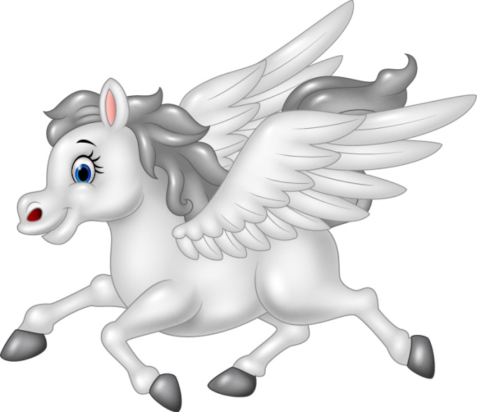
Example 3 (uses facts, description and
sentences run on to the next line)
  P egasus, the winged hose from Ancient Greece, as
  E legant and as white as snow, a caring creature of peace. Many
  G ods and goddesses admired him, the muses were inspired by him. One day
  A hero named Bellerophon captured this magical
  S teed, and used him in his attacks,
  U ntil the day he grew too bold and fell off Pegasus' back.
  S o Pegasus was free again to live with might Zeus, king of gods and men.

Slide 11
Feedback time!
Work with a partner
Read your poem to them
Your partner is to give feedback; something they liked about the poem and a suggestion on how to improve it
You then listen to your partner’s poem and give them feedback
Make any changes to your work before handing your work to your teacher

Slide 12
We hope you have enjoyed writing a poem today!
www.youngwriters.co.uk

