Slide 1
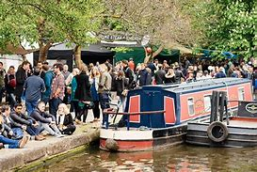
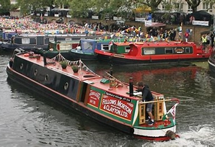
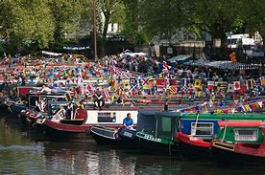
Canal Cavalcade 2024
May bank holiday weekend
IWA Canalway Cavalcade returns to London’s Little Venice on Saturday 4th May 2024 for the full early May Bank Holiday weekend. Each year we celebrate the best of life on the waterways in London and its community at IWA Canalway Cavalcade. Save Britain’s Waterways is the theme of the event this year

Slide 2
You are going to design your
Own Cavalcade art ,
Thousands of public visitors will see it

Slide 3
The theme is “Save Our Waterways.”

Slide 4
There are
Letters on your
Template
Together,
they spell
out the theme

Slide 5
1.Decorate the full page individually with
your chosen design
2.Decorate and colour the letters
on your template
3.Use your imagination and what you
see at the canal.
4.Your teachers will pick 2 winners each

Slide 6
All finished pieces will go on display
The public will see them all
All entries will be published online
You can sign your name if you like

Slide 7


