Slide 1
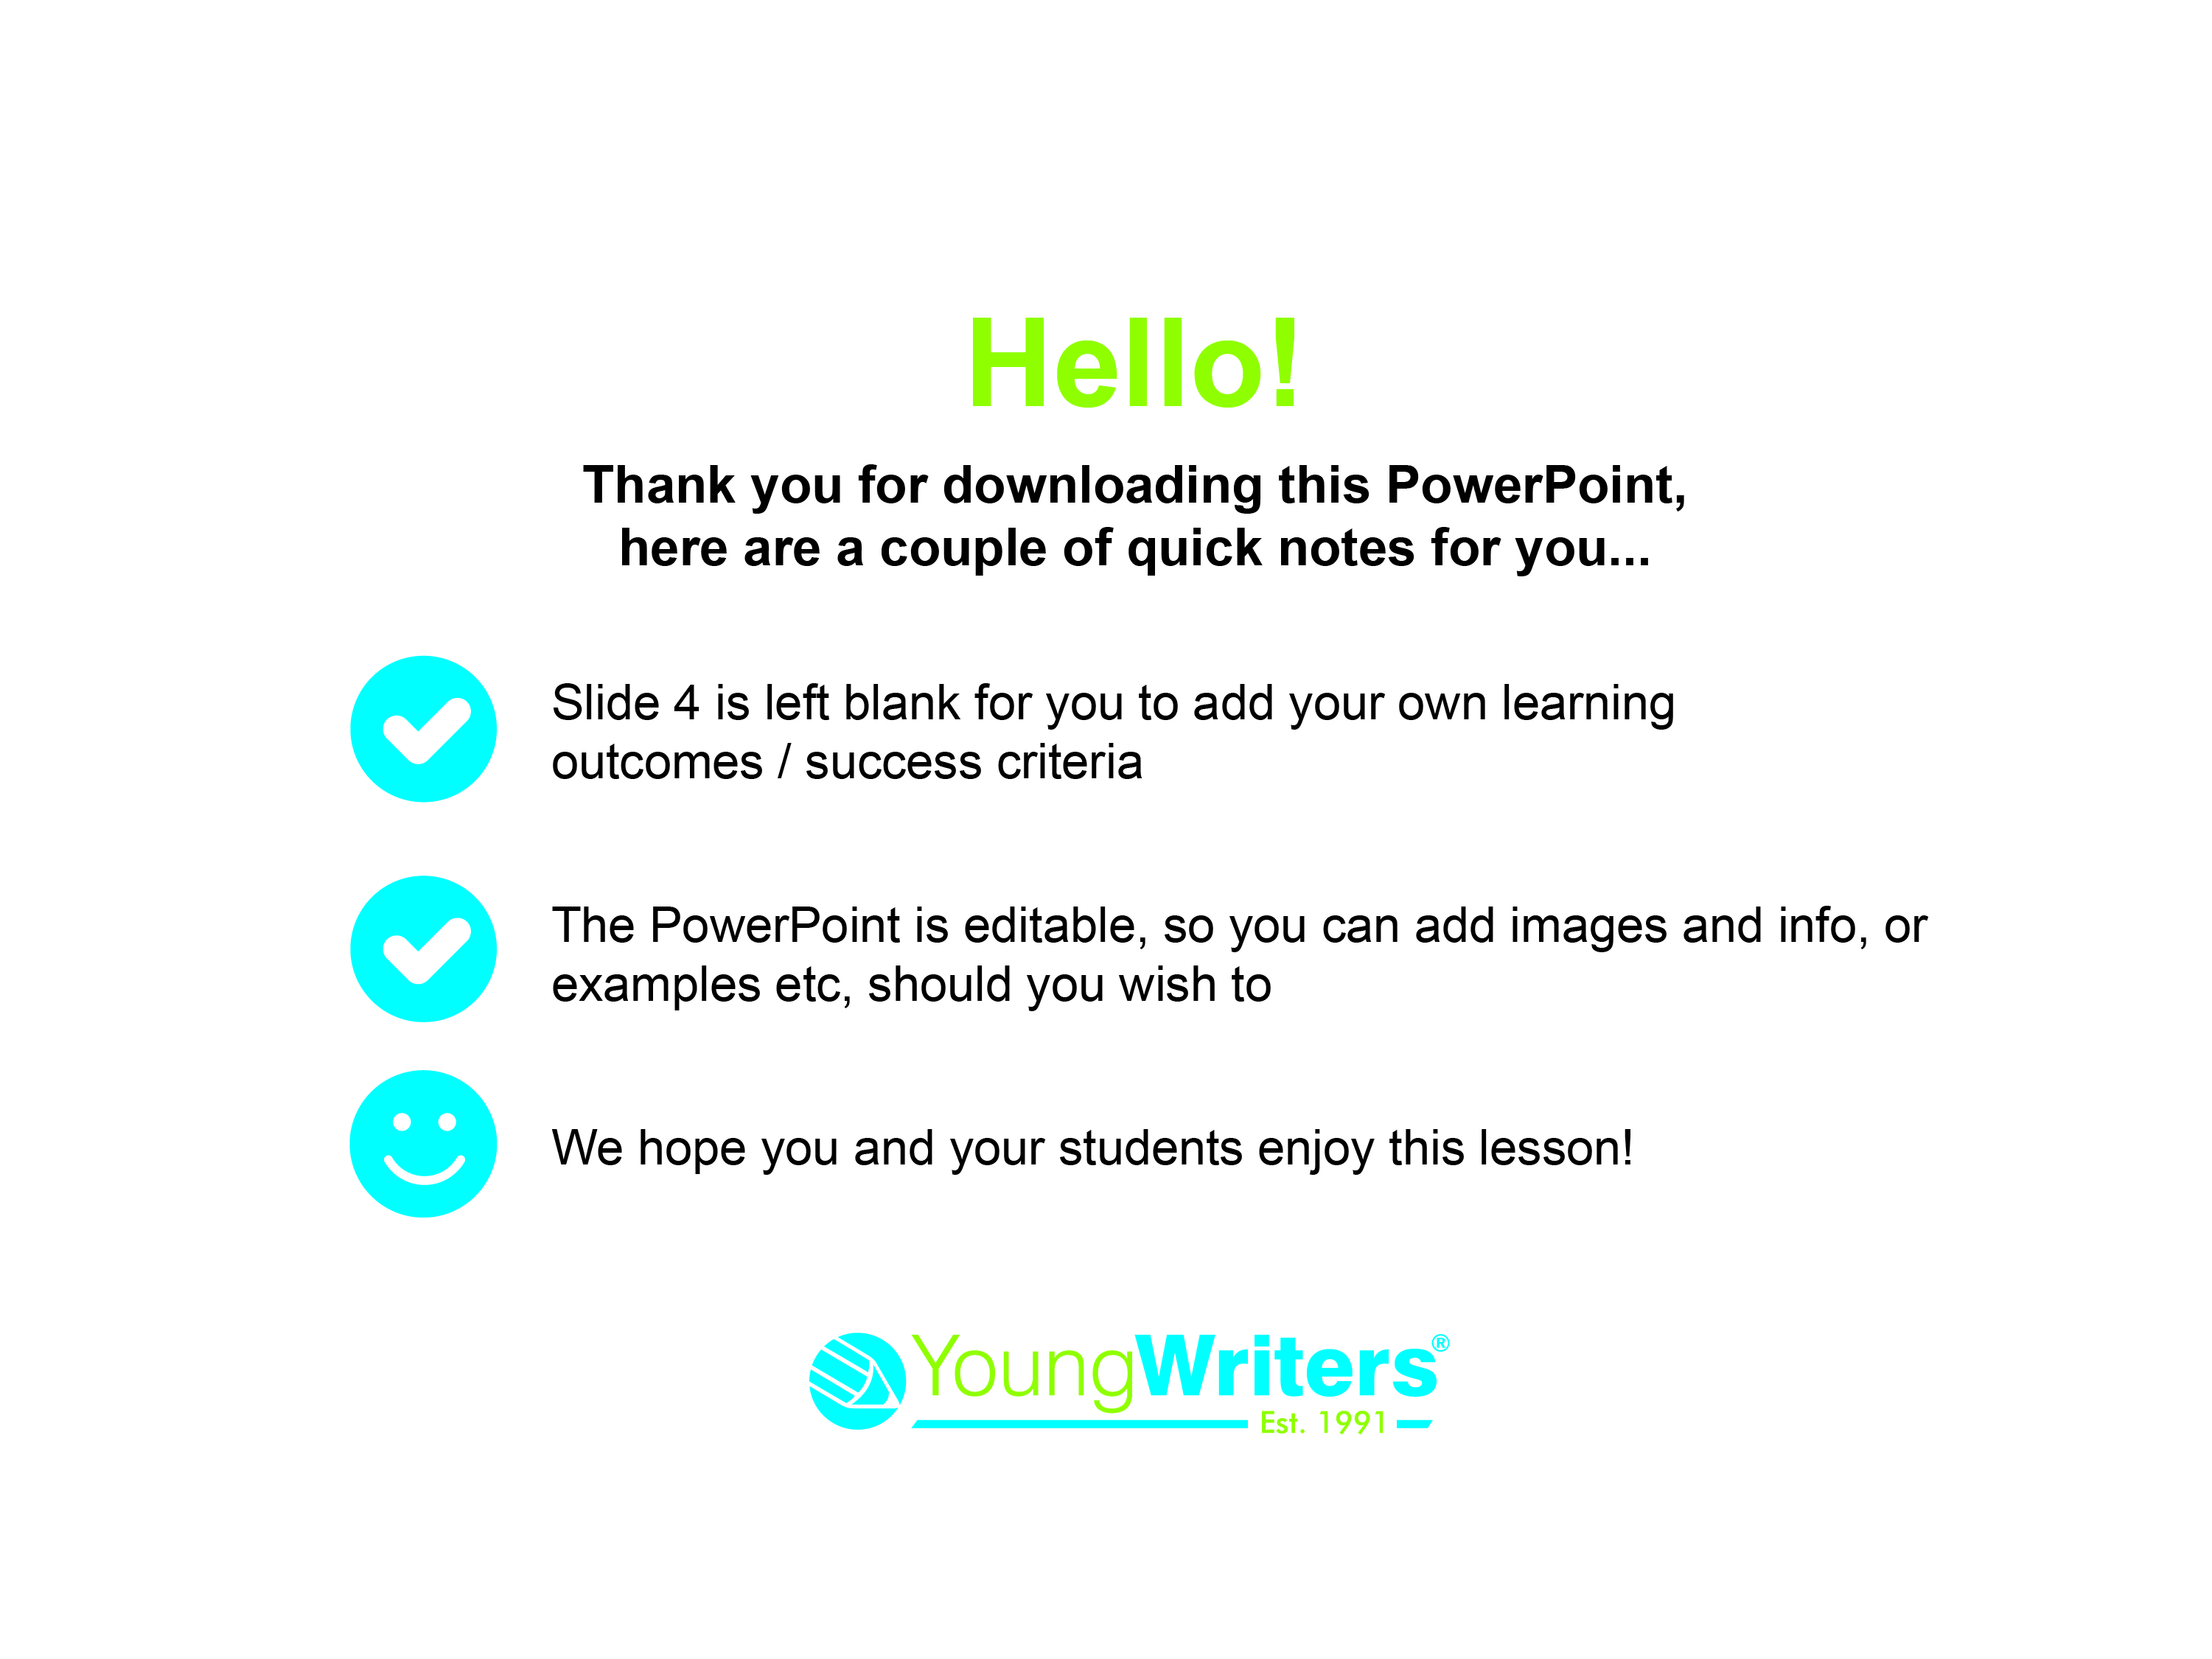

Slide 2


Slide 3


Today you are going to:
Learn about a style of writing called a ‘mini saga’
Learn how to write a diary entry
Use adjectives to add interest to your writing
Plan, draft and write a mini saga for ‘The Incredible Diary Of...’ creative writing competition
Have fun with creative writing!

Slide 4
Learning outcomes & success criteria for today’s lesson:

Slide 5
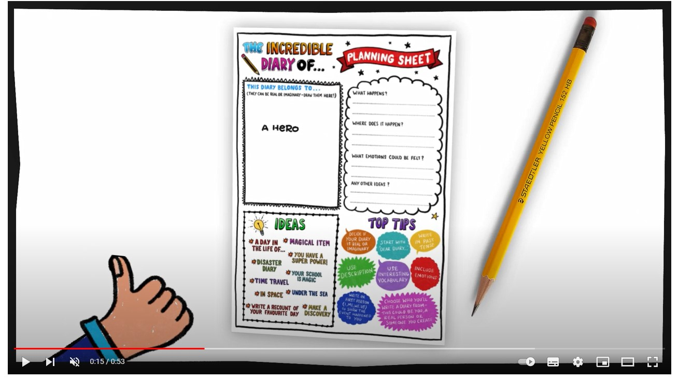
Firstly, you’re going to watch a video that introduces the activity:
https://youtu.be/bmUJzOGZkRw
Notes:
https://youtu.be/bmUJzOGZkRw

Slide 6
What is a diary?
A diary entry can be a recount of something you have done, an imaginary scenario or a mix of both!
Diaries are written in past tense, about something that has already happened (whether it’s real or imaginary!)
Diaries must use personal pronouns e.g. I / we etc
Diaries are written in chronological order
Diaries are written in chatty, informal (colloquial) language
Diaries are descriptive and show feelings/emotion, thoughts and/or opinions
You can be as original and as creative as you like in 100 words!

Slide 7
You’ll now read two different diary extracts,
one is real and one is imaginary.
Discuss the difference between the real diary entry and the imaginary one.

Slide 8
You’ll now be split into groups and be given an item to write a short paragraph from the object’s point of view.
You can write a real diary event or a fictional one.
If you choose to write about a real event, consider how you can make the entry exciting to read – think about the language, tone and format.
E.g. If your item was a pen, the pen could be chewed by a child, dropped on the floor and roll under the trays, then do some writing. Or if you opt for an imaginary day the pen could belong to a spy and go on a thrilling adventure!

Slide 9

Take it in turn to read your entry to the rest of their group.
Discuss and agree on the best sentence in each entry’s paragraph and highlight it.

Slide 10
As a class, discuss who or what would make a great
subject to write about.
No idea is wrong, too weird or too wonderful!
From a leaf or a unicorn to a wizard or an inventor, let your imagination run riot!

Slide 11
Top 5 Diary Tips!
Here are the 5 key points that you need to remember when writing your diary:
Diaries are written in past tense, about something that has already happened (whether it’s real or imaginary!)
Diaries must use personal pronouns e.g. I / we etc
Diaries are written in chronological order
Diaries are written in chatty, informal (colloquial) language
Diaries are descriptive and show feelings/emotion, thoughts and/or opinions

Slide 12
It’s Peer Assessment Time!
Work with a partner
Read your diary entry to them. They will provide you with feedback; something they like and something that can be improved
You need to then do the same for them
Edit your work as necessary
Include your name and age on your entry form before handing it to your teacher

Slide 13


