Slide 1

Amazing Mazes
A maze is a puzzle with twists and turns, where you try to find a path from the entrance to the exit without hitting dead ends. You can walk through a maze, or let your pencil do the walking. The goal of a maze is to get through it, which means going the wrong way, retracing your steps, and choosing different paths.

Slide 2
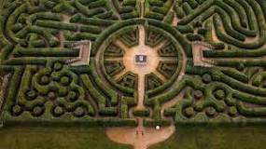
Ancient Mazes
The earliest known garden mazes were constructed by the ancient Egyptians around 2500 BC. These mazes were typically made of reeds and were used in religious rituals. The ancient Greeks also had a tradition of creating labyrinths, which were often built as part of larger temples or shrines.

Slide 3
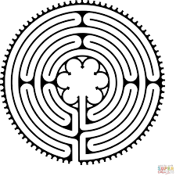
Are mazes useful today?
Mazes help students develop problem-solving skills
Mazes are the perfect tool for helping students learn how to break down a problem into smaller pieces and then find a solution.
When students are solving a maze, they need to constantly think about their next move and how it will get them closer to the exit.
Use your finger to work your way through this famous maze.

Slide 4
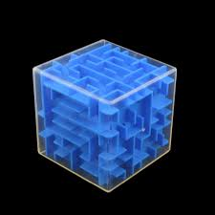
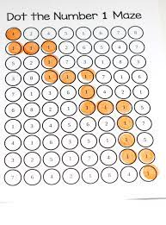
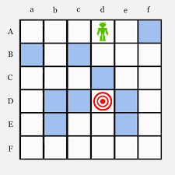
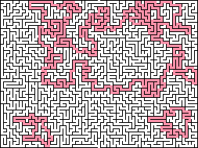
Types of maze
There are many different types of Maze:
Standard maze: Find a path from and back to the star.
Circular maze type: Find a route to the centre of the maze.
Loops and traps maze: Follow the arrows from and back to the star.
Block maze: Fill in four blocks to make a road connecting the stars. No diagonals.
Number maze: Begin and end at the star.

Slide 5
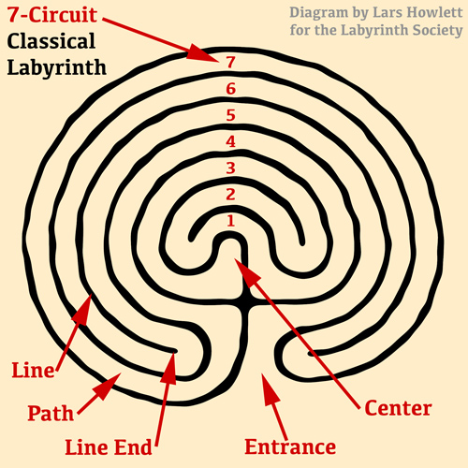
Labyrinths and Mazes
The word “maze” dates from the 13th century and comes from the Middle English word mæs, denoting delirium or delusion. The word “labyrinth” may date as far back as the 14th century, and derives from the Latin labyrinthus and the Greek labýrinthos, or, a building with intricate passages

Slide 6
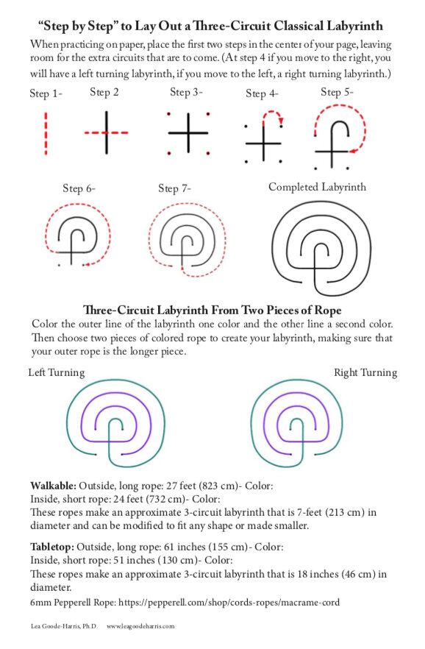
Drawing a Labyrinth

Slide 7
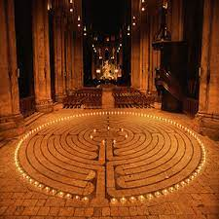
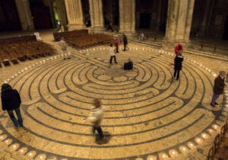
Chartres Labyrinth-France
Exeter Cathedral Labyrinth

Slide 8
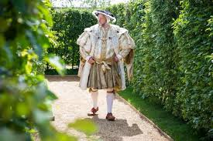
The oldest, existing hedge-maze
What is the oldest maze?
Hedge maze
The oldest surviving puzzle hedge maze, at Hampton Court Palace in Surrey, England, was built for King William in the late 17th century. Its distinctive trapezoidal shape is due to pre-existing paths running alongside the maze.

Slide 9
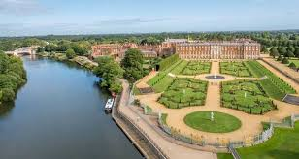
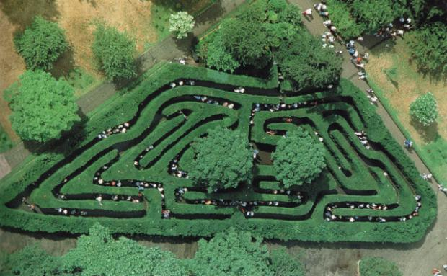
Hampton Court Maze-England

Slide 10
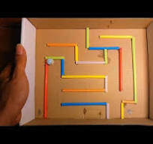
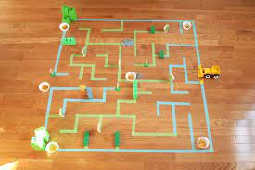
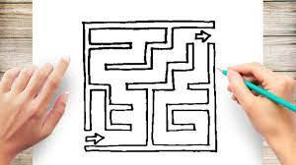
Design you own maze.
Use what you have learned about mazes
and labyrinths to design your own maze.

Slide 11
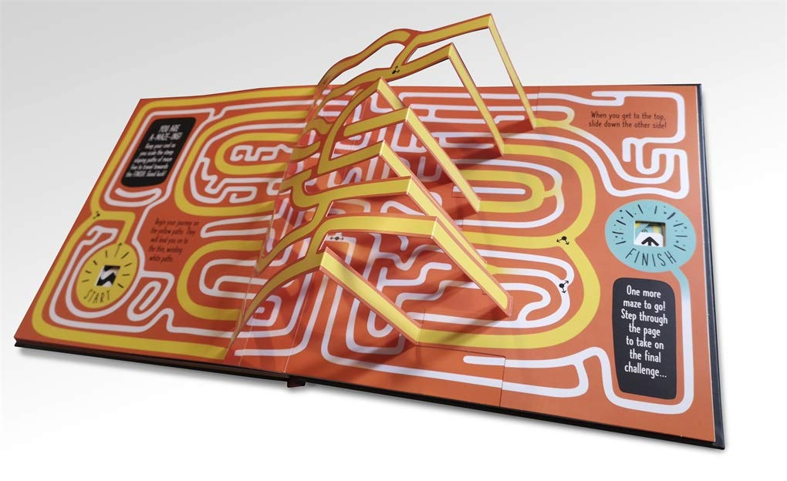

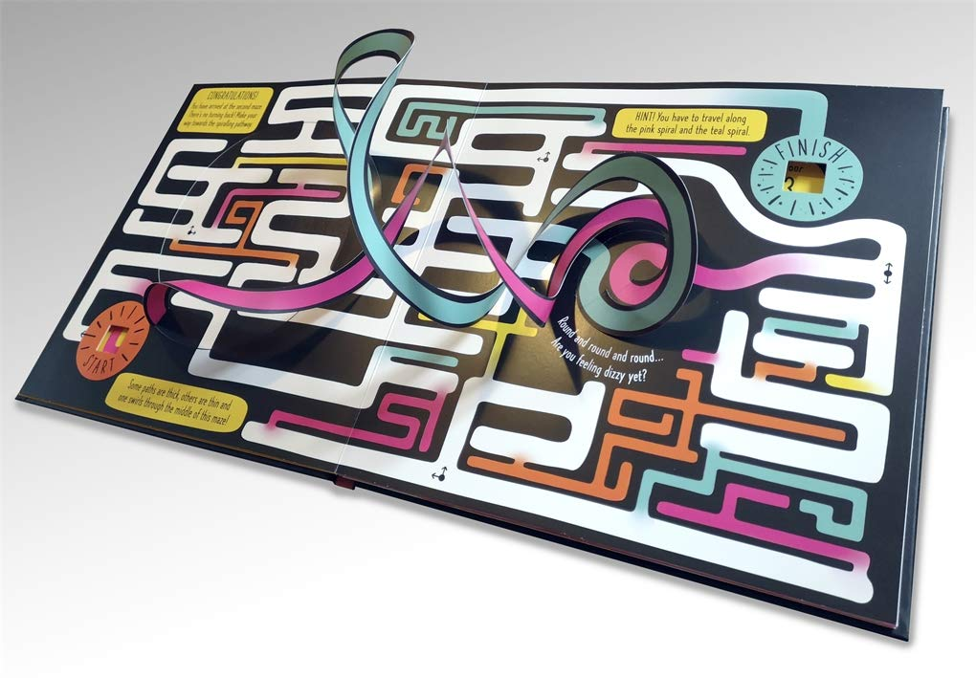
We will provide an amazing,
pop-up, maze-book for the winning entry
and can organize the winning
class free-entry to
Hampton Court Place this April

