Slide 1
Mindful Seeing
KS2
Lesson 5

Slide 2
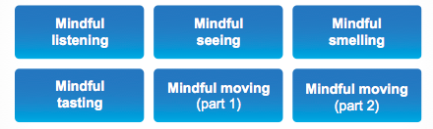
Unit 2 – Sharpening Your Senses
We have learnt about the Reticular Activating System (RAS) and know how mindful listening can help us to sharpen our focus
Now let’s look at mindful seeing
✔

Slide 3

Lesson 5
Mindful Seeing
Mindful seeing is looking at something closely, noticing precise and exact details.
In this lesson we will practice looking at something,
and really seeing all the detail.

Slide 4

Review prior learning
Mindful Seeing
How do you think mindful seeing can help us?
Can you think of a time when mindfully looking at something in detail has been helpful for you?
Other?

Slide 5
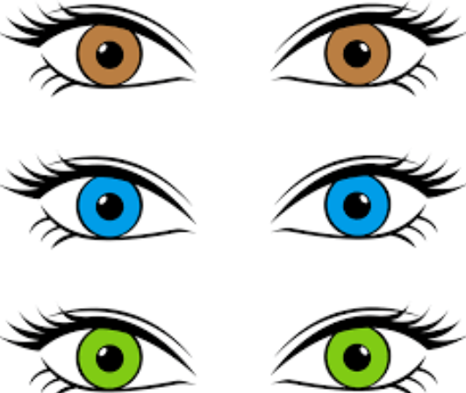
Lesson background
Why – Mindful Seeing?
Mindful seeing helps us focus by using our sense of sight to carefully study an object, or really notice details of the people and environment around us
How can it help with learning?
How about keeping us safe?
Refer to P.60

Slide 6
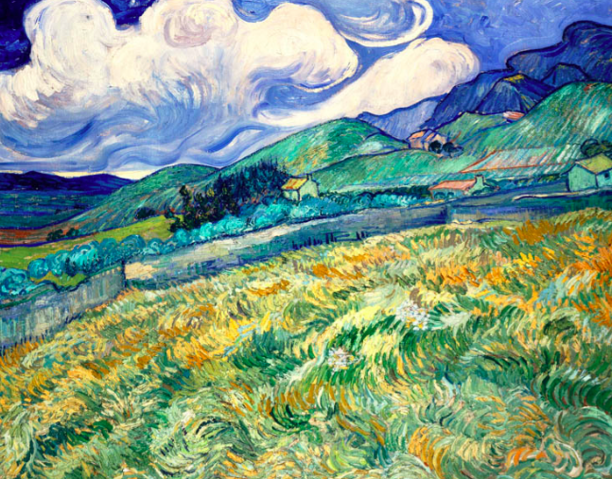

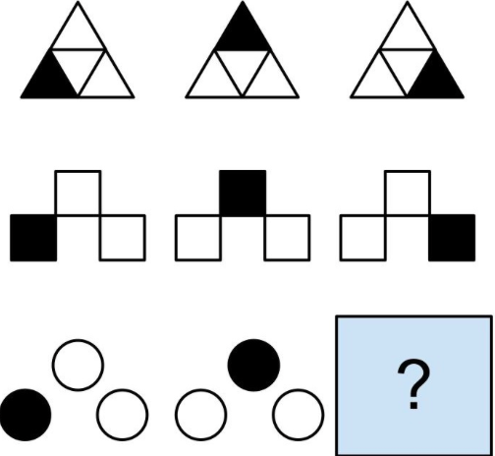
Lesson background
Why – Mindful Seeing?
Brushstrokes in art
Doing
science experiments
Maths
problems
Other?
Refer to P.60

Slide 7

Brain research
Brain Research
Using any of our senses in a mindful way, helps us to keep our focus in our PFC and helps to keep our amygdala calm.
Practising mindful seeing helps us to get better at using our RAS to focus on one thing. This helps us strengthen our neural pathways to being mindful and focused, and to be able to pay closer attention to things around us
Refer to P.61

Slide 8
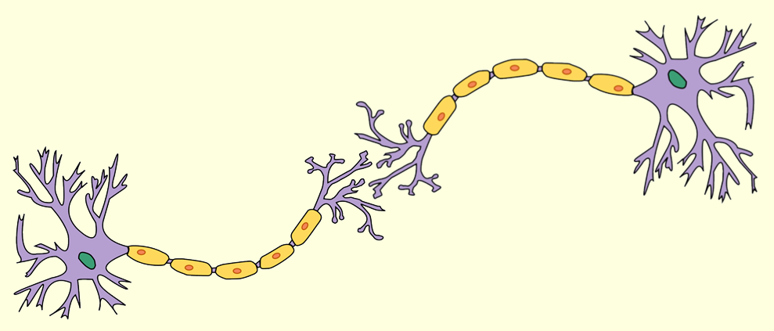
Brain research
Mindful Seeing
and Neuroplasticity
Let’s practise building our own neural pathways
using mindful seeing
Neurons connecting together
Refer to P.61

Slide 9
Our Learning/Main Activity
Use/adapt the ideas in lesson 5 to develop a main activity
There are a selection of activities on the following slides as examples or you can use the activity on P64-5
Refer to P.64-5

Slide 10
E.G
Our Learning/Main Activity
SPOT THE DIFFERENCE
There are 5 differences per picture.
Can you spot them all?
Refer to P.64-5

Slide 11



Slide 13



Slide 15
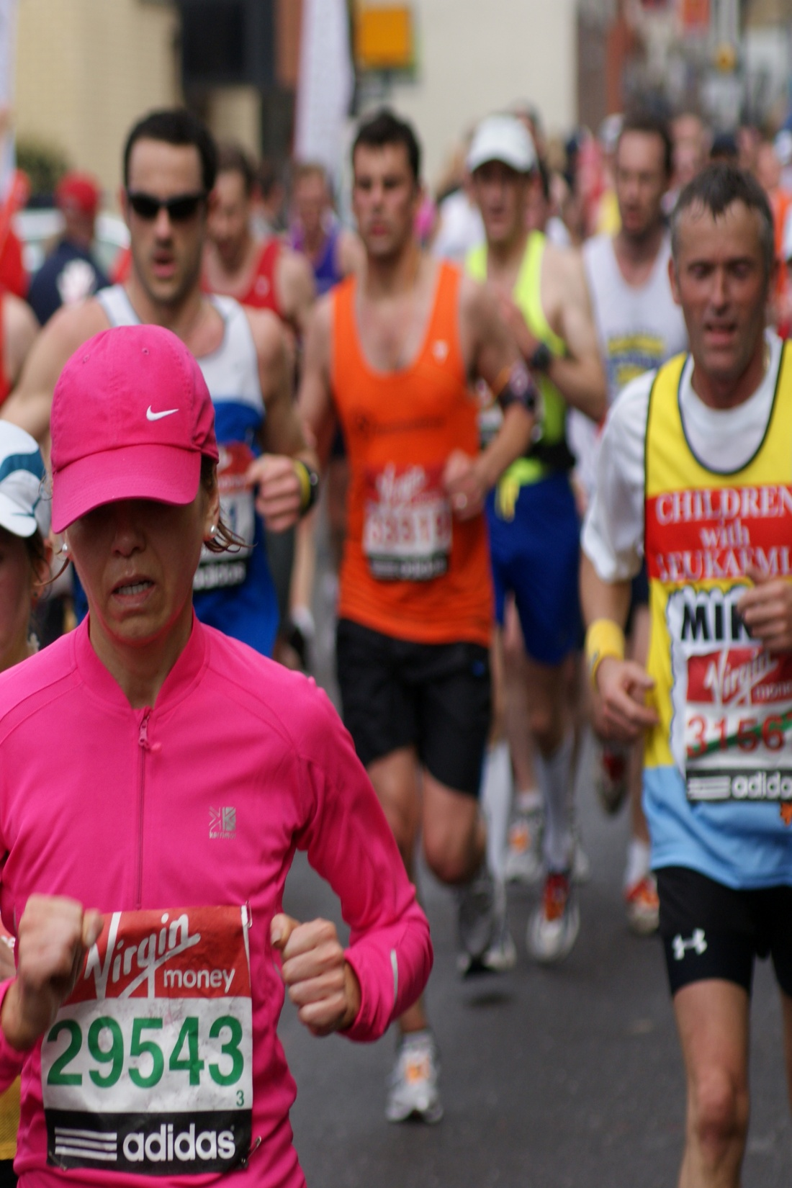
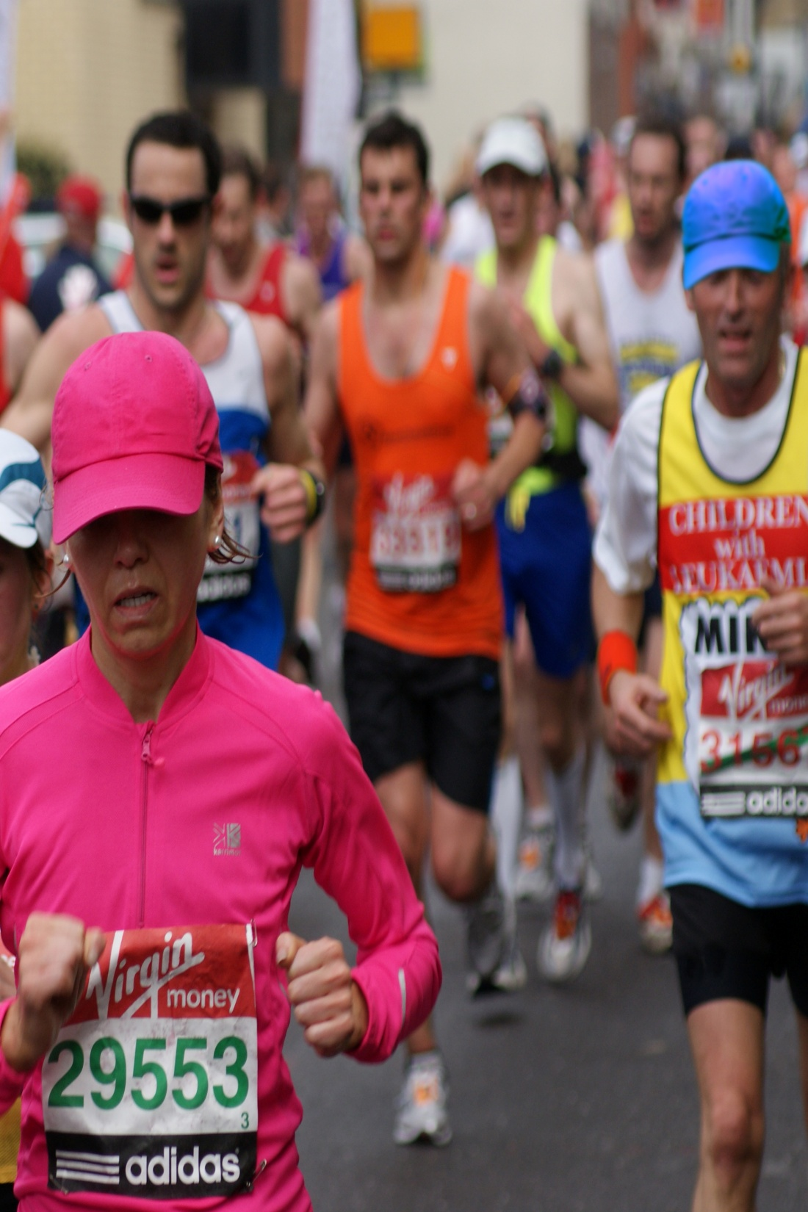

Slide 17
E.G
Our Learning/Main Activity
SPOT THE DIFFERENCE
In pairs, small group, make your own SPOT THE DIFFERENCE picture
Make sure people really have to look at the pictures in detail to find the difference
Refer to P.64-5

Slide 18
Reflect
This should refer back to the brain and explain how this is relevant to them in everyday life
WHY IS IT IMPORTANT TO KNOW/DO THIS?
Refer to P.65

Slide 19
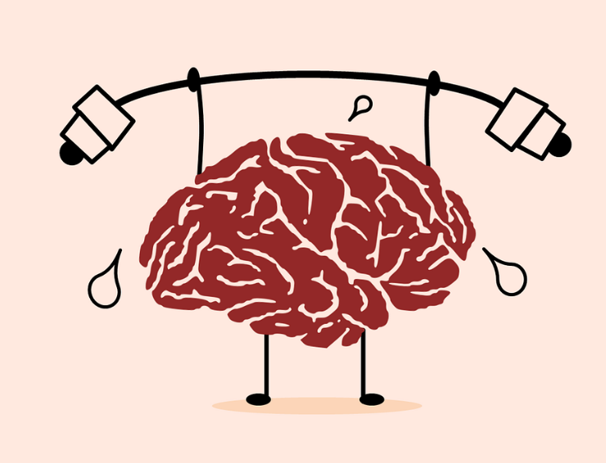
E.G
Reflect
Practising mindful seeing helps us train our RAS to be more effective, helping us to focus and concentrate on what we are doing.
Mindful seeing helps us learn and get better at keeping our focus in the PFC and calms our amygdala
Refer to P.65

