Slide 1
Mindful Listening
KS2
Lesson 4

Slide 2
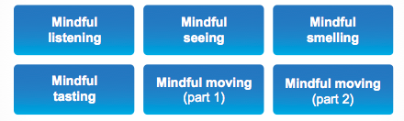
Unit 2 – Sharpening Your Senses
In these lessons you will learn how to focus your attention by concentrating on one sense at a time

Slide 3
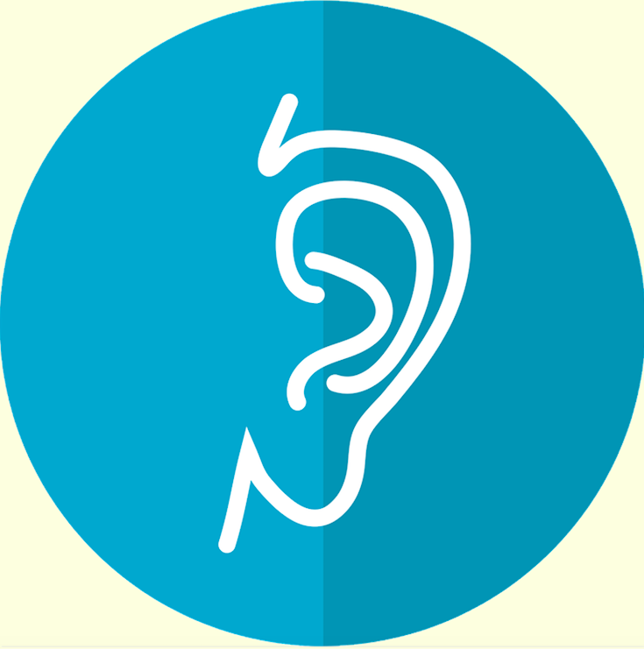
Lesson 4
Mindful Listening
In this lesson we will be focusing our attention on different sounds. We will practise really listening to the sounds to sharpen our focus. This practice helps us to be mindful in the way we hear and respond to others

Slide 4

Reviewing prior knowledge
Mindful Listening
How do you think listening mindfully can help us?
At home?
At school?
Other?

Slide 5

Lesson background
Why – Mindful Listening?
When we listen mindfully we become more focused and aware of the environment around us
By concentrating on specific sounds, we learn how to direct our attention to where it is needed. When there are lots of sounds, it is useful to be able to pick out and focus on just one at a time.
Refer to P.52-3

Slide 6
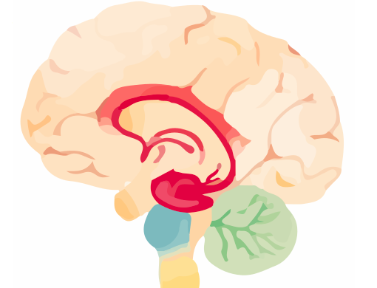
Brain research
What’s happening in our brain
when we listen mindfully?
The reticular activating system (RAS) is the brain’s sensory filter.
We get sensory information from the world around us all the time
(sounds, taste, touch)
The brain cannot process all this sensory information coming in all at once, so the RAS sorts and sifts the inputs so that we can make sense of some of the information and ignore other information we don’t need.
The RAS helps the brain to be focused and alert.
Refer to P.53

Slide 7
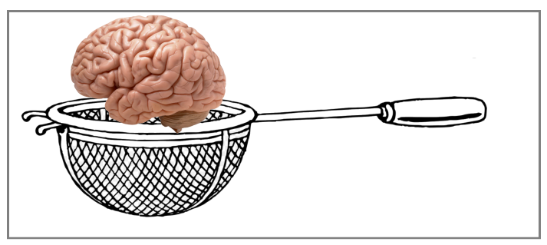
Brain Research
What’s happening in our brain
when we listen mindfully?
The RAS is like a sieve.
Can you think of some of the sounds that the RAS lets through that are useful for us to hear
at school?
outside all around us?
What are some of the sounds we don’t want to focus on at school?
Other?
Refer to P.53 to adapt

Slide 8
Our Learning/Main Activity
Use/adapt the ideas in lesson 4 to develop a main activity
Refer to P.56, P.154

Slide 9

E.G
Our Learning/Main Activity
Listen to/guess the sounds
(use/adapt ideas from guide)
Listen to the sounds as mindfully as you can?
What do you think the sounds are?
What parts of your brain are you using to listen to/recognise the sounds
You may choose to use an online sound game
Refer to P.56, P.154

Slide 10
Reflect
This should refer back to the brain and explain how this is relevant to them in everyday life
WHY IS IT IMPORTANT TO KNOW/DO THIS?
Refer to P.57

Slide 11
E.G
Reflect
Make a list on post it notes of ways you can stay focused
on listening in school.
When you find you are struggling to focus on one sound,
use the list to remind you of the strategies to help
Refer to P.57

