Slide 1
Focused Awareness
THE CORE PRACTICE
KS2
Lesson 3

Slide 2
Unit 1 - Getting Focused
By practising the Brain Break and other MindUP™ strategies, we can help ourselves to stay calm, make good choices and be a good learner
Lesson 1:
How Our Brains Work
Lesson 2:
Mindful or Unmindful
Lesson 3:
Focused Awareness
✔
✔

Slide 3
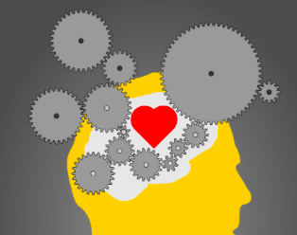
Lesson 3
Focused Awareness
THE CORE PRACTICE
Pause….Listen....Breathe
The Brain Break helps us to quiet our minds and get ready for learning

Slide 4
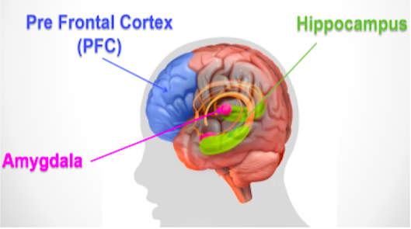
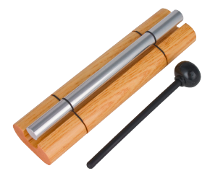
Lesson background
Why – Focused Awareness?
By focusing on the sound of a chime and then your breathing, you can calm your amygdala and get your PFC ready to
focus for learning.
The Core Practice helps us to self-regulate and be more mindful.
What do you think being able to self-regulate means?
Discuss
Refer to P.42-3

Slide 5

Brain research
Brain Research
Focusing on breathing helps to calm the body by:
slowing the heart rate
lowering blood pressure
sharpening focus
Focusing on your breathing helps you to manage times when you
feel stressed, anxious, worried or upset.
It helps you to think first with your PFC and plan a mindful response
Refer to P.42-3

Slide 6

Brain research
Neuroplasticity
Brain cells (neurons) make stronger connections when we practise a skill again and again.
This helps us to get better at that skill.
By practising the brain breaks three times a day, our brains become better at using mindful breathing when we need to
Refer to P.42-3
https://www.youtube.com/watch?v=ELpfYCZa87g

Slide 7
Brain Research
Neuroplasticity
Remember a time when you:
Changed a bad habit or thought about something differently, learnt a new skill, chose a different emotion in a situation?
Other?
Refer to P.42-3

Slide 8

Brain research
Neuroplasticity
Practising the Brain Break three times a day helps us to get better at using breathing to….
make good choices
calm down
Other?
Other?
focus
ready for learning
Refer to P.42-3

Slide 9
Our Learning/Main Activity
Use/adapt the ideas in lesson 3 to develop a main activity
Refer to P.46-7

Slide 10

E.G
Our Learning/Main Activity
Learning to Take a Brain Break: Step 1
Let’s Practice
Sitting Comfortably
Sit comfortably
Relax your shoulders
Rest your hands in your lap
If you are comfortable close your
eyes or look down at your hands

Slide 11
E.G
Our Learning/Main Activity
Learning to Take a Brain Break: Step 2
Let’s Practice
Listening Mindfully to the Chime
Listen to this sound
Listen to it for as long as you can
When you cannot hear it any more, open your eyes
Was it easy to keep listening?
How did you stay focused on listening?
Let’s do it again and this time, stay focused on the sound for as
long as you can

Slide 12
E.G
Our Learning/Main Activity
Learning to Take a Brain Break: Step 3
Let’s Practice Focusing on our Breathing
Sit down in a comfortable position
If your comfortable close your eyes or look down at your hands
Pay attention to your breathing
Take calm, slow breaths
Feel the air coming into your body and going out again
If your mind tries to think about other things, that’s ok, bring your attention back to your breathing
Feel your tummy rising and falling
Open your eyes slowly and take another slow deep breath with your eyes open
How did you feel as you breathed in and out?
What did you notice about your breathing?
How did you keep your mind focused on your breathing?

Slide 13
E.G
Our Learning/Main Activity
Taking a complete Brain Break
Sit down in a comfortable position.
Close your eyes or look down at your palms…to be respectful of others in the room
Take calm, slow breaths. Gently breathe in and out.
Keep your shoulders relaxed.
When you hear the chime, listen to the sound as long as you can (hit chime – wait until you cannot hear the chime).
Bring your attention to your breath (pause for 10 seconds).
If your mind wanders, that’s ok, just try to bring your focus back to your breath (pause for 10 seconds).
Feel your tummy rising and falling (pause for 10 seconds).
Picture the air coming into your body and going out again (pause for 10 seconds).
When you hear the chime again, listen as long as you can.
When you can’t hear the sound any longer, slowly, gently open your eyes and look to the front of the room (hit chime).

Slide 14
Reflect
This should refer back to the brain and explain how this is relevant to them in everyday life
WHY IS IT IMPORTANT TO KNOW/DO THIS?
Refer to P.47

Slide 15
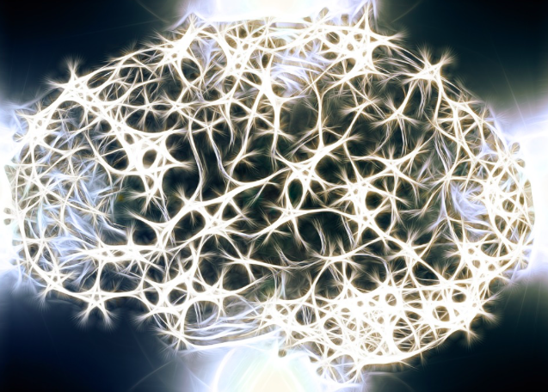
E.G
Reflect
What do you think was happening inside your brain during the
Brain Break?
What do you think each part of your Brain was doing?
Identify times when doing a Brain Break would be useful for you in school and at home
Let’s collect these to make a class list to remind us when a brain break can be helpful
Refer to P.47

