Slide 1
Mindful Awareness
KS2
Lesson 2

Slide 2
Unit 1 - Getting Focused
By learning about our brains and by practising MindUP™ strategies, we can improve our ability to self-regulate, learn and have positive relationships
Lesson 1:
How Our Brains Work
Lesson 2:
Mindful Awareness
Lesson 3:
Focused Awareness
✔

Slide 3
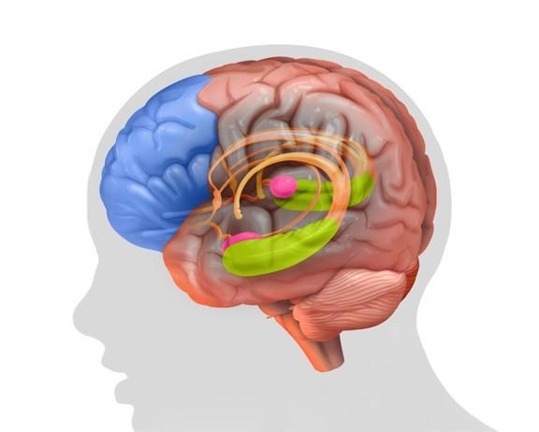
Reviewing prior learning
What did we learn last lesson
‘How Our Brains Work’
What have we already learnt about our brains?
✖
✖
Prefrontal Cortex
(PFC)
✖
Hippocampus
Amygdala
Use your own ideas to review the learning….give other examples

Slide 4
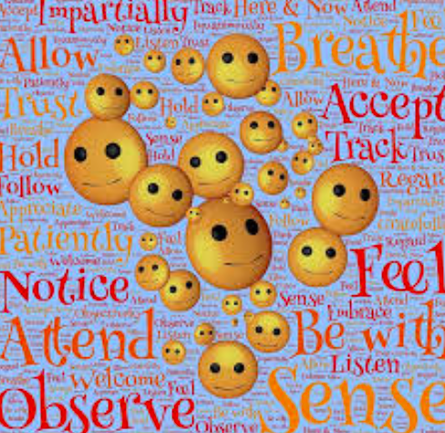
Lesson background
Lesson 2
Mindful Awareness
We are all physically present here and now…
Often we worry about what has happened in the past or feel anxious about something that may or may not happen in the future so even if our body is present our mind is not.
Think of some examples
Refer to P.34-5

Slide 5

Lesson background
Why – Mindful Awareness?
Focusing on the
here and now
(the people around you, the world around us, a learning challenge)
in a considerate and
non-judgmental way,
is called
mindful awareness
Refer to P.34-5

Slide 6

Lesson background
Mindful Awareness
Being mindful is paying close attention to what is happening around you, wherever you are and whatever you are doing.
Let’s be mindful now by listening to all the sounds we can hear around us.
What can we hear?
Are these sounds in the classroom?
Outside the classroom?
Refer to P.34-5

Slide 7
Lesson background
Mindful Awareness
Being mindful is also about being non-judgemental….
....waiting to form an opinion until you have considered a situation more carefully.
?
?
?
A mindful approach to making friends would be getting to know someone before deciding whether to be friends: ‘non-judgemental’
An unmindful approach would be deciding not to be friends because you don’t like what the person looks like, without even getting them to know them: ‘judgemental’
Refer to P.34-5

Slide 8
Brain Research
What’s happening in our brain
when we are being mindful?
PFC
in charge
Hippocampus
can remember
Amygdala
is calm
When we are mindful, we create time for the PFC to work and stay in charge.
This helps us to think clearly and make better choices.
This is MINDFUL BEHAVIOUR
Refer to P.34-5

Slide 9
Brain Research
What’s happening in our brain
when we are being unmindful?
PFC
is NOT in charge
✖
Hippocampus
CANNOT
remember
When we are being unmindful, our PFC does have time to think, so we can react without thinking, react judgementally and make unhelpful choices.
This is UNMINDFUL BEHAVIOUR
Refer to P.34-5

Slide 10
Reflecting on mindful or
unmindful behaviours
Your friend invites you over for a play date.
You get there and your friend spends most of their time playing on computer games. What do you do?
Mindful or unmindful? Why?
What might be happening in your brain?
Impact on yourself and others?
Stop, think – for a more mindful behaviour

Slide 11
Reflecting on mindful or
unmindful behaviours
You’re out in the playground. You’ve noticed that someone in your year group spends most of their playtimes and lunchtimes alone. They have asked your group of friends to play. Your friends say no. What do you do?
Mindful or unmindful? Why?
What might be happening in your brain?
Impact on yourself and others?
Stop, think – for a more mindful behaviour

Slide 12
Reflecting on mindful or
unmindful behaviours
Your friend had a favourite band that they listen to. You’ve never heard of them. Your friend wants to play you one of their songs. What do you do?
Mindful or unmindful? Why?
What might be happening in your brain?
Impact on yourself and others?
Stop, think – for a more mindful behaviour

Slide 13
Our Learning/Main Activity
Use/adapt the ideas in lesson 2 to develop a main activity
Refer to P.38, P.153

Slide 14
E.G
Our Learning/Main Activity
Think of one scenario
(perhaps something that has happened to you)
Write the scenario in the box
Mindful
SCENARIO
Unmindful
Consider these questions to help you annotate/draw to show mindful and unmindful responses
What might be happening in your brain?
Impact on yourself and others?
Stop, think – for a more mindful behaviour
Refer to P.38, P.153
Notes:
Provide a model scenario before you ask the children to complete this activity

Slide 15
Reflect
This should refer back to the brain and explain how this is relevant to them in everyday life
WHY IS IT IMPORTANT TO KNOW/DO THIS?
Refer to P.39

Slide 16
E.G
Reflect
Mindful Language
Collect mindful language to use in the classroom
Refer to P.39

Slide 17
E.G
Reflect
Mindful Learning
What might mindful learning look like?
Collect mindful learning behaviours
Refer to P.39

