Slide 1
How Our
Brains Work
KS2
Lesson 1

Slide 2
Unit 1 - Getting Focused
By learning about our brains and practising MindUP™ strategies, we can get better at learning, self-regulating and having positive relationships
Lesson 1:
How Our Brains Work
Lesson 2:
Mindful Awareness
Lesson 3:
Focused Awareness

Slide 3
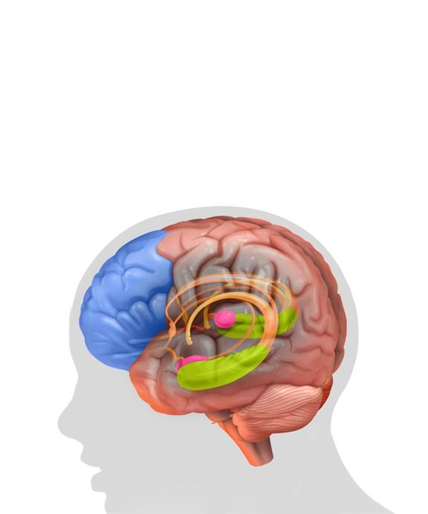
Reviewing prior knowledge
Lesson 1
How Our Brains Work
What do you already know about your brain?
Why is your brain
so important?
Other?
?
Other?
What does it help you do?
Eg Sentis video
https://www.youtube.com/watch?v=XSzsI5aGcK4&t=1s
Use your own ideas to introduce the learning….give other examples
Notes:
We have…...

Slide 4
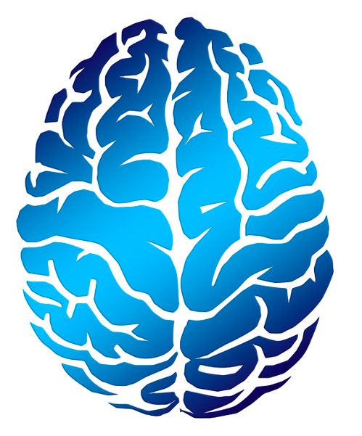
Lesson background
Why is it so important to
learn about the brain?
Neuroscience shows us how we learn
and why we behave the way we do…..
Other?
In what ways is this helpful?
Refer to P.26

Slide 5
Lesson background
We can learn to notice how our brain is behaving
We can help our brain make better choices about the words we use and the way we act
We can learn to focus our brain on our learning
Refer to P.27

Slide 6
Brain research
Getting to Know My Brain
We will be learning about these three parts of the brain
Hippocampus
Prefrontal Cortex (PFC)
Amygdala
Refer to P.27

Slide 7
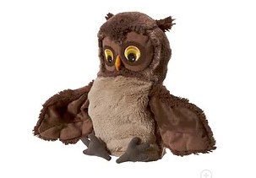
Brain research
Brain Research
Learning, thinking and reasoning
The Wise Owl
Prefrontal Cortex (PFC)
Makes
decisions
Focuses and pays attention
Solves problems
Compares and contrasts
Other?
Other?
Makes moral and ethical choices
Analyses and evaluates
Refer to P.27

Slide 8
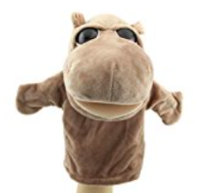
Brain research
Brain Research
The memory saver
The Hippo
Hippocampus
Forms, stores, organises and recalls memories
Links with the PFC to help us learn
Other?
Other?
Transfers short term to long term memories
Helps us remember good and bad choices we have made
Refer to P.27

Slide 9

Brain research
Brain Research
Fight, Flight, Freeze
The Guard Dog
Amygdala
Reacts to negative emotions and threats – perceived or real
It helps to keep us safe
Other?
Reacts before
the PFC
It is on alert to protect us.
It is like our Guard Dog
Other?
Can cause emotional flooding…..
’can’t think straight’
Refer to P.27

Slide 10
Brain research
Brain Research
Emotional Flooding
✖
Prefrontal
Cortex (PFC)
✖
Hippocampus
✖
Amygdala
https://www.youtube.com/watch?v=5_vT_mnKomY
When your amygdala stars barking/kicks off it stops the other parts of your brain working so that it can decide whether you are in danger or not.
When your amygdala realises that you are safe, it calms down and allows
the rest of the brain to work effectively again
Refer to P.27

Slide 11
Our Learning/Main Activity
Use/adapt the ideas in lesson 1 to develop a main activity to get the children to explore/show their understanding of the 3 parts of the brain
Refer to P.30, P.152

Slide 12
E.G
Our Learning/Main Activity
Each group will be given a one part of the brain.
In your groups, design a poster that includes:
a description of
the
function
of this part
of the
brain
an explanation
of how this
part connects
to the two
other parts
of the brain
a poem, rap or song
that will help you
and your friends
to remember
this part of
the brain
Refer to P.30, P.152

Slide 13
Reflect
This should refer back to the brain and explain how this is relevant to them in everyday life
WHY IS IT IMPORTANT TO KNOW/DO THIS?
Refer to P.31

Slide 14

E.G
Reflect
Present your posters
Feedback Bun
Something
that was good
2. Something that could have been clearer
3. Something
that was good
Refer to P.31

