Slide 1
Mindful Smelling
KS2
Lesson 6

Slide 2
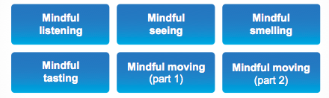
Unit 2 – Sharpening Your Senses
We have been practising using our
RAS for mindful seeing
Now let’s focus our attention on mindful smelling
✔
✔

Slide 3
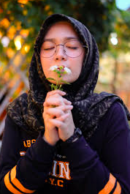
Lesson 6
Mindful Smelling
By using our sense of smell we can
- improve our ability to pay close attention
- remember memories and feelings linked to certain scents
- strengthen our RAS to focus on one thing at a time

Slide 4
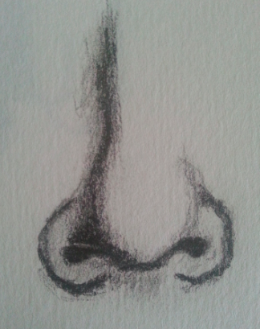
Review prior learning
Mindful Smelling
How does mindful smelling help us?
How does it trigger different memories?
How do the PFC and hippocampus work together when we are doing mindful smelling?
Other?

Slide 5
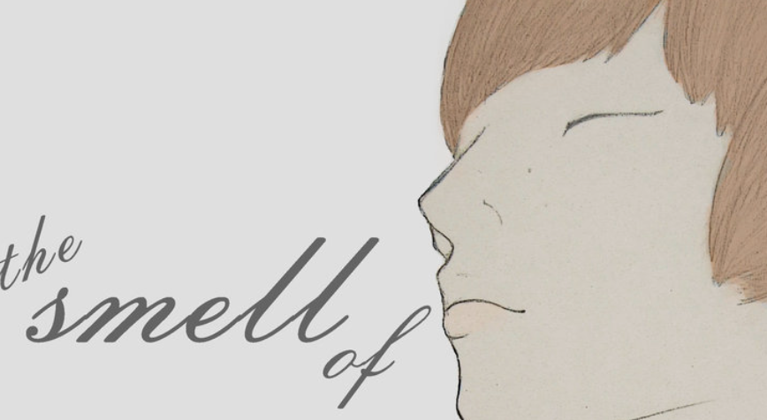
Lesson background
Why – Mindful Smelling?
?
Our brain links certain smells with certain memories.
It remembers the people, places, or things we associate with different smells.
When we practise mindful smelling, it can help us really notice things around us and link memories to experiences
Refer to P.68

Slide 6

Lesson background
Why – Mindful Smelling?
Memories are linked to different smells and scents.
This is because the smell and memory centres in the brain are close to each other.
When we smell a familiar scent, this can trigger a memory linked to the time and place we smelt that scent before.
We can also feel the same things we felt at that time.
For example, smelling fresh strawberries reminds me of the summer and makes me feel warm and fuzzy
Can you think of one?
Refer to P.68

Slide 7

Brain Research
Brain Research
When we have a happy memory associated with a certain sense, like the smell of strawberries in summer, we release a
CHEMICAL in our brain called DOPAMINE.
Dopamine is a ‘feel good’ chemical that our brain releases that helps us feel happy. When we link a smell to a happy memory, our brain releases dopamine and we feel good
Refer to P.69

Slide 8
Our Learning/Main Activity
Use/adapt the ideas in lesson 6 to develop a main activity
Refer to P.72-3

Slide 9
E.G
Our Learning/Main Activity
Guess the smell
(place various smells on cotton wool balls or in jars for pupils to smell)
Just using your PCF think about the smell.
What do you think it is?
Using your hippocampus, try and think about when you might have
smelt that smell before
Using your PFC and your hippocampus together, think about
what this smell reminds you of.
Do any memories pop into your mind that are associated with this smell?
In pairs, discuss if any of these smells gave you a good or happy feeling. If none did, think of other smells that make you feel good (like strawberries and summer)
?
Refer to P.72-3

Slide 10
Reflect
This should refer back to the brain and explain how this is relevant to them in everyday life
WHY IS IT IMPORTANT TO KNOW/DO THIS?
Refer to P.73

Slide 11
E.G
Reflect
?
SMELL
WHAT/MEMORY/FEELINGS/
Can you describe how you think you remember certain smells?
Which parts of your brain are working hard when you do mindful smelling and when you remember things?
What is happening when you feel different ways in response to different smells?
Refer to P.73

